Slide 1
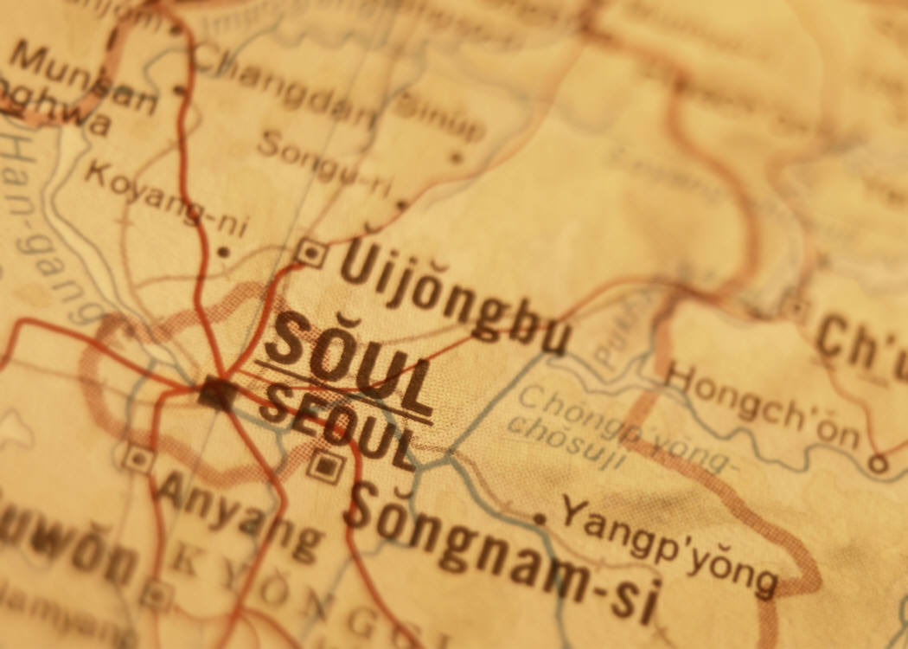
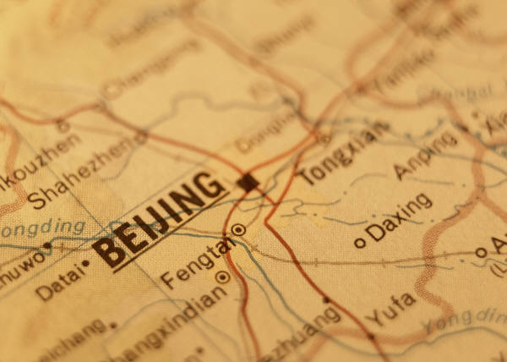
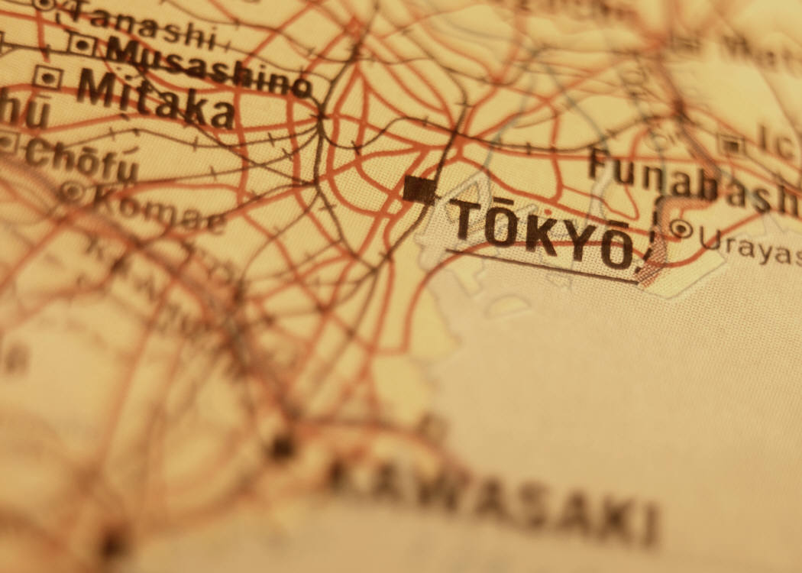
SOUTHERN AND EASTERN ASIA
Government/Civics Understandings

Slide 2
SS7CG6 – a. Describe the ways government systems distribute power: unitary, confederation, and federal.
Unitary Government System
Central government holds nearly all power
State, county and local governments are under central government control
Monarchy or constitutional monarchy is an example
People’s Republic of China and Japan is an example

Slide 3
SS7CG6 – a. Describe the ways government systems distribute power: unitary, confederation, and federal.
Confederation Government System
Local governments hold power and central government depends on local governments
United Nations and Association of Southeast Asian Nations (ASEAN)
UN can only offer advice and assistance when member nations agree to cooperate

Slide 4
SS7CG6 – a. Describe the ways government systems distribute power: unitary, confederation, and federal.
Federal Government System
Power is shared among different levels of government
India is an example

Slide 5
SS7CG6 – b. Explain how governments determine citizen participation: autocratic, oligarchic, and democratic.
Autocratic
Individuals have no rights to choose leaders or vote
Example: North Korea

Slide 6
SS7CG6 – b. Explain how governments determine citizen participation: autocratic, oligarchic, and democratic.
Oligarchy
Government by the few
Small group rules over government making all major decisions
People have little choice
Example: People’s Republic of China

Slide 7
SS7CG6 – b. Explain how governments determine citizen participation: autocratic, oligarchic, and democratic.
Democratic
People play a much great role
Goal is to leave as much individual freedom as possible
Examples: India, Japan and South Korea

Slide 8
SS7CG6 – c. Describe the two predominant forms of democratic governments: parliamentary and presidential.
Parliamentary
People vote for parliament
Parliament: makes and carries out (enforces) laws
Prime Minister: appointed by parliaments leading party as head of government
Examples: Japan and India

Slide 9
SS7CG6 – c. Describe the two predominant forms of democratic governments: parliamentary and presidential.
Presidential
President is chosen separate from the legislature by voters
Legislature passes laws
President enforces laws and is official head of government

Slide 10
SS7CG7 – a. Compare and contrast the federal republic of The Republic of India, the communist state of The People’s Republic of China, and the constitutional monarchy of Japan, distinguishing the form of leadership, and the role of the citizen in terms of voting rights and personal freedoms.
The Republic of India
Was a British Empire until 1947
After independence they modeled their government after Great Britain
Even Untouchable caste was granted equal rights

Slide 11
SS7CG7 – a. Compare and contrast the federal republic of The Republic of India, the communist state of The People’s Republic of China, and the constitutional monarchy of Japan, distinguishing the form of leadership, and the role of the citizen in terms of voting rights and personal freedoms.
The People’s Republic of China
Communist country run as a one-party dictatorship
People have very little say-so

Slide 12
SS7CG7 – a. Compare and contrast the federal republic of The Republic of India, the communist state of The People’s Republic of China, and the constitutional monarchy of Japan, distinguishing the form of leadership, and the role of the citizen in terms of voting rights and personal freedoms.
The Constitutional Monarchy of Japan
There is a king or emperor, who is limited to the power granted to him by the constitution or laws of the nation
Two-house parliament called the Diet
Government led by prime minister
Diet is elected and they choose the prime minister
Emperor remains in his position but has no political power

