Slide 1
A loan from Kiva to a Ugandan man.
By: EJ, Bryan, Alex

Slide 2
Alex lives in Kamwenge, Uganda

Slide 3
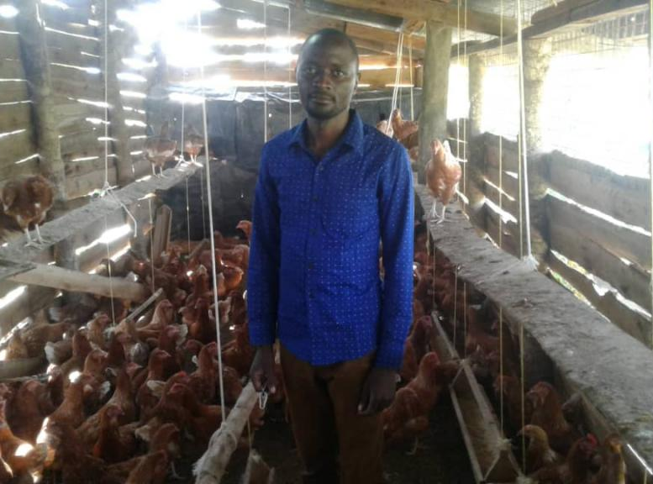
About Alex
Alex is a married man who is very positive minded and hardworking. He has one child who attends school in Kamwenge.
Alex works in the poultry business as his economic activity. He started this business in a rural area in 2013 with an aim of improving his family’s standard of living. He also earns a salary from the Kamwenge district local government where he works as a clinical officer as his other source of income.

Slide 4
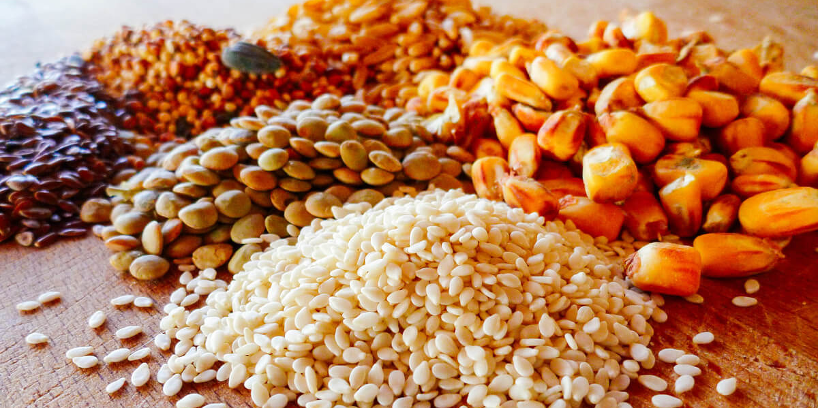
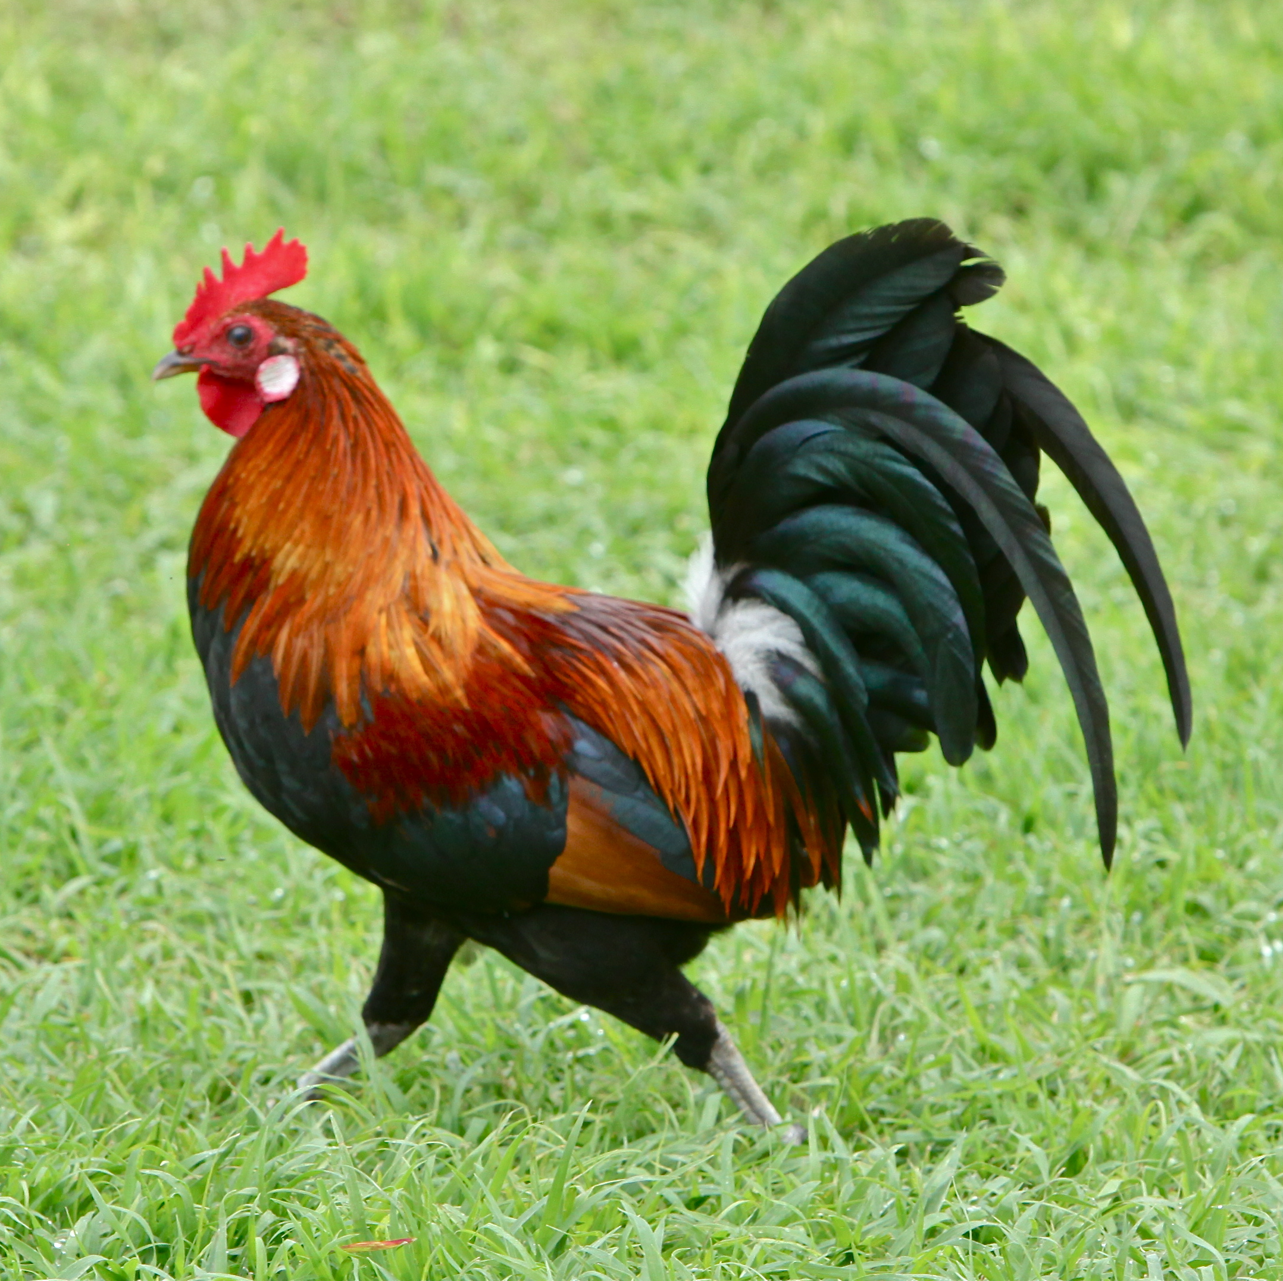
What the loan is going to.
He needs the loan to buy vaccines and more feeds like maize for his chickens. Although he is faced with the challenge of high prices on the chicken feeds, his prospects are of expanding his poultry project.

Slide 5
Facts
Average annual income (USD):
$1,800
Uganda Shillings (UGX) = $1:
3,739.4
Loans currently fundraising:
682
Funds lent in Uganda:
$48,704,750

Slide 6
What the money will do.
In conclusion when you send in this loan you are helping improve his family standard of living. So his family can get the common essentials we take for granted that his family do not have.

Slide 7
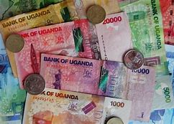
Kiva's support page so you can lend money to Alex.
https://www.kiva.org

Slide 8
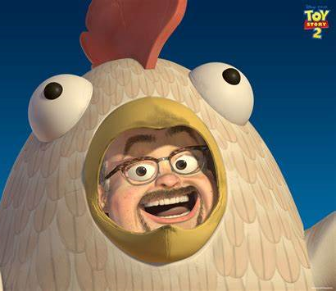
Thank you for your time.

