Slide 1
SS7E10
Factors that impact Gdp – Gross domestic product

Slide 2
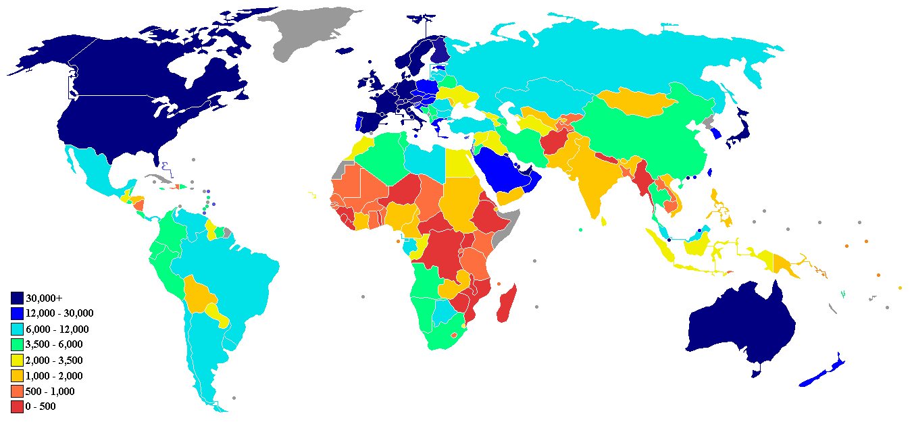
GDP
A country’s GROWTH is measured by its GDP
Gross Domestic Product: Value of all goods and services produced in a country IN ONE YEAR

Slide 3
What influences economic growth?
There are four factors that impact growth in a country:
Human capital: knowledge and skill necessary for workers to earn a living
Capital goods: the factories, machines, and technology that people use to make goods
Natural resources: raw materials that come from the land
Entrepreneurship: individuals who risk their time and money to start a business

Slide 4
FACTORS OF PRODUCTION - INDIA
HUMAN CAPITAL
India invests in human capital through education
Children 10-14 have a literacy rate of 95%
English is taught in all schools because careers in business and technology require fluency in English
Due to India’s thriving education and amount of citizens fluent in English, the technology industry in India is booming
CAPITAL GOODS:
India has failed to properly invest in capital goods
People live in poverty
Infrastructure in India is very poor
Today, government is trying to improve roads, buildings, airports to provide better standard of living

Slide 5
FACTORS OF PRODUCTION - INDIA
NATURAL RESOURCES:
India has Fertile land for farming, rice, wheat, coal for their natural resources
ENTREPRENEURSHIP:
India also has high levels of entrepreneurship – new businesses are encouraged

Slide 6
FACTORS OF PRODUCTION IN CHINA
China is moving from a command economy to a more modernized mixed economy
HUMAN CAPITAL
Invests in human capital by improving education system
Investing in more technical schools
CAPITAL GOODS
China invests heavily in capital goods
Foundation for growing GDP
Improved infrastructure and bought new machinery for factories

Slide 7
FACTORS OF PRODUCTION IN CHINA
NATURAL RESOURCES
Coal, iron ore, petroleum, and natural gas
ENTREPRENEURSHIP
Chinese government has only allowed individual businesses since 1970

Slide 8
FACTORS OF PRODUCTION IN JAPAN
One of the strongest economies in the world
HUMAN CAPITAL
Japan HEAVILY invests in human capital through education
Literacy rate is 99%
Most highly educated population
Most work with same companies their entire careers
CAPITAL GOODS
Invests in capital goods by constantly investing in new technology and providing it’s workers with the best equipment
New factories and machinery are also purchased

Slide 9
FACTORS OF PRODUCTION IN JAPAN
NATURAL RESOURCES
Very little natural resources, must import raw materials
ENTREPRENEURSHIP
VERY HIGH levels of entrepreneurship, new businesses and ideas are strongly encouraged!

Slide 10
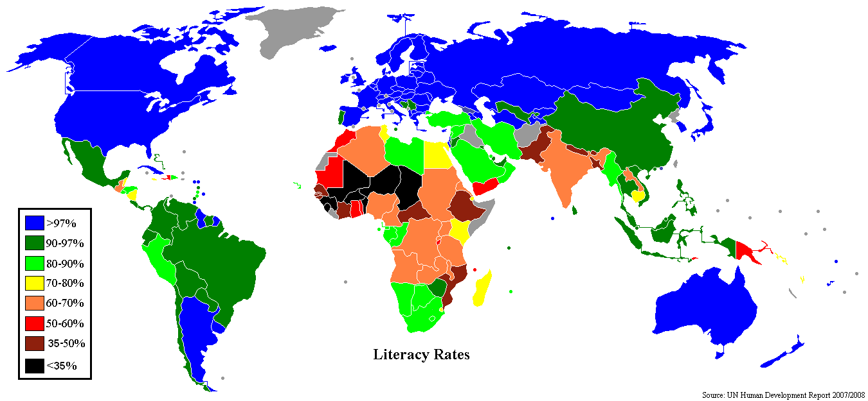

Slide 11
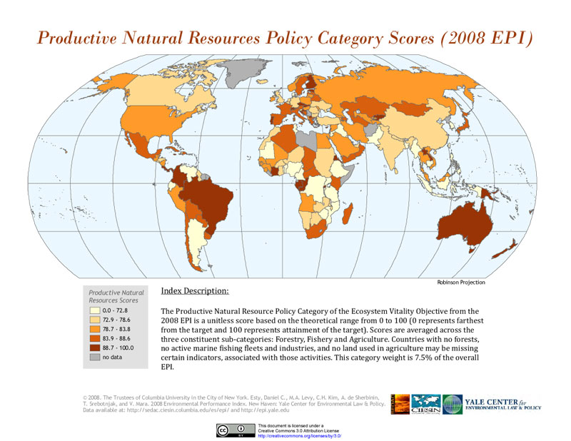

Slide 12
