Slide 1
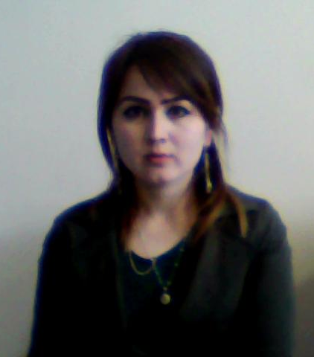
Shahrina
Why should we lend money to her?
By: Alex Orndorff, Alain Civil, and Jacky Innocent

Slide 2
Reason
She doesn't make enough money to pay for medicine. She wants a $425 loan. We can loan her $100 – almost a ¼ of her total goal!
She's 26 years old and a mother of three young children. One of which is seriously ill and needs our help to keep him alive. This loan is special because it will help Shahrina's family pay for potential lifesaving expenses.

Slide 3
Things you need to know
She is a smart investment.
She is a woman, and (according to PBS) women are more likely to pay back loans.
She has a 4-star risk rating on Kiva.org. The risk rating shows the risk of institutional default associated with each of Kiva’s partners. A 0.5-star rating means the organization has a higher risk of institutional default, while a 5-star rating indicates the organization is at a lower risk of default
She is paying interest, so our loan would be paid back with more money than what we gave.
She only has a repay time of 12 months, so the money will be repaid in little time.

Slide 4
Where Shahrina lives
She lives in Tajikistan, an impoverished country.
The annual income per capita is only $2,700 USD. In the US, it is $18,431 USD.
Many like Shahrina are seeking loans, but she is the best option.

Slide 5
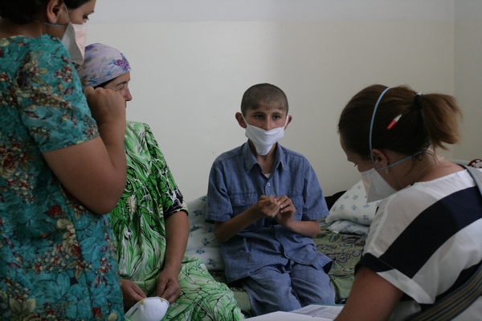
With our loan of $100, we can help her young son have a second chance.
If we all work together, we can save lives.
Let's save Shahrina's son.

