Slide 1
I can explain why we need paragraphs in our writing.

Slide 2
Some things go together and some things do not.
Take a look at these pictures……

Slide 3
How are the objects in this picture alike?

Slide 4
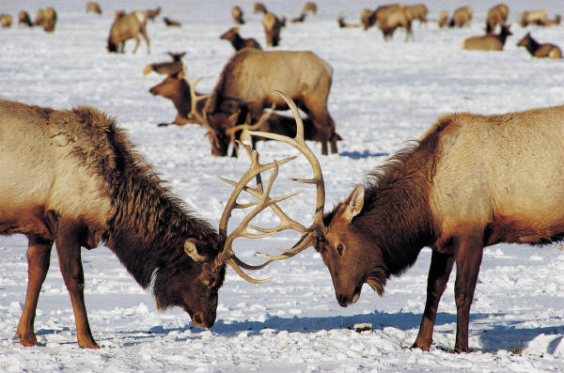
How are these things alike?

Slide 5
Look closely at the words listed below.
Which words go together?
Cat
Apple
Dog
Rabbit
Mouse
Bird

Slide 6
How are those things alike?

Slide 7
You’ve got it!
They go together because they have things in common.
Things that are alike!

Slide 8
Words can go together, too!

Slide 9
Look at my grocery list. Which words on the list go together?
Eggs
Apples
Milk
Sugar
Flour
Waters
Hamburger meat
grapes
Hotdogs
Coffee
Bread
Cheese
Popsicles
Jello
Raisins
Let’s put them into groups!
Group 1
Group 2
Group 3
Group 4

Slide 10
Great Job!!!
Are you ready to stretch your brains a little further???
OK!!! Get ready!

Slide 11
If you can put things together then you can write sentences!
No only that…YOU can turn those sentences into paragraphs!!!!

Slide 12
Let’s Practice!!!

Slide 13
Read the sentences below and decide which one doesn’t belong.
We take our sleds and go to the big hill behind our house.
I have so much fun on snow days!
Snow days are the best!
Yellow is my favorite color.
My family likes to go
sledding!

Slide 14
Let’s practice again!
Valentine’s Day is my favorite holiday!
My aunt helps me make a beautiful valentine box!
I send valentines to all of my friends at school.
We went to the Dollar Store yesterday.
Chocolate is my favorite candy!
Valentine’s Day is so much fun!

Slide 15
Did you see the sentences that didn’t belong?
Easy right?
Maybe. But one issue that pops up time and time again in your writing concerns paragraphs.
The previous slides were created for 4th graders. Now lets explore paragraphs from a middle school perspective.

Slide 16
Kicking it up a notch!
NOW LETS TAKE A MORE SOPHISTICATED LOOK AT PARAGRAPHS.
IN SMALL WORK GROUPS, CHOOSE A READER TO READ THE “ISOLATION ROOM” ARTICLE ALOUD.
THEN WORK AS A GROUP TO DECIDE WHERE PARAGRAPHS SHOULD GO.
INDICATE USING THE PARAGRAPH SYMBOL

Slide 17
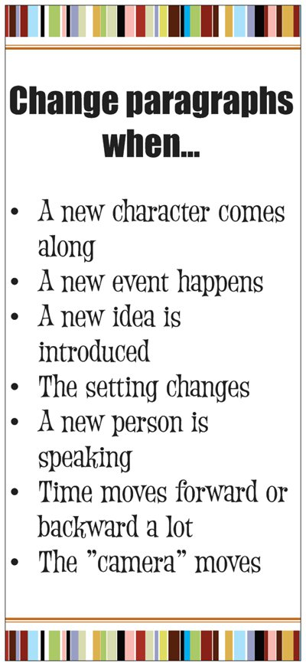
Cheat Sheet

Slide 18
What does when the “camera moves” mean?
A way to think about paragraphs is to think about how the camera moves in a movie scene.
For example, let’s look at this scene from the Matrix. On your paper, tally how many times the camera cuts from one shot to another:
https://www.youtube.com/watch?v=zQ1_IbFFbzA

Slide 19
What did you notice?
How many times did the camera change?
When did the camera change?
Now look back at your article and compare it to the “rules” bookmark you have been given.

Slide 20
Paragraph Practice
Here are some examples, excerpted from the novel Kate Macready and the Pirates. They are color coded when possible to show which type of paragraph break is being used: Black for new topic, brown for new time, purple for new place, light blue for new speaker, dark blue for an action that takes the place of some dialogue, and green for dramatic effect.

Slide 21
The one good thing I could see was that the water was so shallow where the Narwhal went down that, once I broke clear of the ship, I didn't have far to go to reach the surface. It was long enough, though. By the time I broke the surface, I had almost given up hope, but I found myself in the air and took a huge, gulping gasp. I splashed around, happy just to be alive. That's when the hand reached down and grabbed me. Before I had a chance to think, I had been hauled into a small boat and dumped there like a load of fish. I opened my eyes and was surprised--and happy--to see Jeremy staring down at me. "You made it," he said. I nodded. "Did you get the map?" he asked. I sat up, outraged. "Is that all you can think about?" I demanded. "No. Of course not. But did you get it?" I pulled the map, now waterlogged, from the folds of my shirt and tossed it to the floor of the boat. Jeremy looked visibly relieved. "Are you all right?" he asked. "I--I think so," I said. "What happened to...uh, to Diablo?" I shrugged. "I don't know. I didn't see him." There was a pause.

