Slide 1
Map Activator Answer the questions on your handout

Slide 2
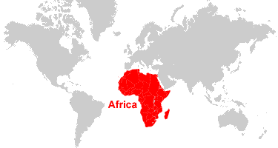
Learning Target: I can identify the major physical features of Africa and where they are located.

Slide 3
In the activator, you attempted to locate a few physical and political features of Africa. By the end of this lesson, you will be able to locate these and many more.

Slide 4
Standards:
SS7G1a. Locate on a world and regional political-physical map: the Sahara, Sahel, savanna, tropical rain forest, Congo River, Niger River, Nile River, Lake Tanganyika, Lake Victoria, Atlas Mountains, and Kalahari Desert.
SS7G1b. Locate on a world and regional political-physical map the countries of Democratic Republic of the Congo (Zaire), Egypt, Kenya, Nigeria, South Africa, Sudan, and South Sudan.

Slide 5
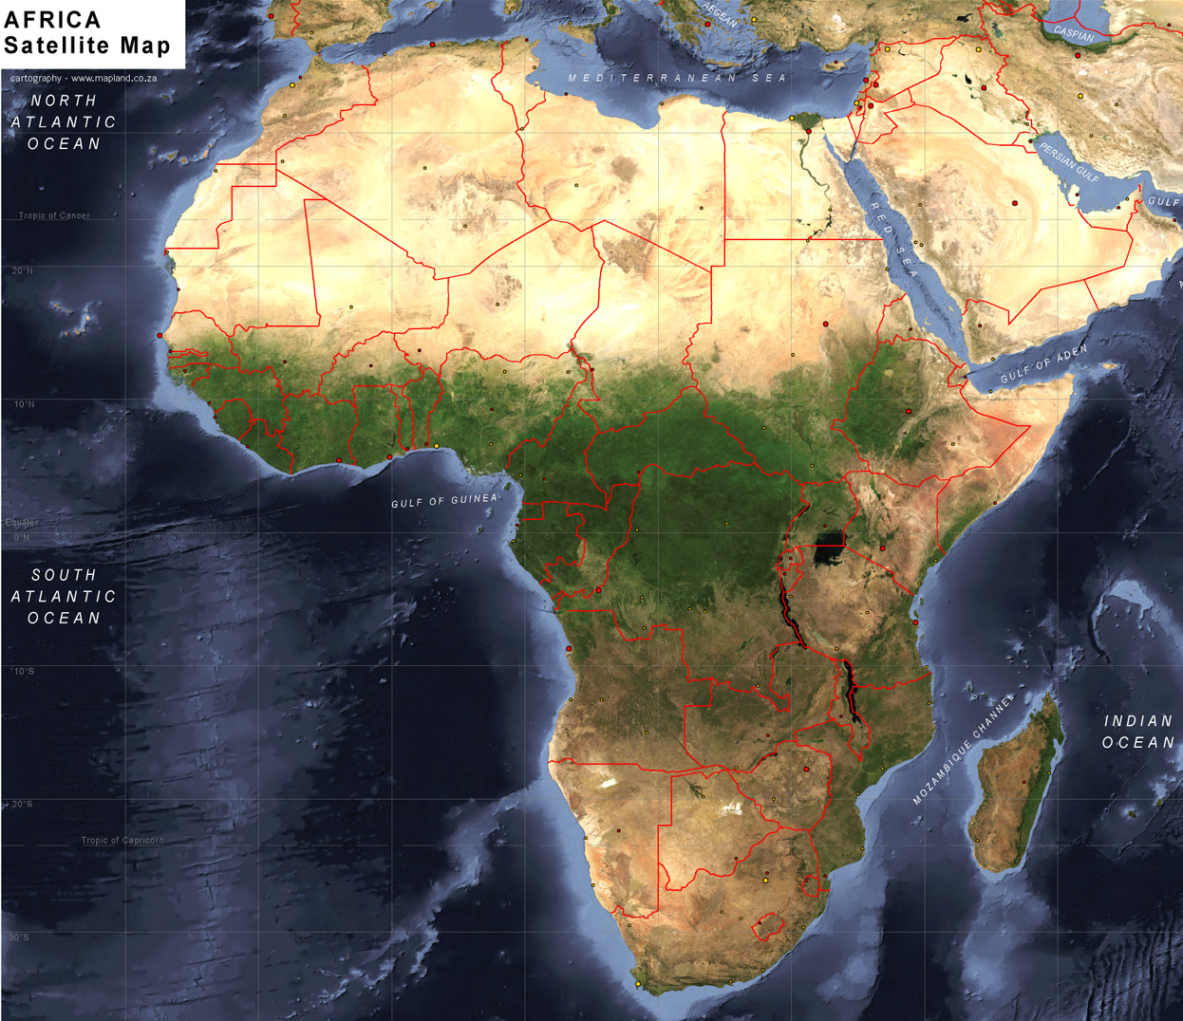
Africa

Slide 6
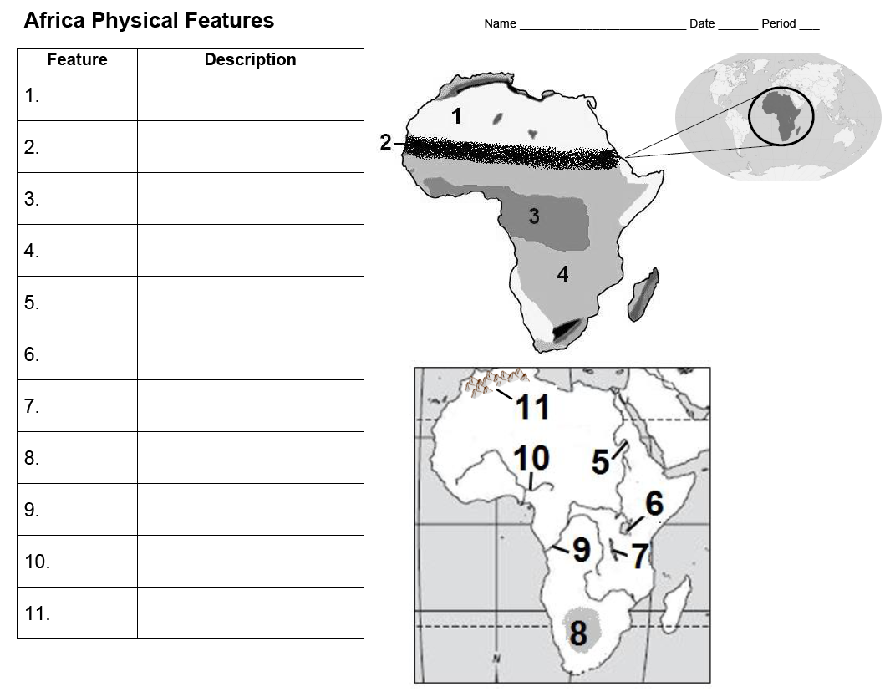
Use the Africa Physical Features Map

Slide 7
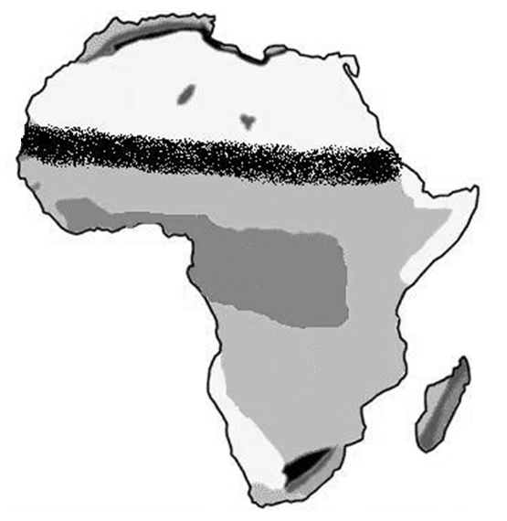
Sahara Desert
1.

Slide 8
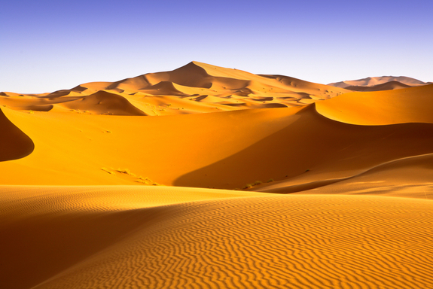
Sahara Desert: World’s largest, hot desert, covering most of Northern Africa

Slide 9
Sahel
2.

Slide 10
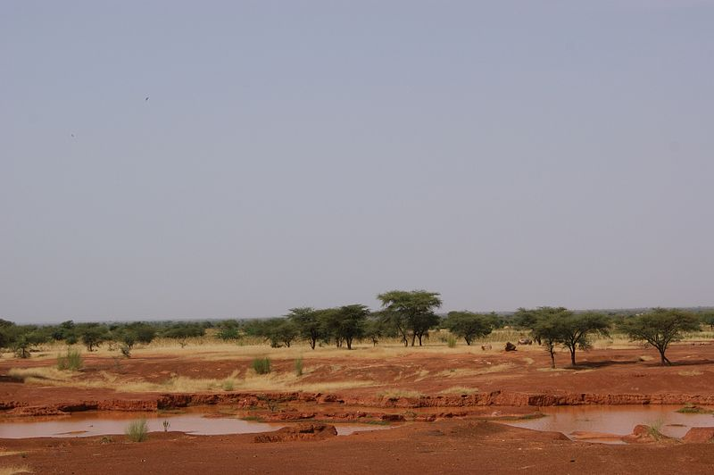
Sahel: Transition zone south of the Sahara; separates Sahara from tropical rain forests

Slide 11
Tropical Rain Forest
3.

Slide 12
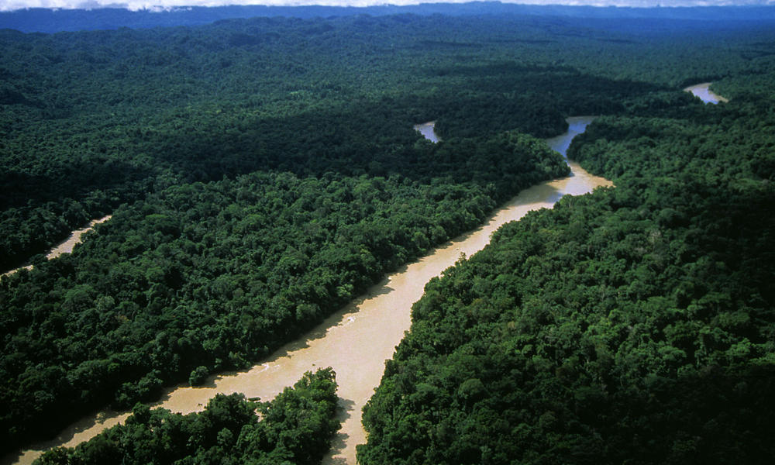
Tropical Rain Forest: Central African tropical rainforest is the second largest in the world

Slide 13
Savanna
4.

Slide 14
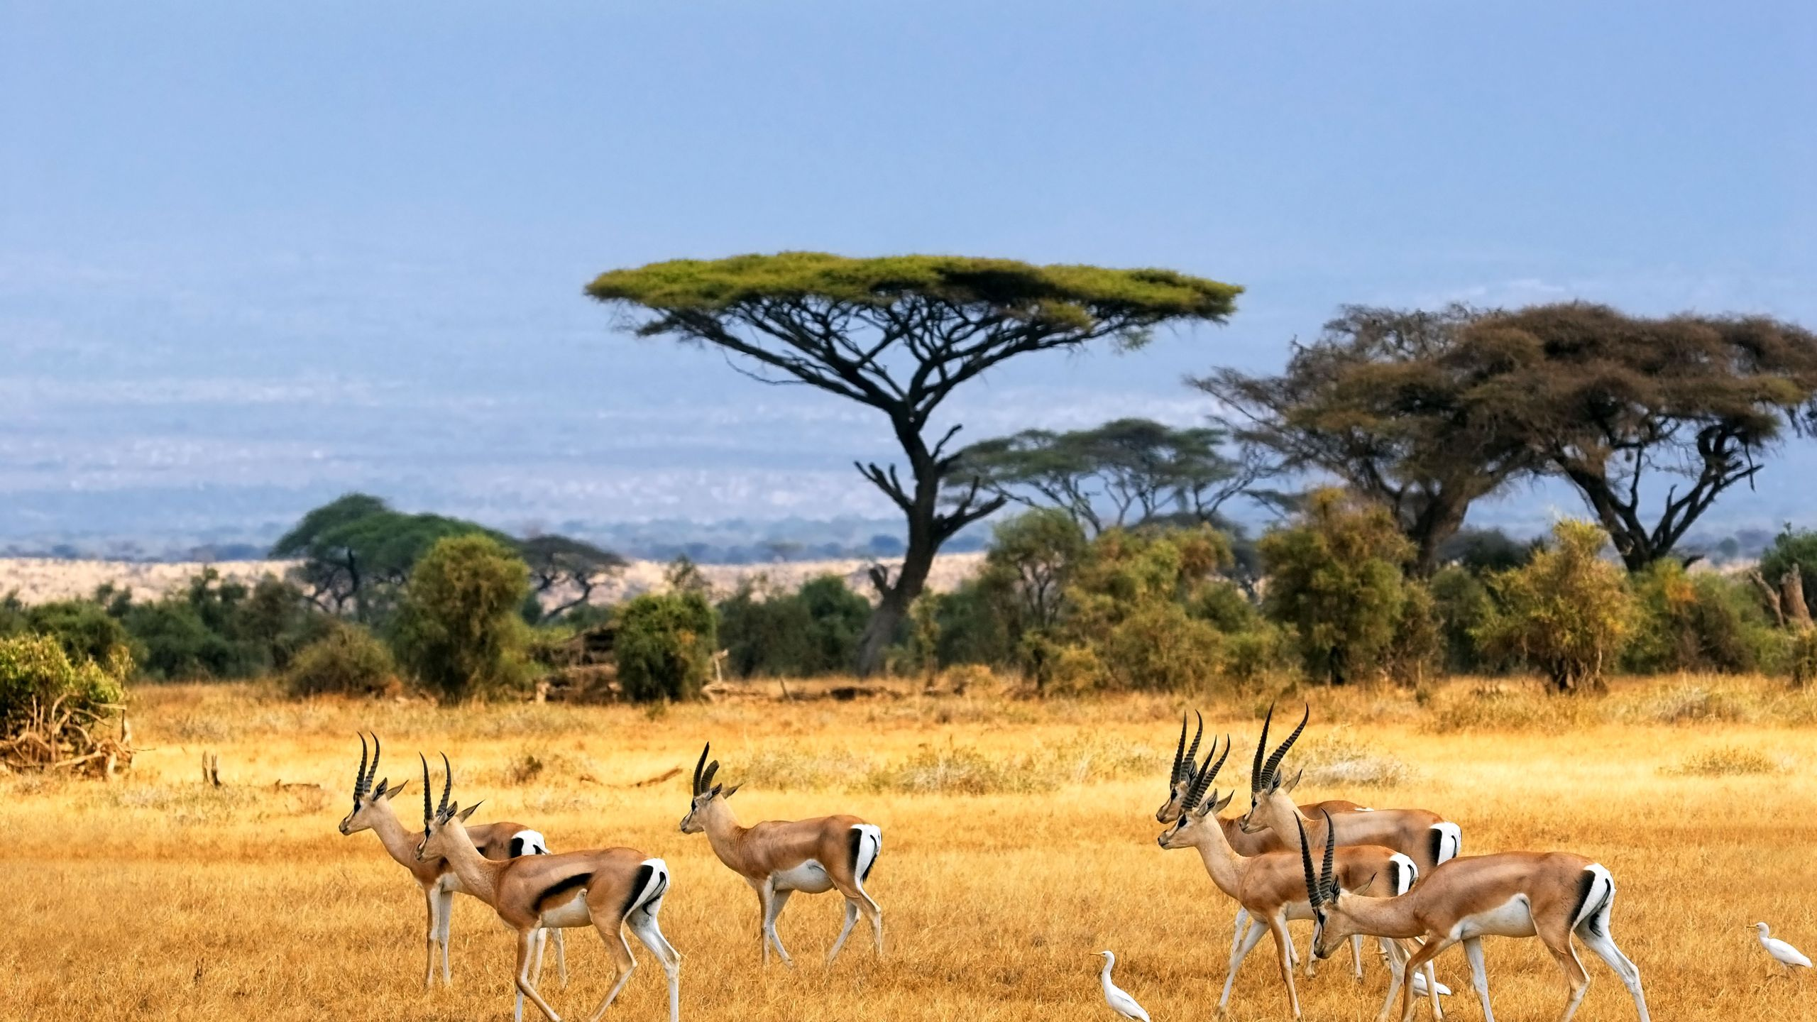
Savanna: Rolling grassland and scattered trees and shrubs

Slide 15
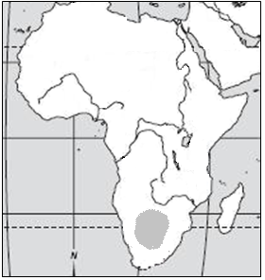
Nile River
5.

Slide 16
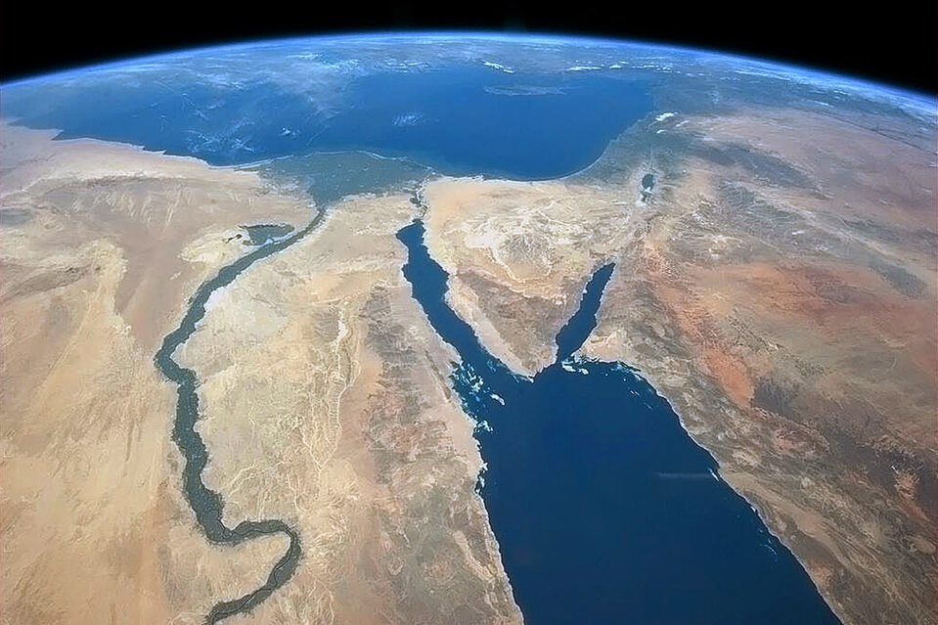
Nile River: World’s longest river; flows northward into the Mediterranean Sea

Slide 17
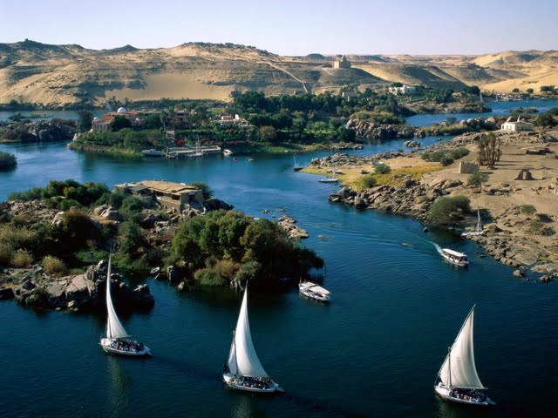
Nile River

Slide 18
Lake Victoria
6.

Slide 19
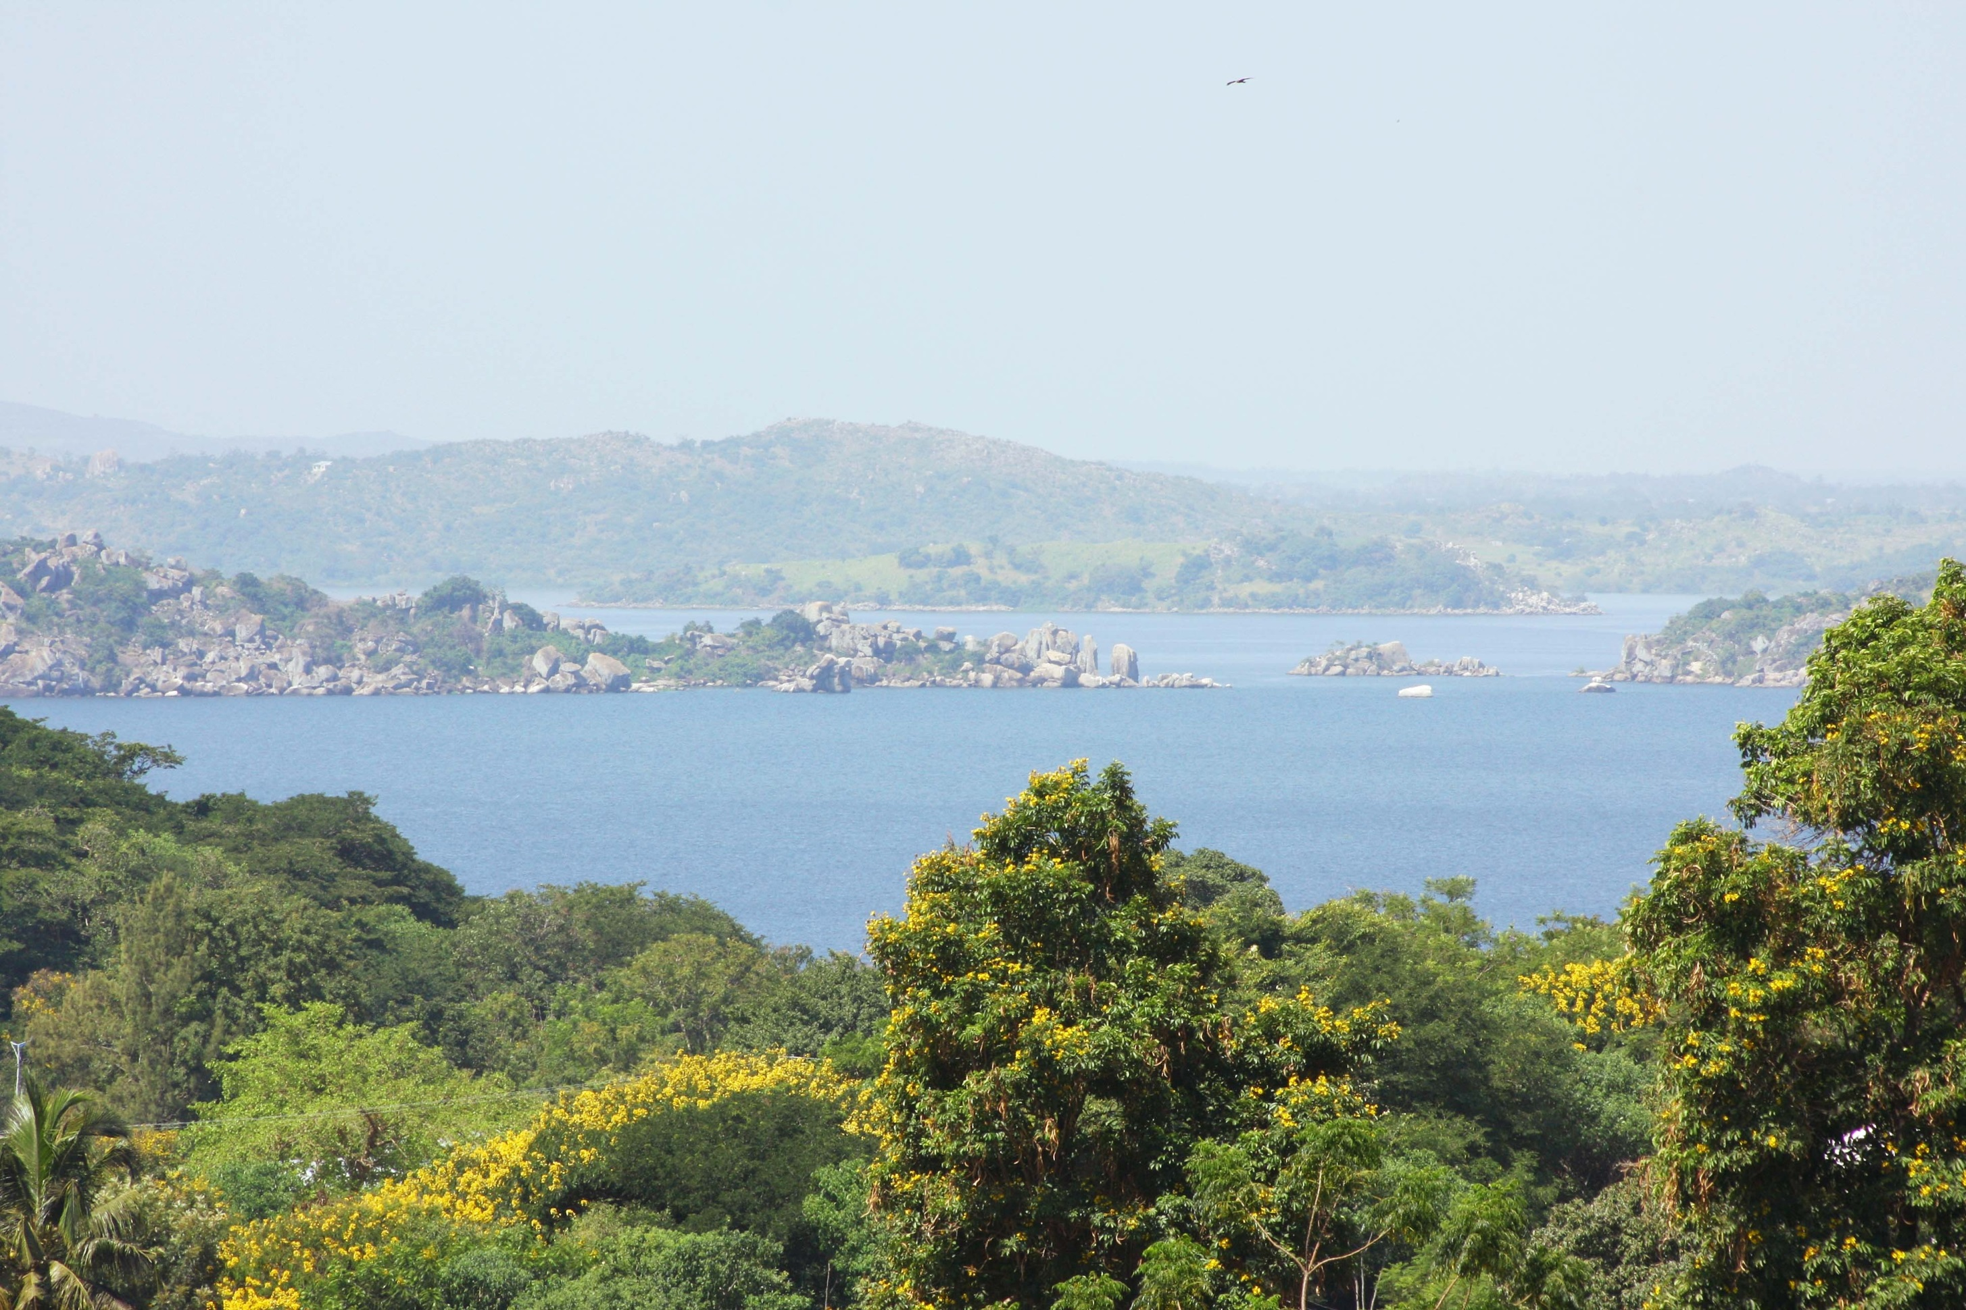
Lake Victoria: Reservoir for the Nile River; largest lake in Africa; 2nd largest freshwater lake in the world

Slide 20
Lake Tanganyika
7.

Slide 21
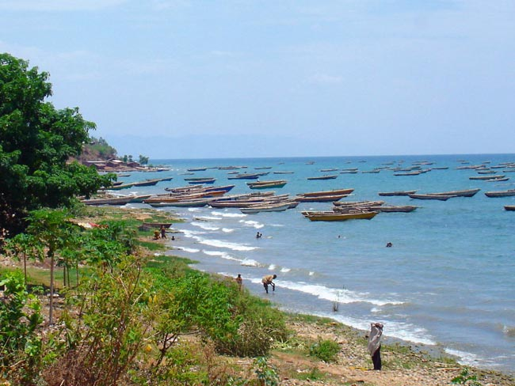
Lake Tanganyika: Longest lake and second deepest in the world; lies in central Africa

Slide 22
Kalahari Desert
8.

Slide 23
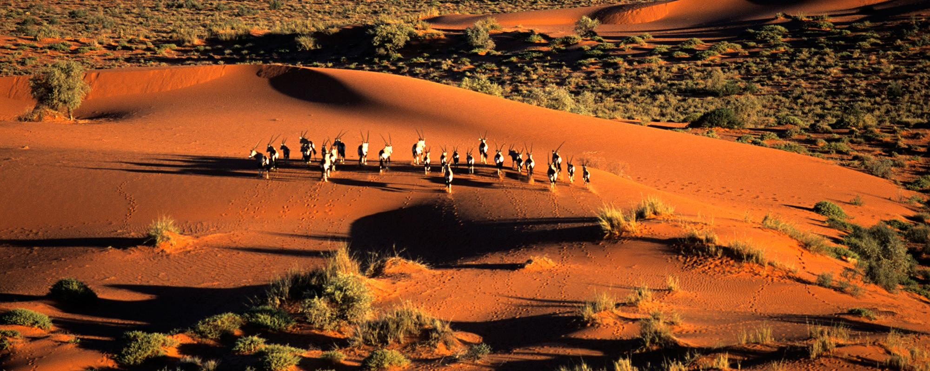
Kalahari Desert: Large, dry (arid) sandy area in southern Africa

Slide 24
Congo River
9.

Slide 25
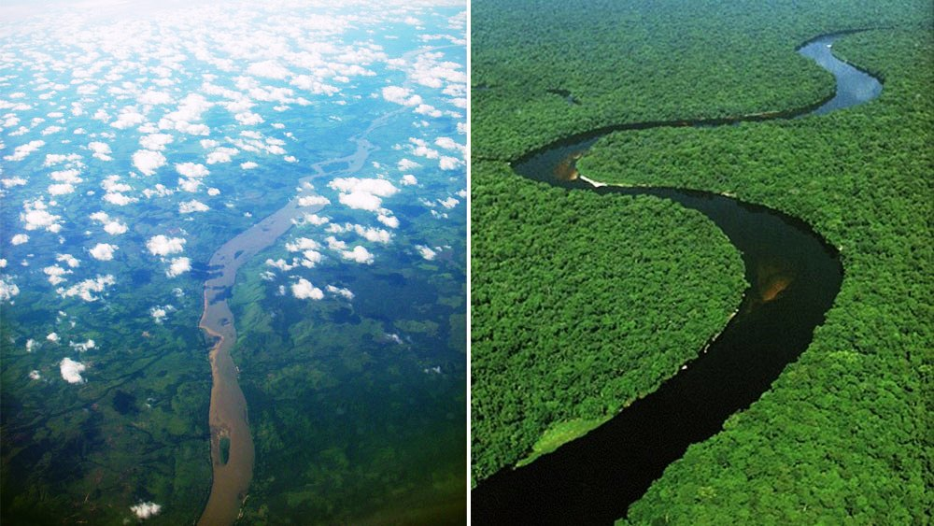
Congo River: Second longest river in Africa; crosses the equator twice and is surrounded by rain forest

Slide 26
Niger River
10.

Slide 27
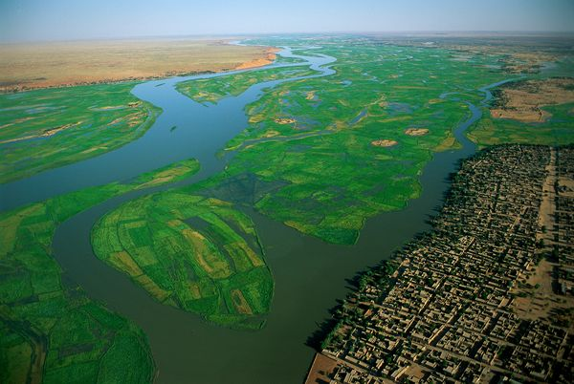
Niger River: Main river in western Africa; five African nations depend on it for water; flows into the Atlantic

Slide 28
Atlas Mountains
11.

Slide 29
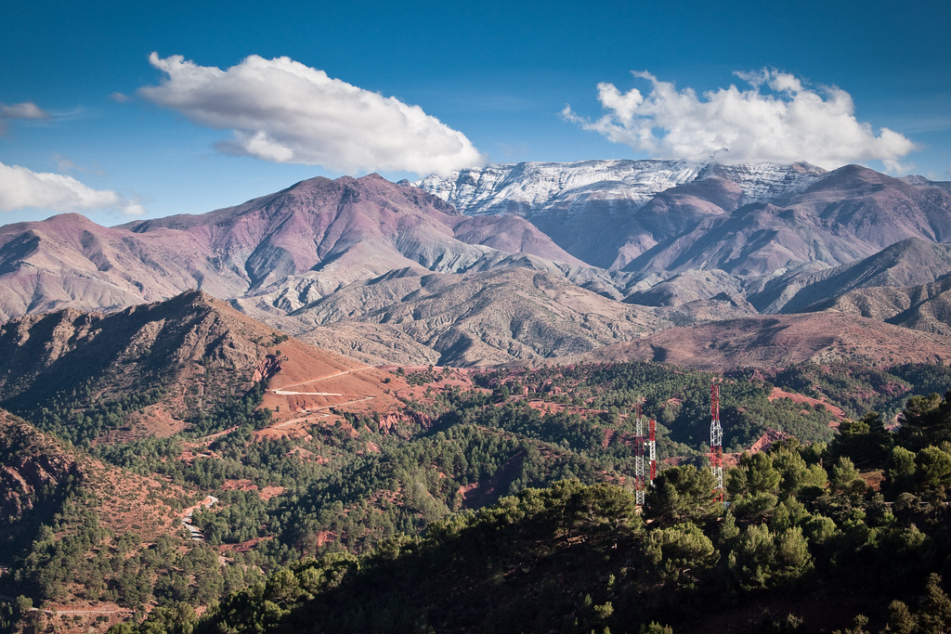
Atlas Mountains: Range in northern Africa between the Mediterranean Sea and Sahara Desert

Slide 30
With a partner, come up with a mnemonic device or other way to remember the location of the physical features of Africa.

Slide 31
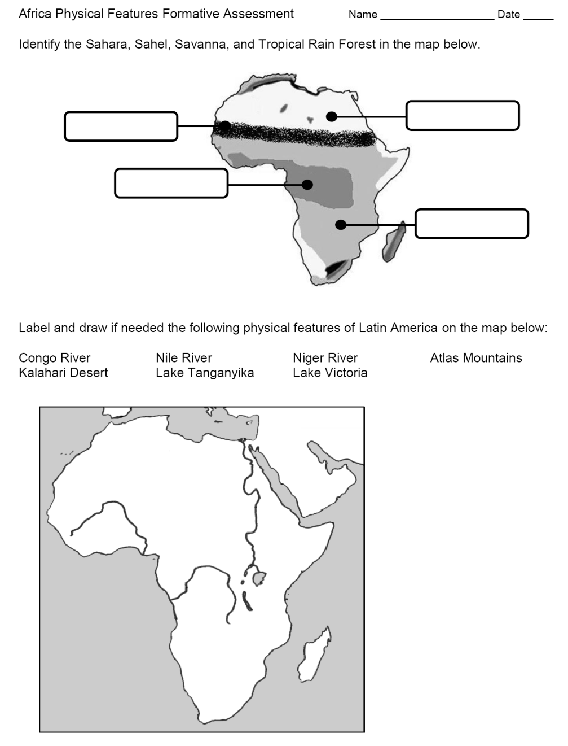
Formative Assessment

Slide 32
Learning Target: I can identify the major political features (nations) of Africa and where they are located.

Slide 33
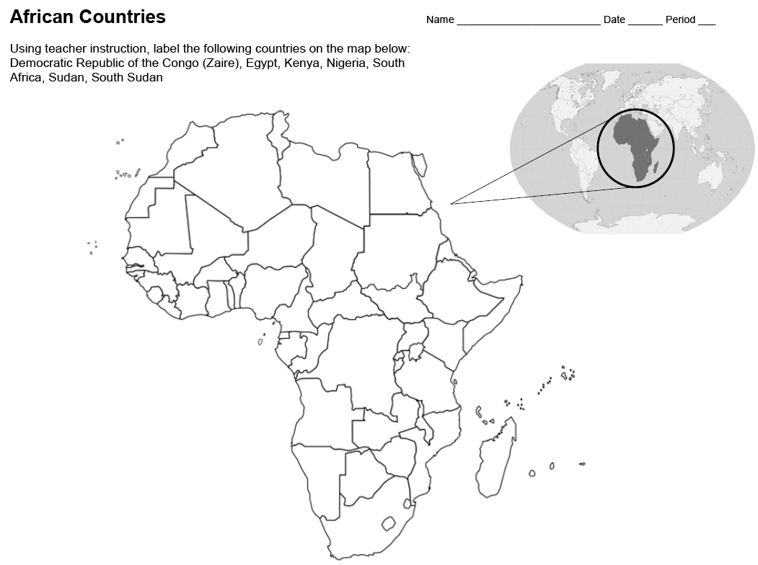
Use the African Countries Map

Slide 34
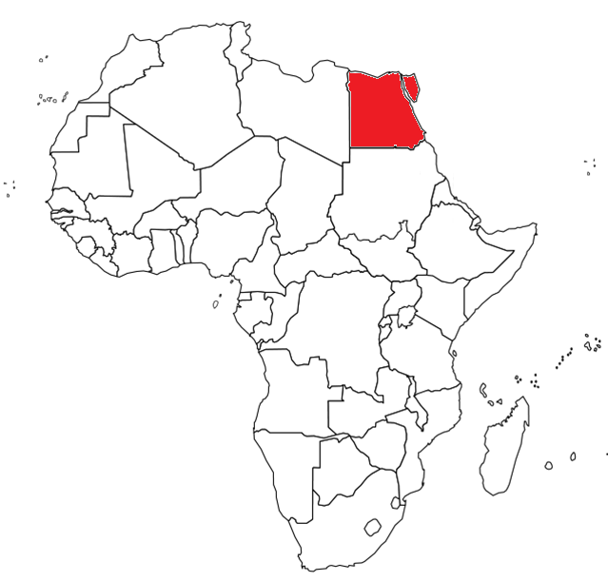
Egypt

Slide 35
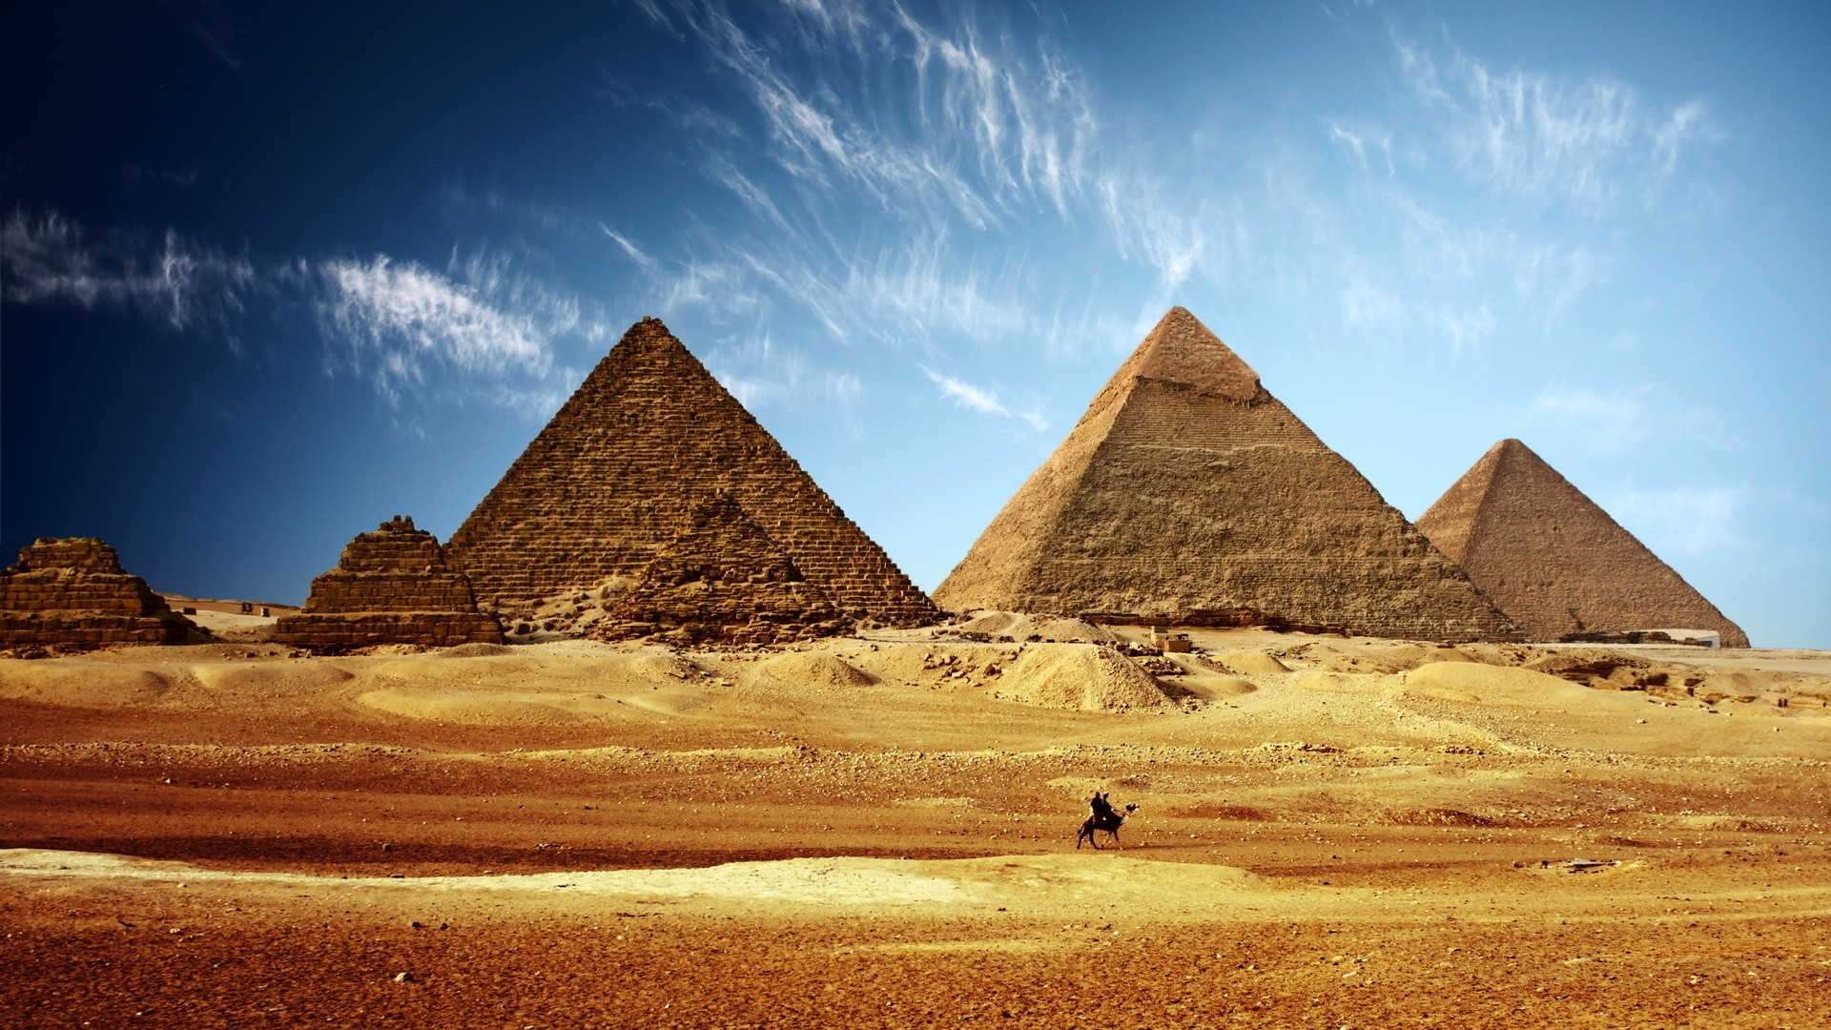
Egypt

Slide 36
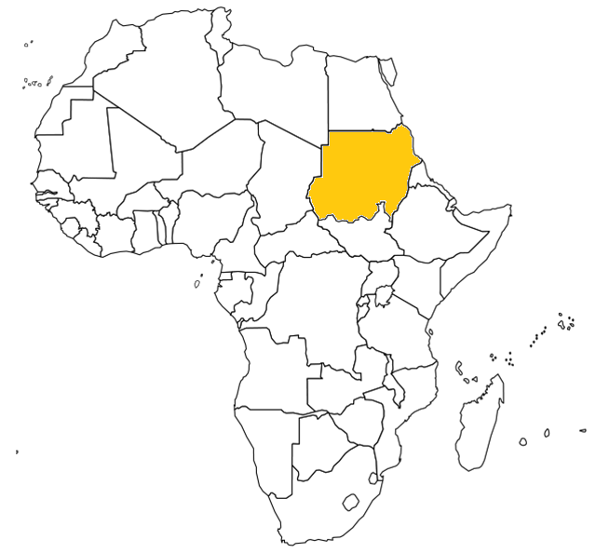
Sudan

Slide 37
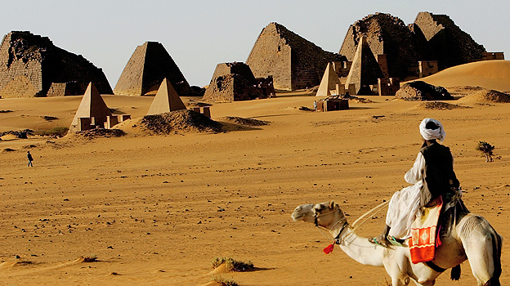
Sudan

Slide 38
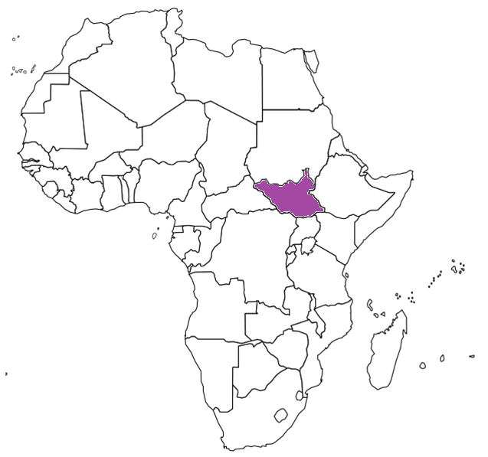
South Sudan

Slide 39
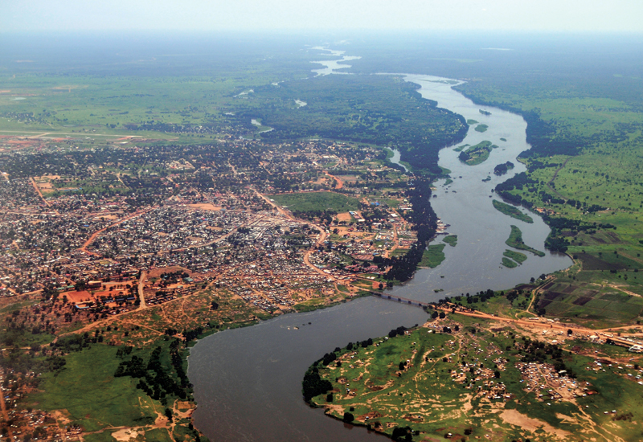
South Sudan

Slide 40
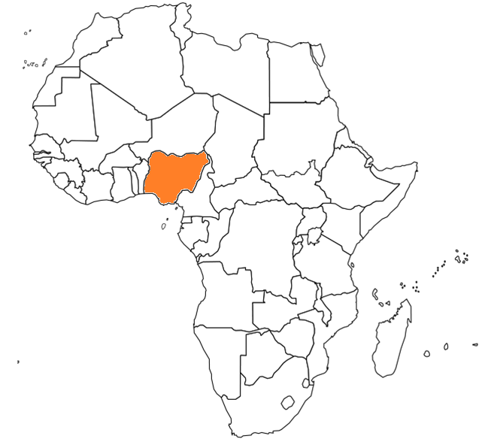
Nigeria

Slide 41
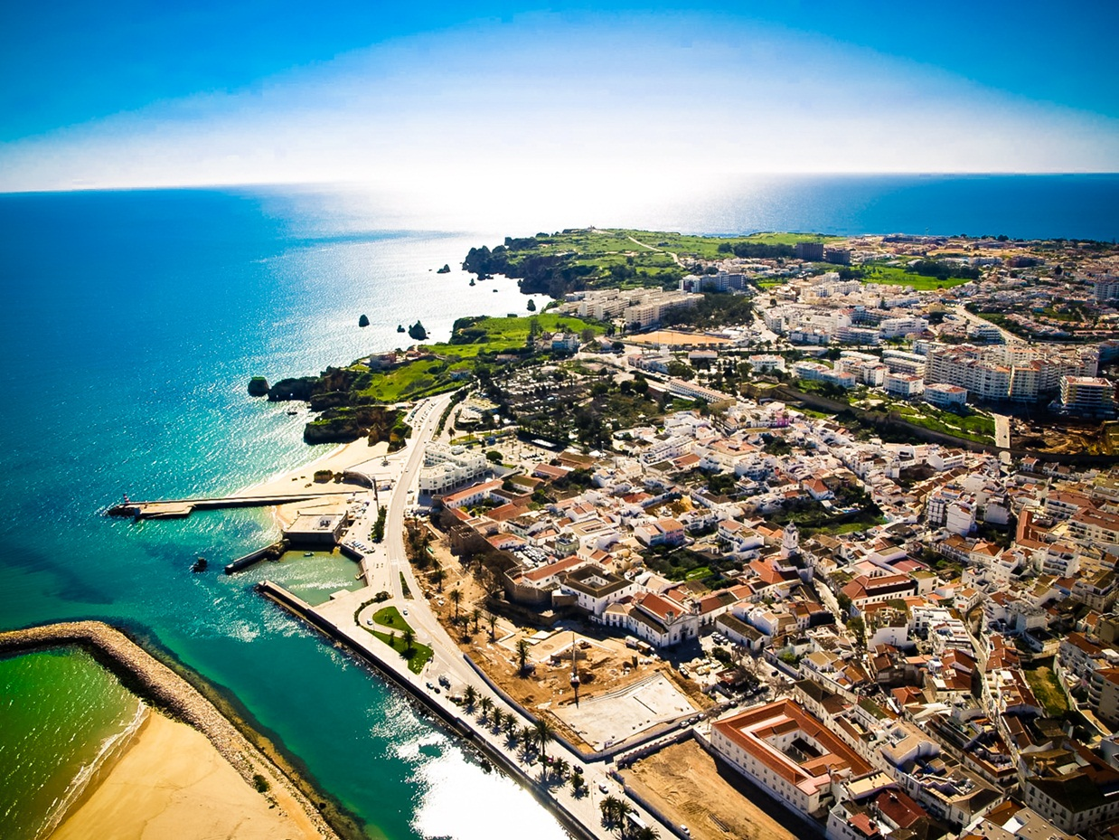
Nigeria

Slide 42
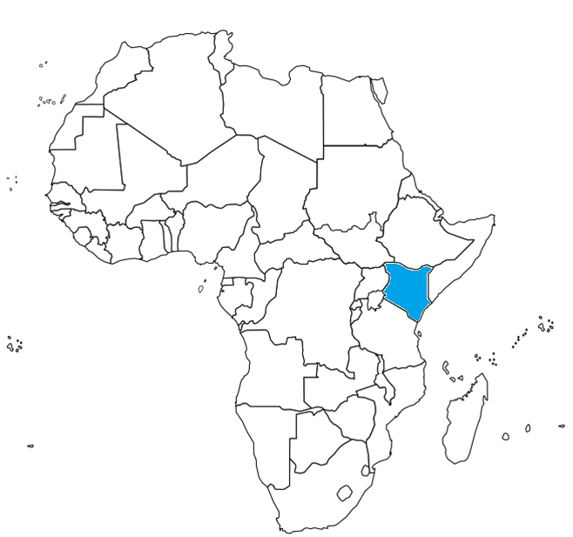
Kenya

Slide 43
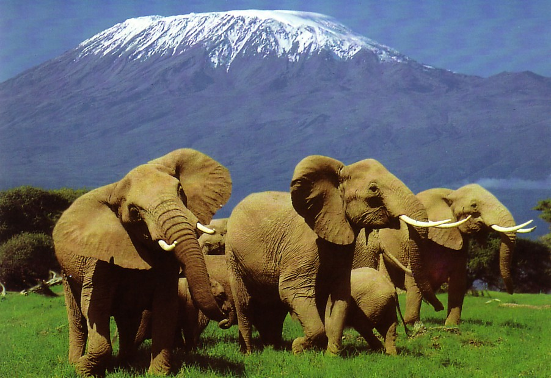
Kenya

Slide 44
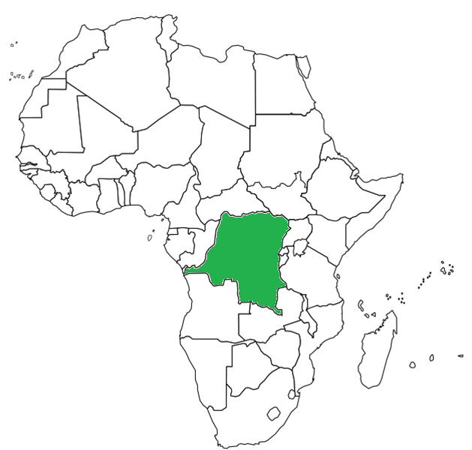
Democratic Republic of Congo (Zaire)

Slide 45
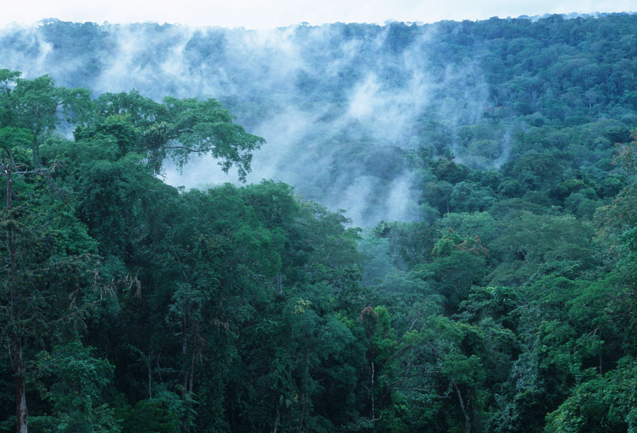
Democratic Republic of Congo (Zaire)

Slide 46
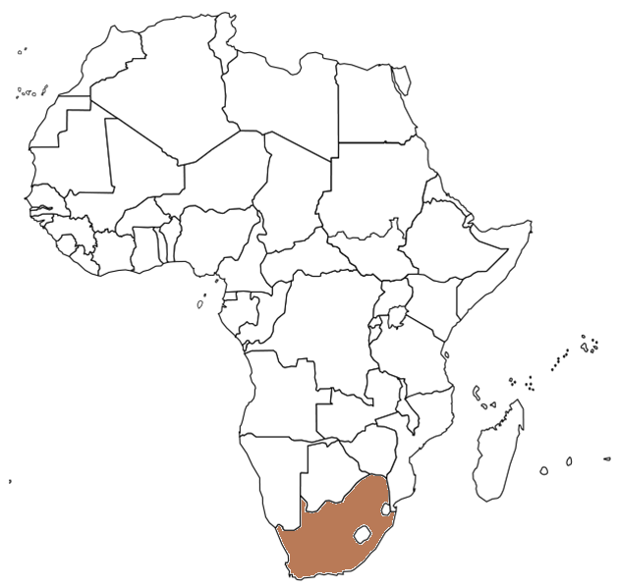
South Africa

Slide 47
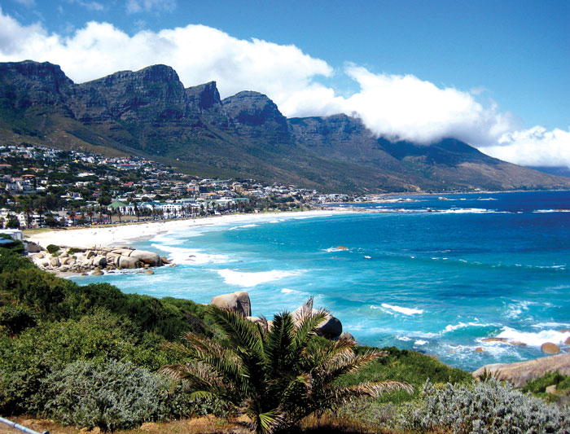
South Africa

Slide 48
Create a Mnemonic Device to help remember the countries of Africa

Slide 49
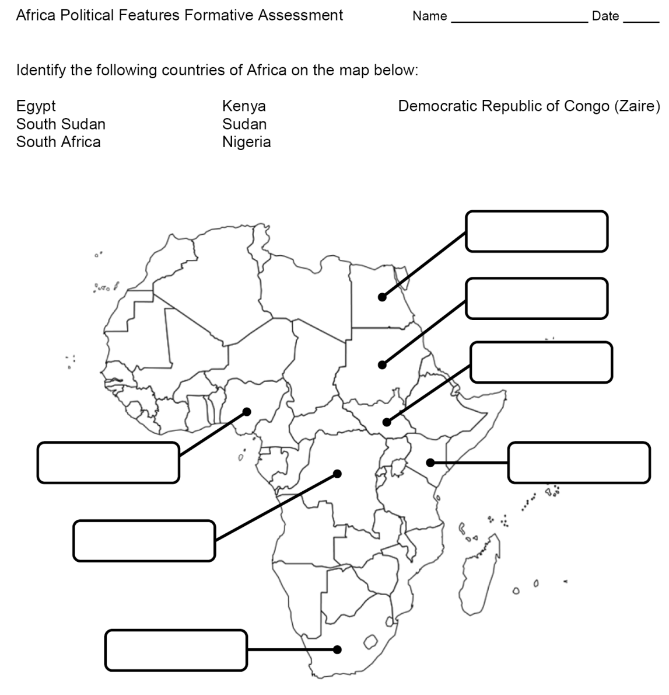
Formative Assessment

Slide 50
Physical and Political Features Review Activities [if needed]
Africa Physical and Political Features Flashcards
Physical and Political Features Slipcover

Slide 51
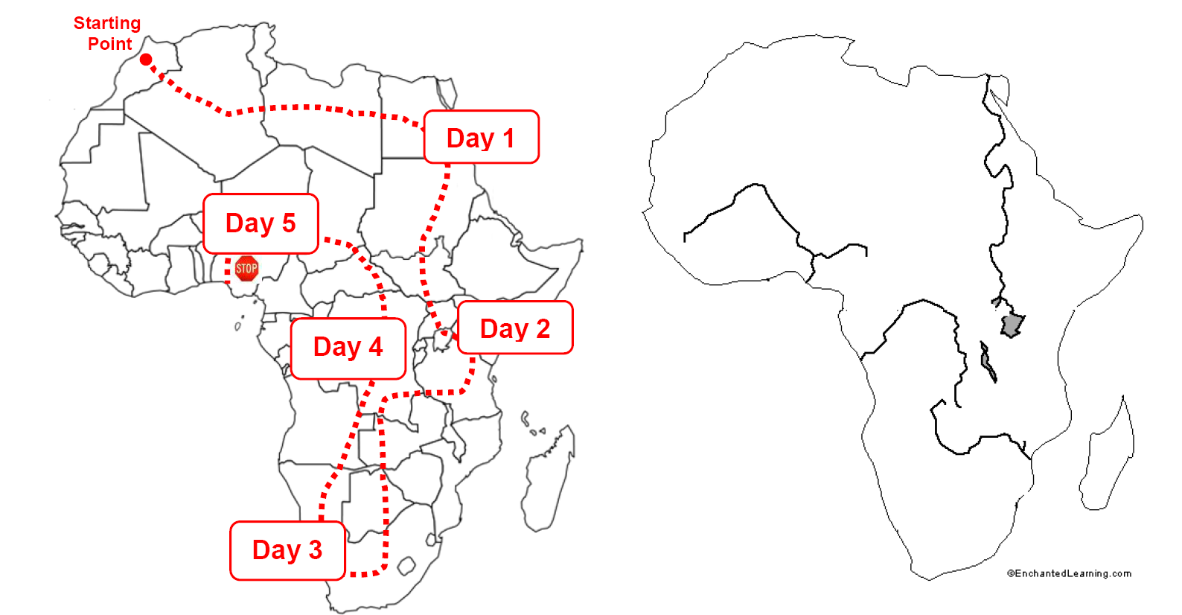
Summarizer
Notes:
There are two options for the summarizer. The one shown on the slide is the lower level version. Another version is higher level because students have to select a starting point, a direction, and determine the physical features and countries seen in each day. Additionally, a word bank is not included for the physical features and countries.

