Slide 1
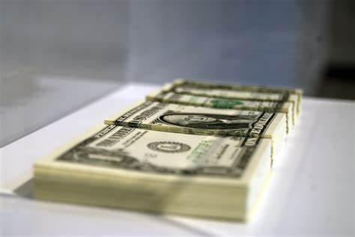
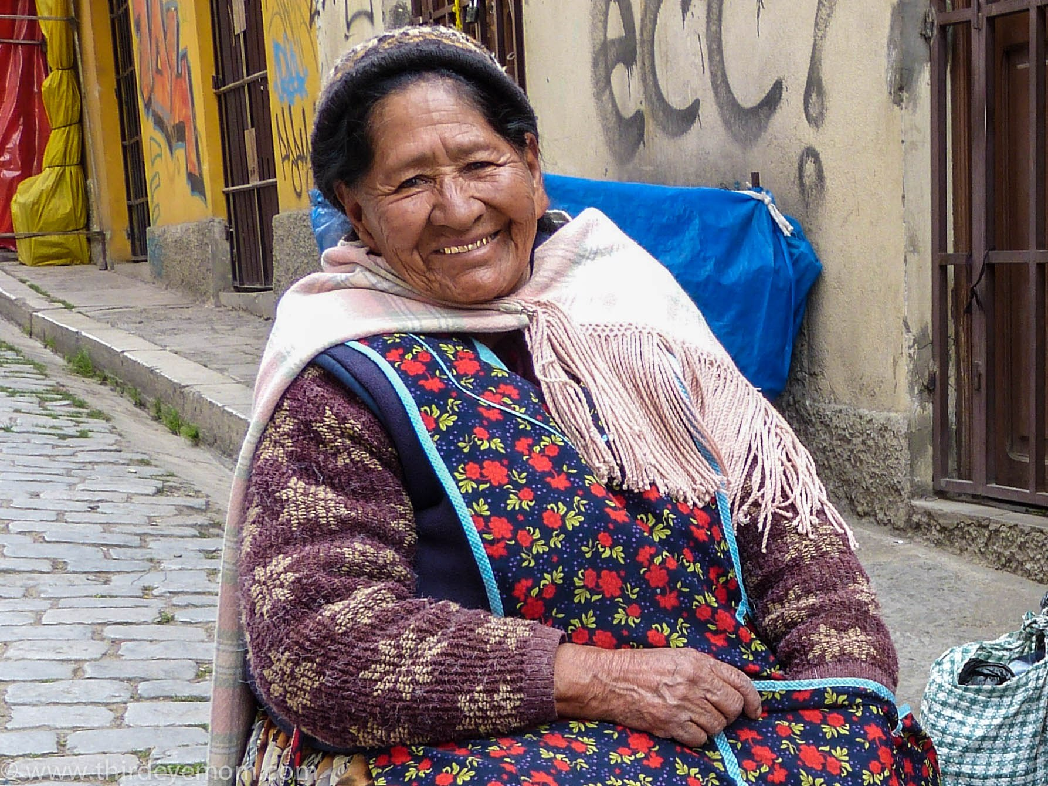
Vivian
Brooklyn Gooding, Zephrah Williams, Lylah Tunstall , and Bryson Fortner

Slide 2
For our Kiva Project we chose Vivian
Vivian is an older lady who has two children. We want to help her because we want to help the next generation of Bolivia (where Vivian is from). We believe that by helping Vivian, we can affect the community of Bolivia. With your help, we can be another example of how one small thing can make a big impact. Our goal is to give Vivian $100 out of the $1,450 she needs. We can help Vivian, don’t be the reason her children won't survive.

Slide 3
A little about Bolivia...
Bolivia is considered a poor country with the lowest GDP per capita among the Latin countries of South America (Guyana, Suriname, and French Guiana are lower).The political situation in Bolivia is not the best ether, If the reports are true that the military is using live ammunition against the protesters, the political situation can only get worse. In previous instances, when the city’s cathedral bells have been rung, Santa Cruz citizens turned out by the thousands.

Slide 4
Why did we pick vivian?..
Our reason for choosing Vivian is, she is getting older and needs medical treatment. As she progresses in age, it can be hard trying to take care of yourself, and your family, if your struggling because of your medical needs.

Slide 5
Our first Fact and Example
If Vivian is sick and does not get the correct treatment necessary to keep her healthy, she could get very sick. If she gets very sick, she could not go to work, and she would not be able to earn any money to help provide for her family.
A person cannot physically work or take care of their family and that causes anxiety with results into further health issues

Slide 6
Our Second Fact and Example
When you have medical issues daily activities become way harder than they should be.
Dizziness
Dizziness can make it hard to do everyday things involving standing up, walking or running and other things.
Swollen ankle
This can make it hard for Vivian to just stand it can be painful.
With Vivian's kids she needs to be able to walk around and provide for her family
Shoulder pain
Shoulder pain accrues in older adults. This can be painful and can prevent people from doing things.

Slide 7
Some mind-blowing facts you probably didn’t know about Bolivia
- Bolivia is one of the poorest countries in Latin America.
- Bolivia is a landlocked South American country.
- Bolivia became independent on August 6, 1825 from Spain.
- Only about 11% of all roads in Bolivia are paved.
- Sadly, Bolivia’s second-largest lake, Lake Poopo (po po) has dried up due to climate change. The Lake is situated more than 12,000 feet above sea level on the country’s Andean plains.
- As of 2017, the life expectancy for people in Bolivia is about 69 years, meaning Vivian may not have long to live, but we can change that.

Slide 8
What is kiva and why is it used?
Kiva is an organization used to bring money to people around the country.
Kiva's mission is to connect people through lending to alleviate poverty
These are real people with real issues and Kiva loans money to them to give them what they need and they

Slide 9
Thank you!
someone@example.com

