Slide 1
Violeta, Food for Good

Slide 2
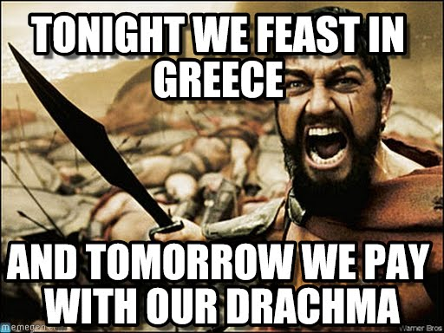
Violeta is a food business woman who works with a female charity group called the negros women for tomorrow foundation.
Violeta's food company deserves to be helped because it will help Violeta be fortunate enough to provide not only for her family, but all of the people of the Philipinnes.
If Violeta gains what she needs she is sure to pay it back soon after it is lent to her, because according to her risk rating on Kiva which explains if she is trustworthy or not, four and a half, she is very trustworthy.
As Violeta pays back what she owes we also get back what we have given her.

Slide 3
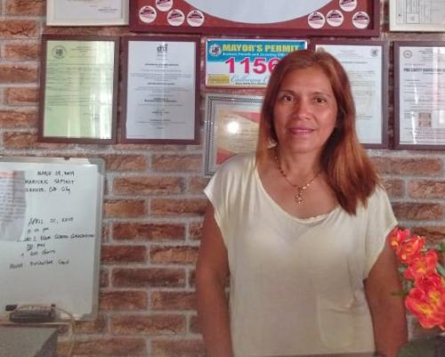
Violeta would like to use a loan of 400 dollars (Via Kiva) and only has 250 more dollars to go
Fact
Helping her build her food business will help people across Philippines get food and help her children to get to college.
Kiva is a non-profit organization that helps people all around the world by persuading many others to pay and give to those asking for help. Kiva saves many lives every day, with your help.

Slide 4
Your money spent well

Slide 5
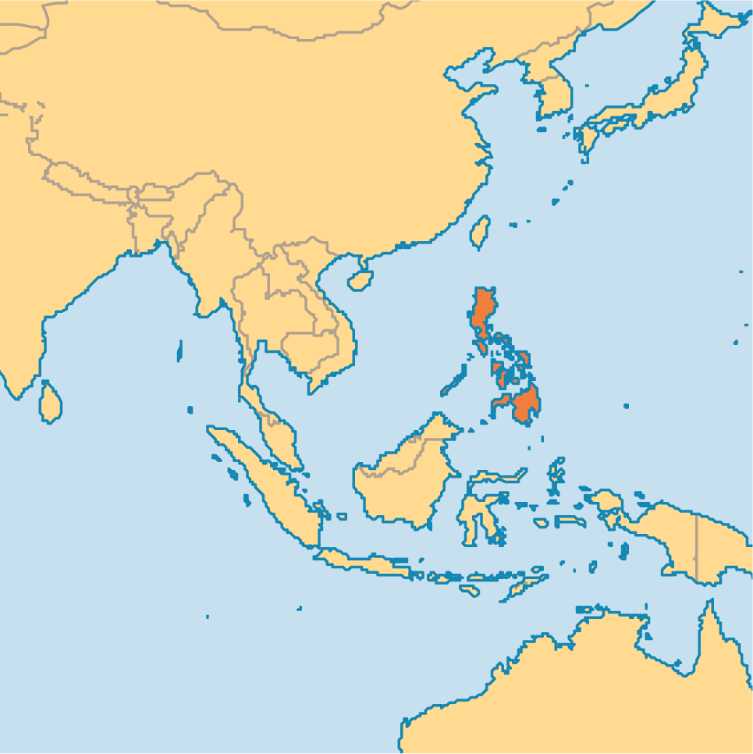
THIS IS THE PHILIpPineS
Facts On the Philippines
*40% of the Philippines are going hungry
*20.3 ranking in world hunger
*Children face risks at malnutrition

Slide 6
Make the right choice and choose violeta
Kiva is a wonderful organization and our peers must decide among many worthy people. The decision we create can affect our lives and others' lives in many ways. Violeta is a very trustworthy person who is worth the money. She deserves this loan so that there may be no more pain or struggle in her life. So please give in and lend to help her and her business to let the people of the Philippines be fed.

