Slide 1
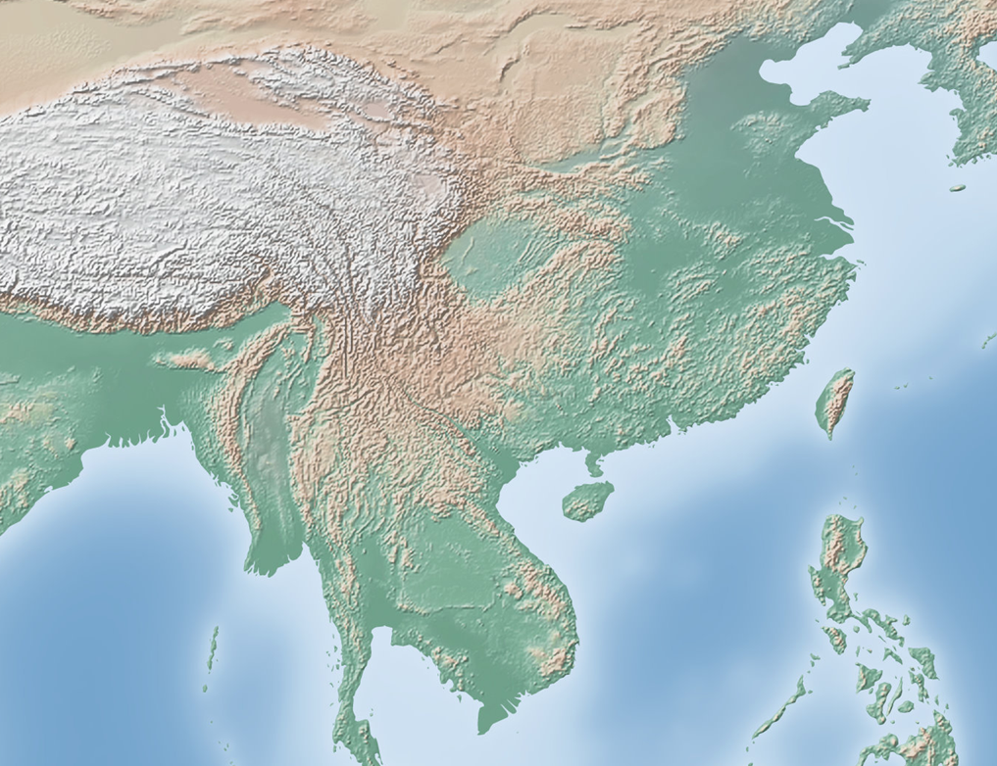
Geography of Southern & Eastern Asia QUIZ

Slide 2
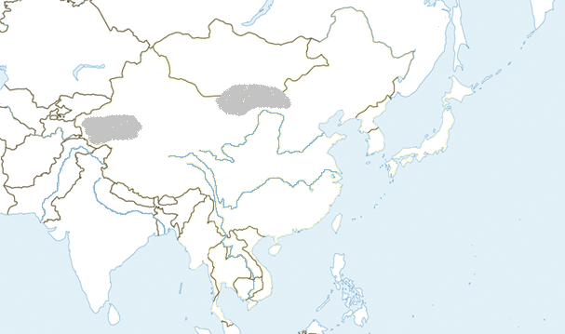
Southern & Eastern Asia Physical Features
1
IDENTIFY
Notes:
Instructional Approach(s): The teacher should present the animated slide. The teacher can ask for student volunteers to name the identified physical feature. When ready, the teacher can click the mouse to reveal the answer. The students should record the correct name of the physical feature on their physical features map.

Slide 3
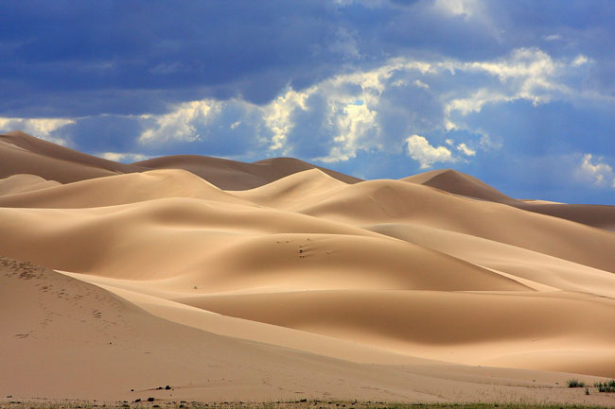
Notes:
Instructional Approach(s): The teacher should use the slide to show an illustration of the previous identified physical feature.

Slide 4
Asia’s largest desert that stretches across southern Mongolia and northern China.
Notes:
Instructional Approach(s): The students should record the description of the physical feature previously identified on their physical features map.

Slide 5
IDENTIFY
2
Notes:
Instructional Approach(s): The teacher should present the animated slide. The teacher can ask for student volunteers to name the identified physical feature. When ready, the teacher can click the mouse to reveal the answer. The students should record the correct name of the physical feature on their physical features map.

Slide 6
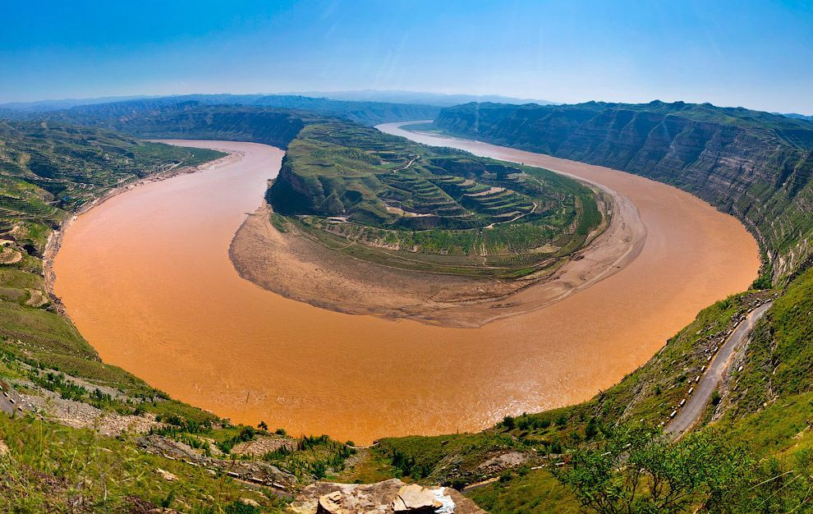
HINT
Notes:
Instructional Approach(s): The teacher should use the slide to show an illustration of the previous identified physical feature.

Slide 7
HINT:
China’s second largest river that causes devastating floods. It is named for the muddy yellow silt it carries
Notes:
Instructional Approach(s): The students should record the description of the physical feature previously identified on their physical features map.

Slide 8
Southern & Eastern Asia Physical Features
3
Notes:
Instructional Approach(s): The teacher should present the animated slide. The teacher can ask for student volunteers to name the identified physical feature. When ready, the teacher can click the mouse to reveal the answer. The students should record the correct name of the physical feature on their physical features map.

Slide 9
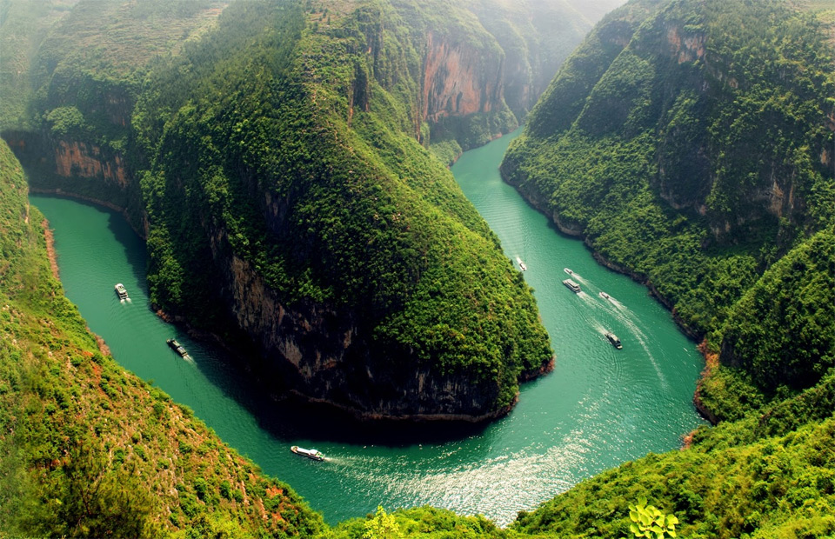
HINT
Notes:
Instructional Approach(s): The teacher should use the slide to show an illustration of the previous identified physical feature.

Slide 10
HINT
Largest and longest river in China; very important because it provides hydroelectric power, water for irrigation, and transportation for cargo ships.
Notes:
Instructional Approach(s): The students should record the description of the physical feature previously identified on their physical features map.

Slide 11
Southern & Eastern Asia Physical Features
4
Notes:
Instructional Approach(s): The teacher should present the animated slide. The teacher can ask for student volunteers to name the identified physical feature. When ready, the teacher can click the mouse to reveal the answer. The students should record the correct name of the physical feature on their physical features map.

Slide 12
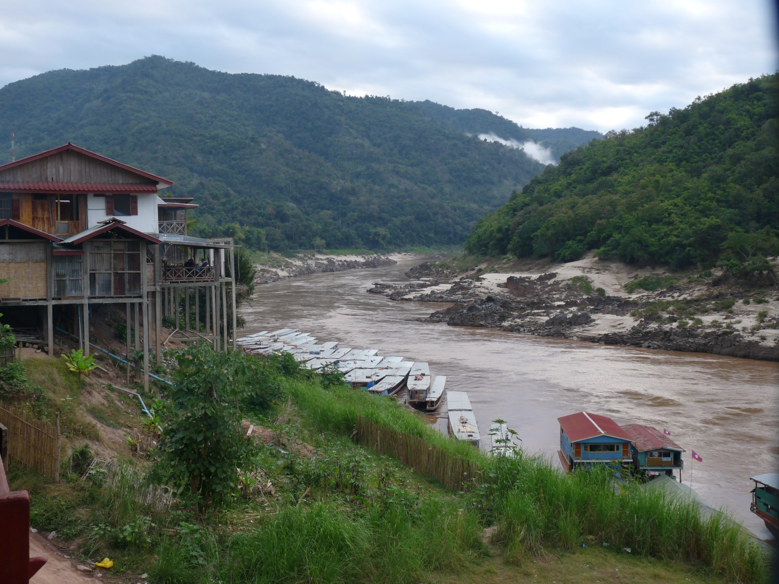
HINT
Notes:
Instructional Approach(s): The teacher should use the slide to show an illustration of the previous identified physical feature.

Slide 13
HINT :
Flows through China, Myanmar (Burma), Thailand, Laos, Cambodia, and Vietnam. One of the region’s most important crops, rice, is grown in the river basin.
Notes:
Instructional Approach(s): The students should record the description of the physical feature previously identified on their physical features map.

Slide 14
Southern & Eastern Asia Physical Features
5
Notes:
Instructional Approach(s): The teacher should present the animated slide. The teacher can ask for student volunteers to name the identified physical feature. When ready, the teacher can click the mouse to reveal the answer. The students should record the correct name of the physical feature on their physical features map.

Slide 15
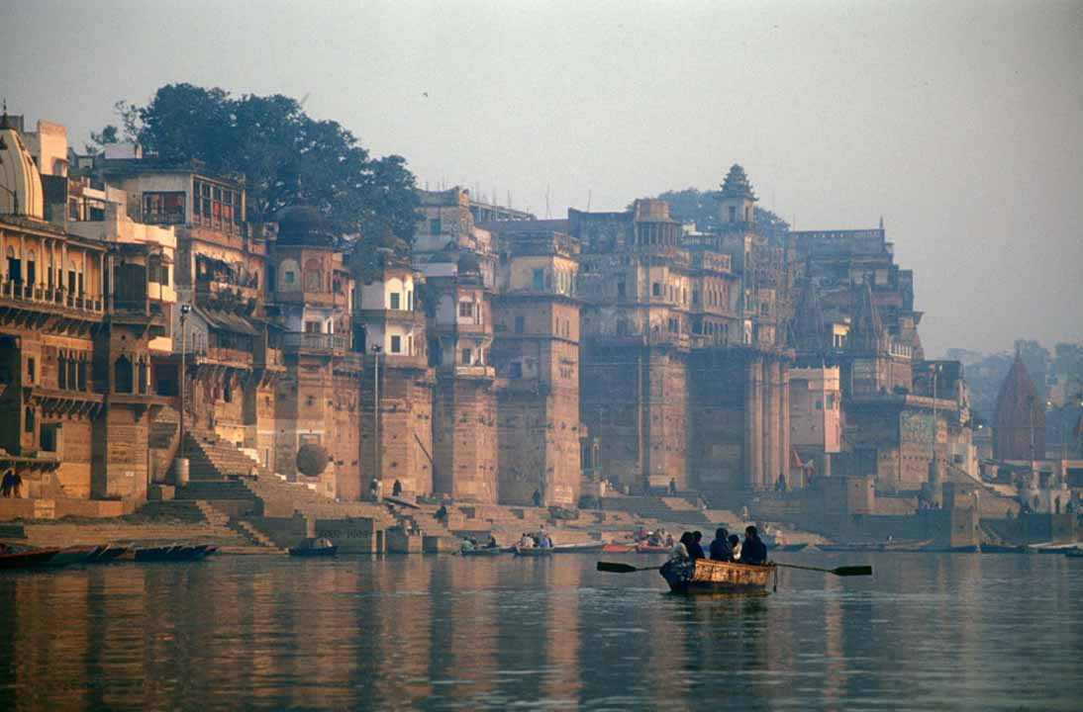
HINT
Notes:
Instructional Approach(s): The teacher should use the slide to show an illustration of the previous identified physical feature.

Slide 16
HINT :
Starts in the Himalayan Mountains; most important river in India because it runs through the most fertile and highly populated areas; considered sacred by the Hindu religion.
Notes:
Instructional Approach(s): The students should record the description of the physical feature previously identified on their physical features map.

Slide 17
Southern & Eastern Asia Physical Features
6
Notes:
Instructional Approach(s): The teacher should present the animated slide. The teacher can ask for student volunteers to name the identified physical feature. When ready, the teacher can click the mouse to reveal the answer. The students should record the correct name of the physical feature on their physical features map.

Slide 18
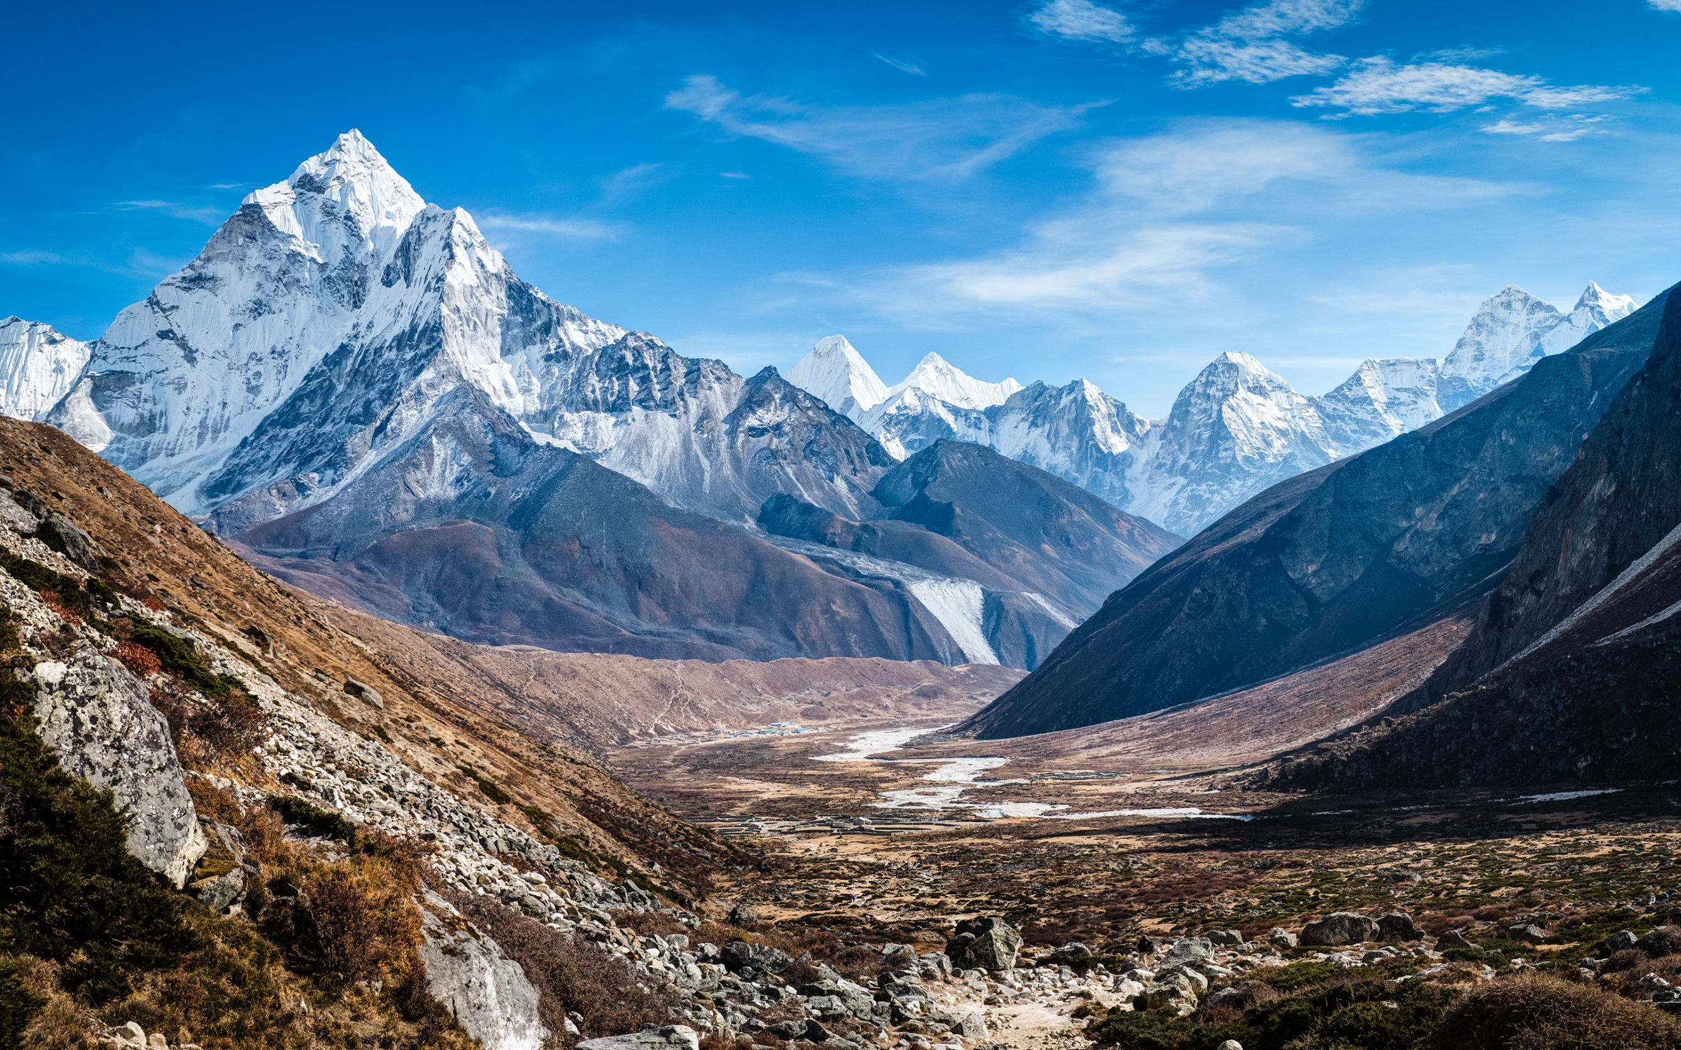
HINT
Notes:
Instructional Approach(s): The teacher should use the slide to show an illustration of the previous identified physical feature.

Slide 19
HINT :
World’s highest mountain range that sits along the northern edge of India; includes Mount Everest, the highest mountain in the world.
Notes:
Instructional Approach(s): The students should record the description of the physical feature previously identified on their physical features map.

Slide 20
Southern & Eastern Asia Physical Features
7
Notes:
Instructional Approach(s): The teacher should present the animated slide. The teacher can ask for student volunteers to name the identified physical feature. When ready, the teacher can click the mouse to reveal the answer. The students should record the correct name of the physical feature on their physical features map.

Slide 21
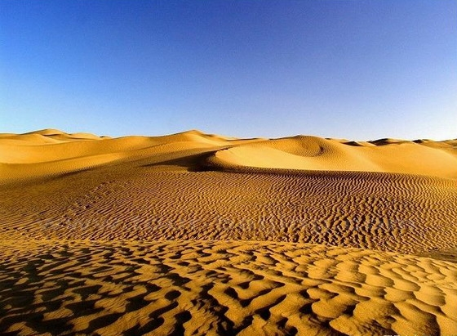
HINT
Notes:
Instructional Approach(s): The teacher should use the slide to show an illustration of the previous identified physical feature.

Slide 22
HINT :
Located in northwestern China between two mountain ranges
Notes:
Instructional Approach(s): The students should record the description of the physical feature previously identified on their physical features map.

Slide 23
Southern & Eastern Asia Physical Features
8
Notes:
Instructional Approach(s): The teacher should present the animated slide. The teacher can ask for student volunteers to name the identified physical feature. When ready, the teacher can click the mouse to reveal the answer. The students should record the correct name of the physical feature on their physical features map.

Slide 24
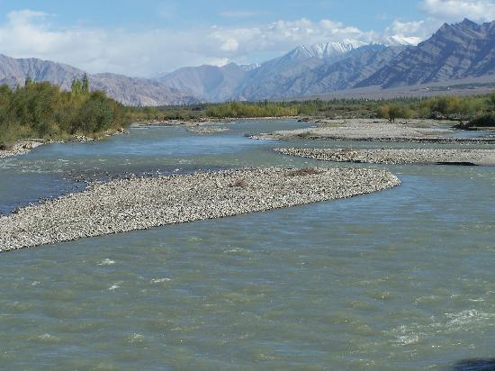
HINT
Notes:
Instructional Approach(s): The teacher should use the slide to show an illustration of the previous identified physical feature.

Slide 25
HINT :
Begins high in the Himalayas and slowly runs through India and Pakistan; provides water for one of the largest irrigation systems in the world
Notes:
Instructional Approach(s): The students should record the description of the physical feature previously identified on their physical features map.

Slide 26
Southern & Eastern Asia Physical Features
9
Notes:
Instructional Approach(s): The teacher should present the animated slide. The teacher can ask for student volunteers to name the identified physical feature. When ready, the teacher can click the mouse to reveal the answer. The students should record the correct name of the physical feature on their physical features map.

Slide 27
HINT
Notes:
Instructional Approach(s): The teacher should use the slide to show an illustration of the previous identified physical feature.

Slide 28
HINT : Third largest ocean; lies between Africa, Asia, and Australia
Notes:
Instructional Approach(s): The students should record the description of the physical feature previously identified on their physical features map.

Slide 29
Southern & Eastern Asia Physical Features
10
Notes:
Instructional Approach(s): The teacher should present the animated slide. The teacher can ask for student volunteers to name the identified physical feature. When ready, the teacher can click the mouse to reveal the answer. The students should record the correct name of the physical feature on their physical features map.

Slide 30
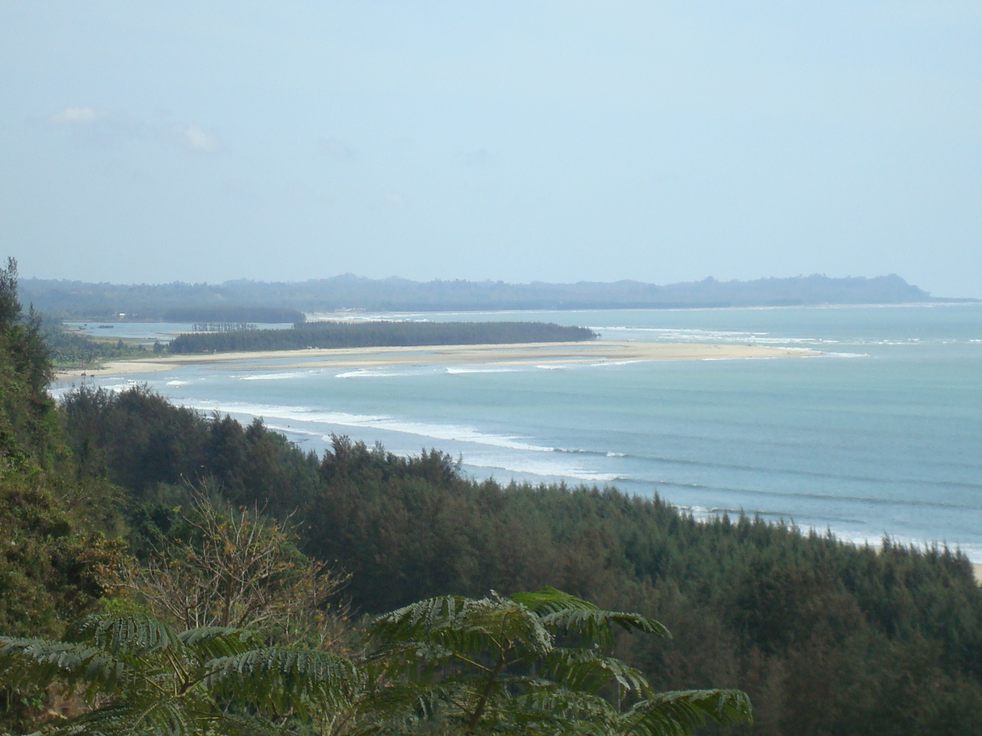
HINT
Notes:
Instructional Approach(s): The teacher should use the slide to show an illustration of the previous identified physical feature.

Slide 31
HINT :
An “arm” of the Indian Ocean with India on its west; many large rivers, including the Ganges, flow into it
Notes:
Instructional Approach(s): The students should record the description of the physical feature previously identified on their physical features map.

Slide 32
Southern & Eastern Asia Physical Features
11
Notes:
Instructional Approach(s): The teacher should present the animated slide. The teacher can ask for student volunteers to name the identified physical feature. When ready, the teacher can click the mouse to reveal the answer. The students should record the correct name of the physical feature on their physical features map.

Slide 33
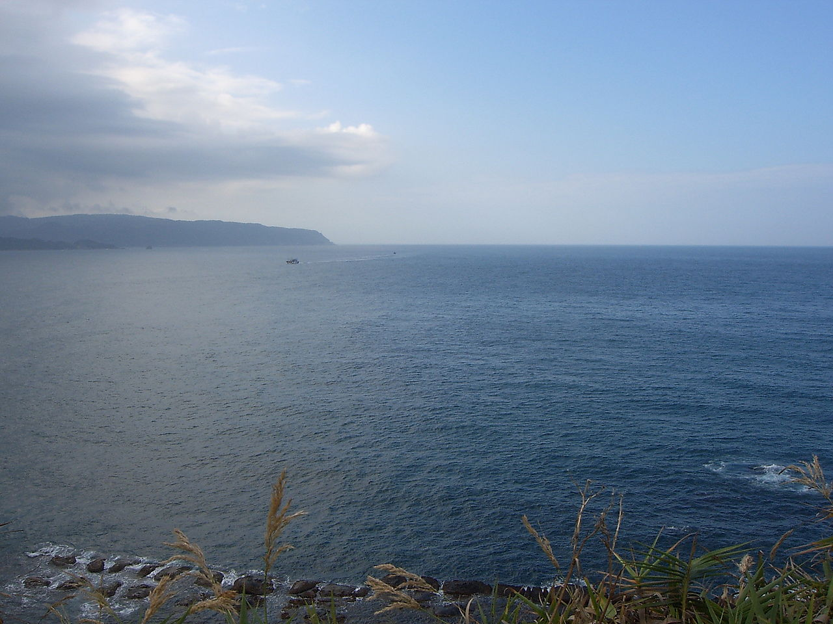
HINT
Notes:
Instructional Approach(s): The teacher should use the slide to show an illustration of the previous identified physical feature.

Slide 34
HINT :
Lies between Vietnam and the Philippines; has violent monsoons and typhoons.
Notes:
Instructional Approach(s): The students should record the description of the physical feature previously identified on their physical features map.

Slide 35
Southern & Eastern Asia Physical Features
12
Notes:
Instructional Approach(s): The teacher should present the animated slide. The teacher can ask for student volunteers to name the identified physical feature. When ready, the teacher can click the mouse to reveal the answer. The students should record the correct name of the physical feature on their physical features map.

Slide 36
HINT
Notes:
Instructional Approach(s): The teacher should use the slide to show an illustration of the previous identified physical feature.

Slide 37
HINT :
An “arm” of the Pacific Ocean that lies between China and Korea; it becomes the East China Sea south of the Korean Peninsula
Notes:
Instructional Approach(s): The students should record the description of the physical feature previously identified on their physical features map.

Slide 38
Southern & Eastern Asia Physical Features
13
Notes:
Instructional Approach(s): The teacher should present the animated slide. The teacher can ask for student volunteers to name the identified physical feature. When ready, the teacher can click the mouse to reveal the answer. The students should record the correct name of the physical feature on their physical features map.

Slide 39
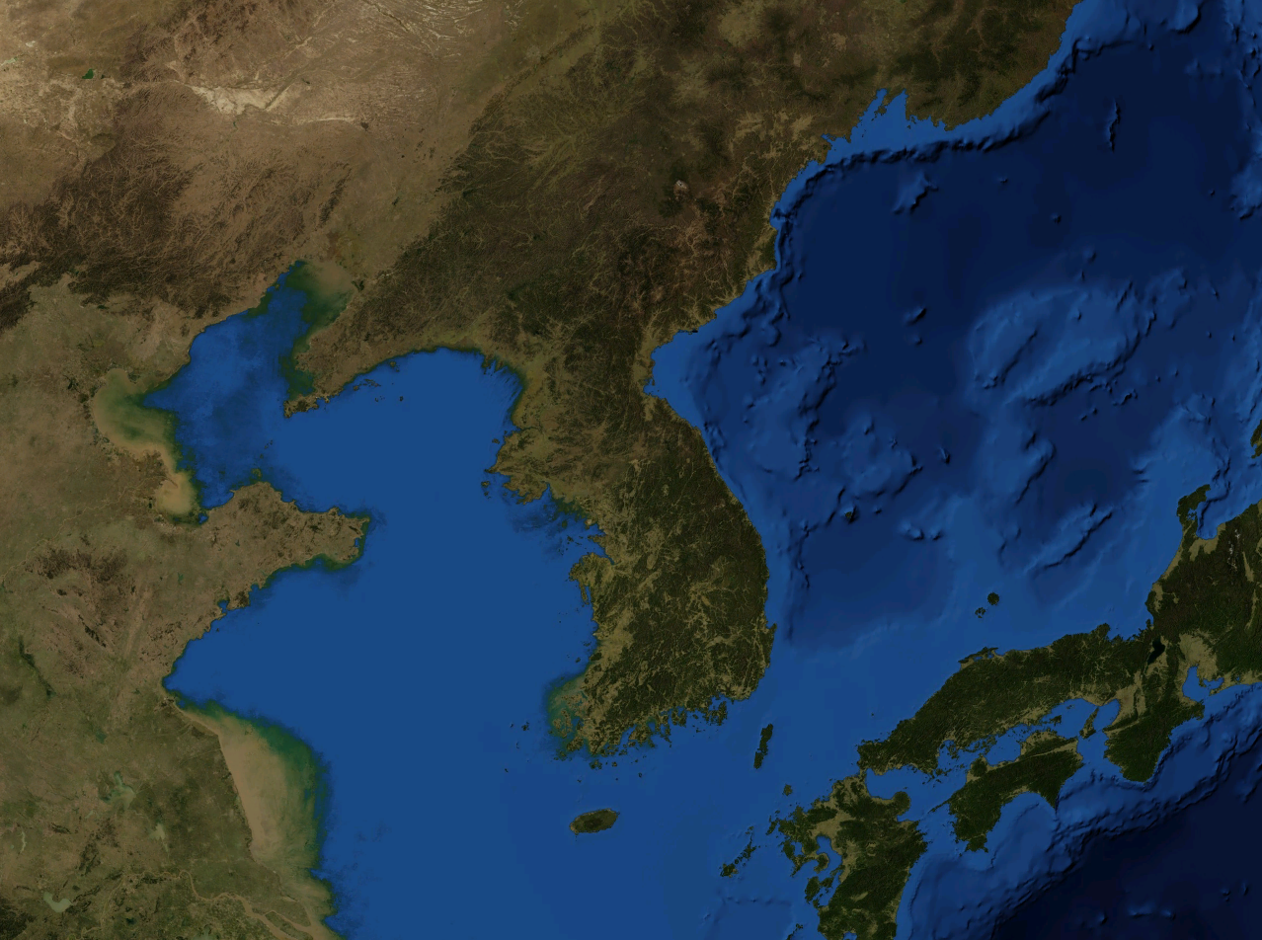
HINT
Notes:
Instructional Approach(s): The teacher should use the slide to show an illustration of the previous identified physical feature.

Slide 40
HINT :
Extends out from China in between the Yellow Sea and the Sea of Japan; divided into two countries
Notes:
Instructional Approach(s): The students should record the description of the physical feature previously identified on their physical features map.

Slide 41
Southern & Eastern Asia Physical Features
14
Notes:
Instructional Approach(s): The teacher should present the animated slide. The teacher can ask for student volunteers to name the identified physical feature. When ready, the teacher can click the mouse to reveal the answer. The students should record the correct name of the physical feature on their physical features map.

Slide 42
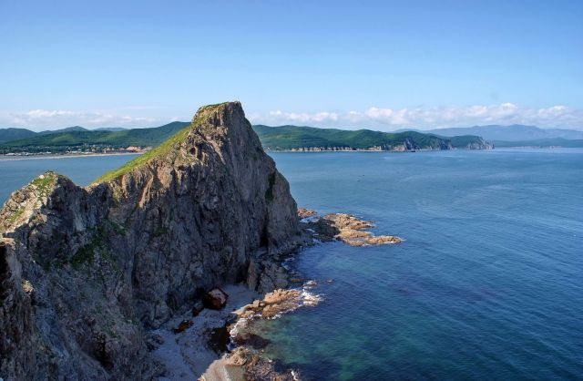
HINT
Notes:
Instructional Approach(s): The teacher should use the slide to show an illustration of the previous identified physical feature.

Slide 43
HINT :
An “arm” of the Pacific Ocean that lies between the continent of Asia and Japan
Notes:
Instructional Approach(s): The students should record the description of the physical feature previously identified on their physical features map.

Slide 44
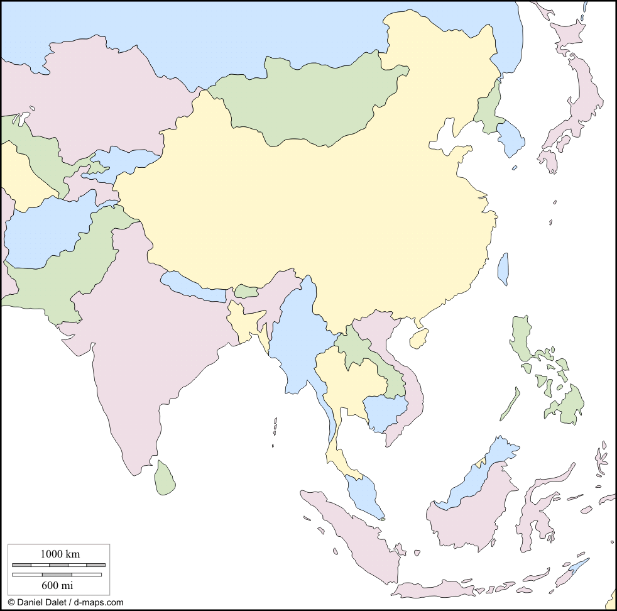
15
Notes:
Instructional Approach(s): The teacher should present the animated slide. The teacher can ask for student volunteers to name the country. When ready, the teacher can click the mouse to reveal the answer. The students should record the correct name of the nation on their map.

Slide 45
16
Notes:
Instructional Approach(s): The teacher should present the animated slide. The teacher can ask for student volunteers to name the country. When ready, the teacher can click the mouse to reveal the answer. The students should record the correct name of the nation on their map.

Slide 46
17
Notes:
Instructional Approach(s): The teacher should present the animated slide. The teacher can ask for student volunteers to name the country. When ready, the teacher can click the mouse to reveal the answer. The students should record the correct name of the nation on their map.

Slide 47
18
Notes:
Instructional Approach(s): The teacher should present the animated slide. The teacher can ask for student volunteers to name the country. When ready, the teacher can click the mouse to reveal the answer. The students should record the correct name of the nation on their map.

Slide 48
19
Notes:
Instructional Approach(s): The teacher should present the animated slide. The teacher can ask for student volunteers to name the country. When ready, the teacher can click the mouse to reveal the answer. The students should record the correct name of the nation on their map.

Slide 49
20
Notes:
Instructional Approach(s): The teacher should present the animated slide. The teacher can ask for student volunteers to name the country. When ready, the teacher can click the mouse to reveal the answer. The students should record the correct name of the nation on their map.

Slide 50
21
Notes:
Instructional Approach(s): The teacher should present the animated slide. The teacher can ask for student volunteers to name the country. When ready, the teacher can click the mouse to reveal the answer. The students should record the correct name of the nation on their map.

Slide 51
LONGITUDE LATITUDE CHECK

Slide 52
22. Latitude lines run around the globe in a/an ____________ direction. They really measure the distance from the _______________.

Slide 53
23. The boundary separating the northern and southern hemispheres is the ____________.

Slide 54
24. Another name for latitude lines is ________________ because they are always the same distance apart. Latitude tells how far ___________ or _________ of the equator you are.

Slide 55
25. Longitude lines, also called ____________, run in a north-south direction and meet at the poles. The one going through Greenwich, England is the first, or __________________.

Slide 56
26. The prime meridian divides the globe into two hemispheres. The one on the left is the ___________________ and the one on the right is the ___________________.

Slide 57
27. Longitude tells how far ________ or _________ of the prime meridian you are.

Slide 58
28. When coordinates are given, the one that is always given first is ____________.

