Slide 1
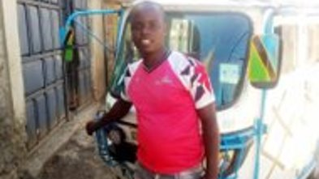
Martin & Kiva
By Savanna Herring.

Slide 2
What is kiva?
Kiva is a non-profit organization that allows people to lend money on the Internet to low-income entrepreneurs and students in over 80 countries.

Slide 3
Martian's story
Martin is 27 years old. He is happily married and has been blessed with a daughter. Martin runs a taxi business with the help of his rickshaw. He is humbly seeking a loan that will enable him repaint it and buy a spare tire to aid him in times of emergencies. Martin's main challenge currently is that his rickshaw appears old and is need of a makeover in order to attract more customers. He plans to pay for his loan with the help of the profits he makes. Martin hopes to grow his transport business and educate his children.

Slide 4
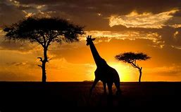
Kenya
Kenya is a country of many contrasts, from its landscape to demographics, and more so its social and economic inequalities. Kenya is one of the most unequal countries in the sub-region. Forty two percent of its population of 44 million, live below the poverty line. Access to basic quality services such as health care, education, clean water and sanitation, is often a luxury for many people.

Slide 5
Why This is Important
This loan is important for Martin because he is wants to get his daughter in school by making more money with his business .Education will help Martin's daughter to learn and to be able to get a formal job.

Slide 6
Please choose Martin

Slide 7
Sources
Thanks for reading
www.africaguide.com/country/kenya/
https://www.center-for-money-making-ideas.com/why-is-education-important.html

