Slide 1
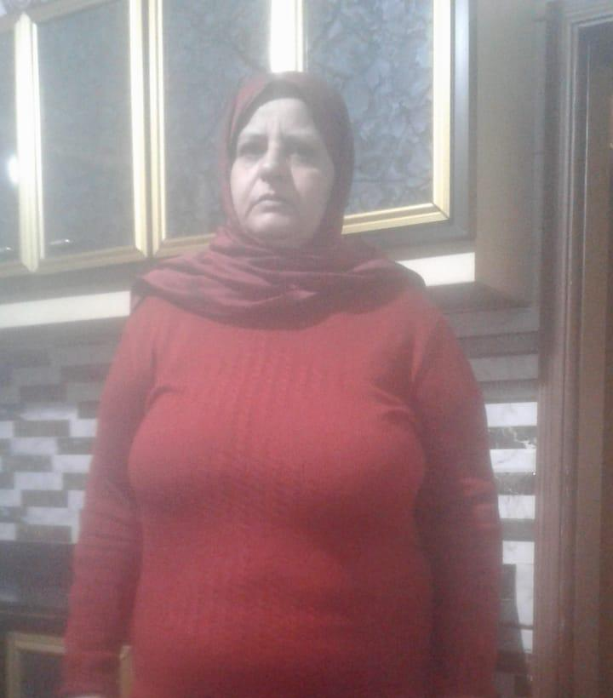
Najla
We want to give her a loan of $100 to help pay for her grandchild's tuition fees.
By: Sydney Thomas, Aiden Hubbard, and Brandon Bender

Slide 2
Her Story
Najla is a 53-year-old Lebanese woman who is married and blessed with five children. She lives with her husband and all her kids are married. Najla’s husband is the main breadwinner: he is an employee of a local company and has worked very whard since 2010 to raise this lovely family. Najla is a caring grandmother and always ready to help her grandchildren achieve a good standard of living.

Slide 3
What She Needs
Najla needs a loan of $1,075 to pay for her grandchild's school fees so he or she can get a good education. By contributing to this loan, you will help this little kid to achieve his or her dream.
This Photo by Unknown author is licensed under CC BY-NC-ND.

Slide 4
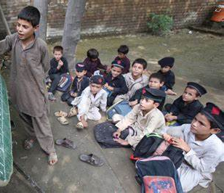
What Are Public Schools Like in Lebanon?
Education is compulsory until the end of the intermediate cycle, is available to all Lebanese students, and is attended by nearly 95 percent of school-age children. However, compulsory education has not been fully implemented by Lebanese authorities, especially in urban slums and remote rural areas. Low cost government schools are available to all, but are of generally low quality compared to private schools.

Slide 5
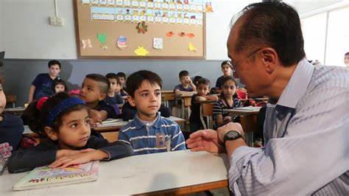
Lebanon's Education System
Lebanon doesn't invest much into their educational systems. Lebanon's educational system is free only up to ages 6-14. 75% of Lebanese schools are enrolling their students into private ones in hopes of the children getting a good education. All Najla is trying to do is give her grandchild the best chance in life.

Slide 6
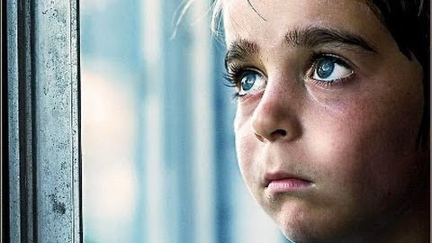
Why We Should Choose Nalja.
Many public schools have infrastructure problems, such as broken windows and leaking roofs. By helping Nalja achieve her goal, her grandchild will be able to get a better quality of education. Nalja is a great woman with a four-star risk rating. The Field Partner risk rating reflects the risk of unappealing default associated with each of Kiva’s Field Partners.

Slide 7
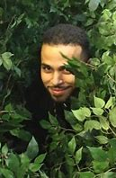
Thanks for listening!

