Slide 1
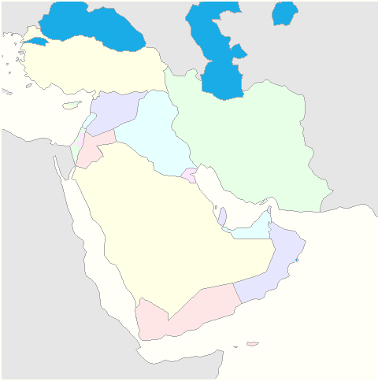
Geography of the
Middle East

Slide 2
Learning Target:
I can identify the major physical features and nations of the Middle East.
Standards:
SS7G5a. Locate on a world and regional political- physical map:
Euphrates River, Jordan River, Tigris River, Suez Canal, Persian Gulf, Strait of Hormuz, Arabian Sea, Red Sea, and Gaza Strip.
SS7G5b. Locate on a world and regional political-physical map the nations of Afghanistan, Iran, Iraq, Israel, Saudi Arabia, and Turkey
Notes:
Instructional Approach(s): The teacher should introduce the essential question and the standards that align to the essential question.

Slide 3
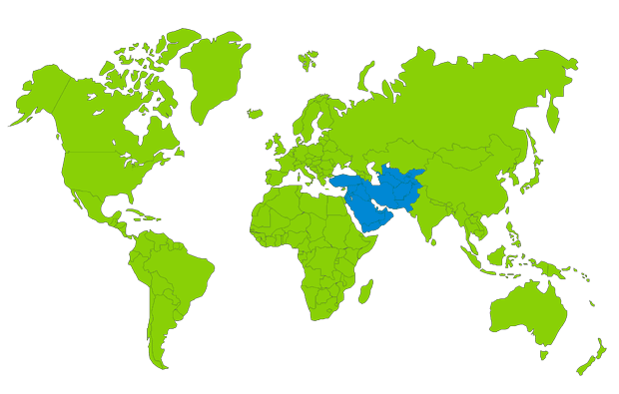
Where is the Middle East?
[Use Google Earth]
Notes:
Instructional Approach(s): The teacher can pose the question to the class and either ask for general location of the Middle East and/or pull down a map and have a volunteer show the location of the Middle East. When ready, click the mouse to show a world map illustrating the location of the Middle East.

Slide 4
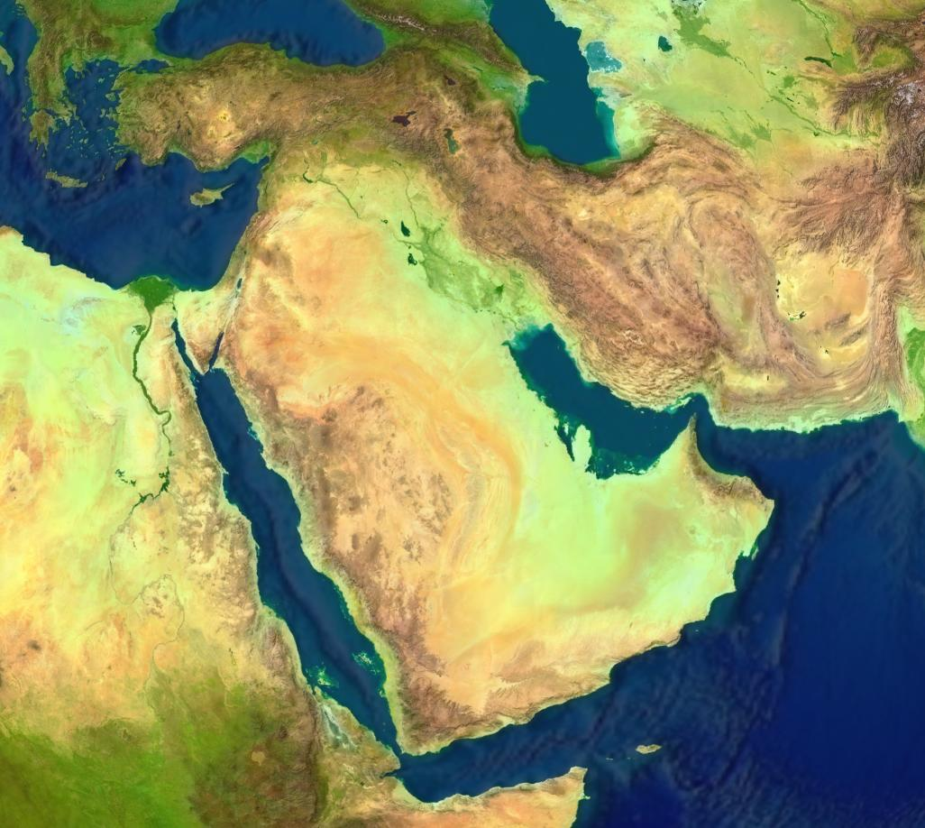
Satellite View the Middle East
Notes:
Instructional Approach(s): The teacher should use the image to further demonstrate the location of the Middle East. The teacher may want to first question students on the type of map shown and about some of the physical features that they already notice by the map. You may want to consider taking volunteer statements or calling on students to tell you about the Middle East just based on the physical features map.

Slide 5
Activating Strategy
Use the Middle East Physical Features and Nations summarizer to activate student’s prior knowledge of the physical features and nations located in the Middle East.
Notes:
Instructional Approach(s): Students can do the activator individually or with a partner. Partners can be determined by the students or the teacher can provide more specific directions such as turn to the person directly in front/behind you or to the right/left of you, etc. It may be necessary to have a group of three if you have an uneven number of students. Do not allow more than 2-3 minutes of discussion time. The teacher should be walking around listening and redirecting students as needed. The teacher can briefly discuss student responses.

Slide 6
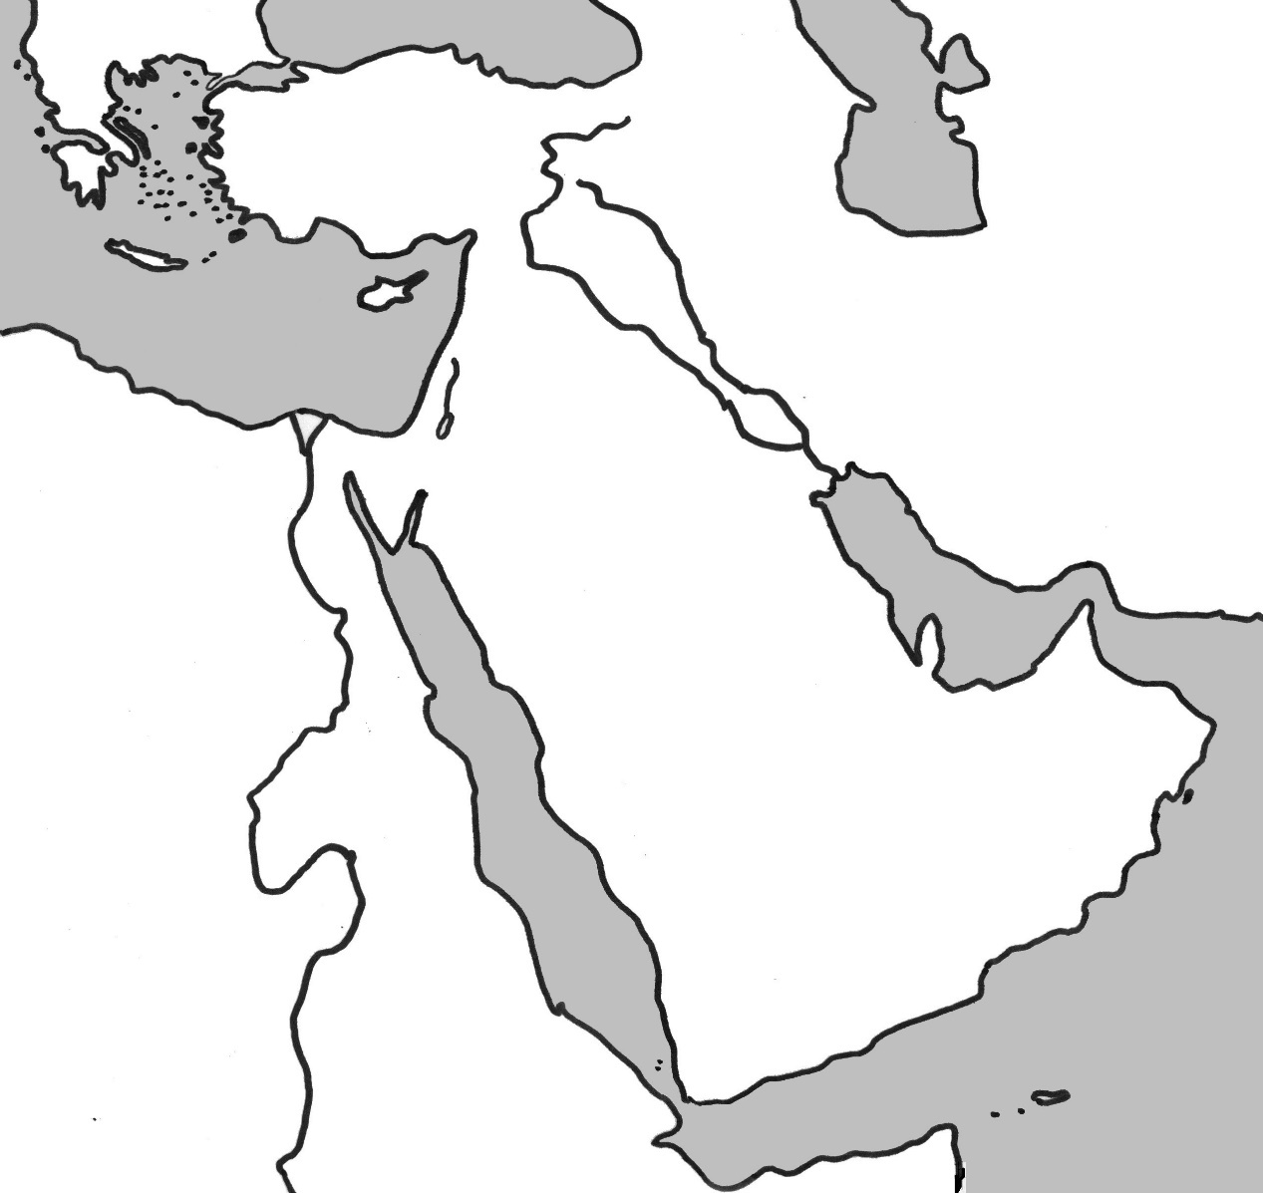
Middle East Physical Features
Use the Physical Features Map to record your answers.
8
1
2
4
7
3
6
5
Notes:
Instructional Approach(s): The teacher should give each student a copy of the Middle East Physical Features Map [linked on the resource page] to label the physical features of the Middle East during the lesson.

Slide 7

Middle East Physical Features
1
Tigris
River
Notes:
Instructional Approach(s): The teacher should present the animated slide. The teacher can ask for student volunteers to name the identified physical feature. When ready, the teacher can click the mouse to reveal the answer. The students should record the correct name of the physical feature on their physical features map.

Slide 8
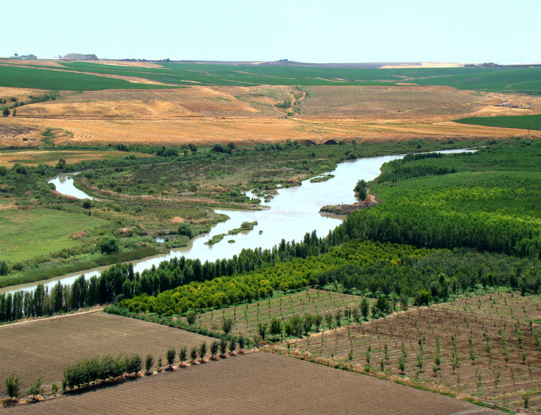
Notes:
Instructional Approach(s): The teacher should use the slide to show an illustration of the previous identified physical feature.

Slide 9
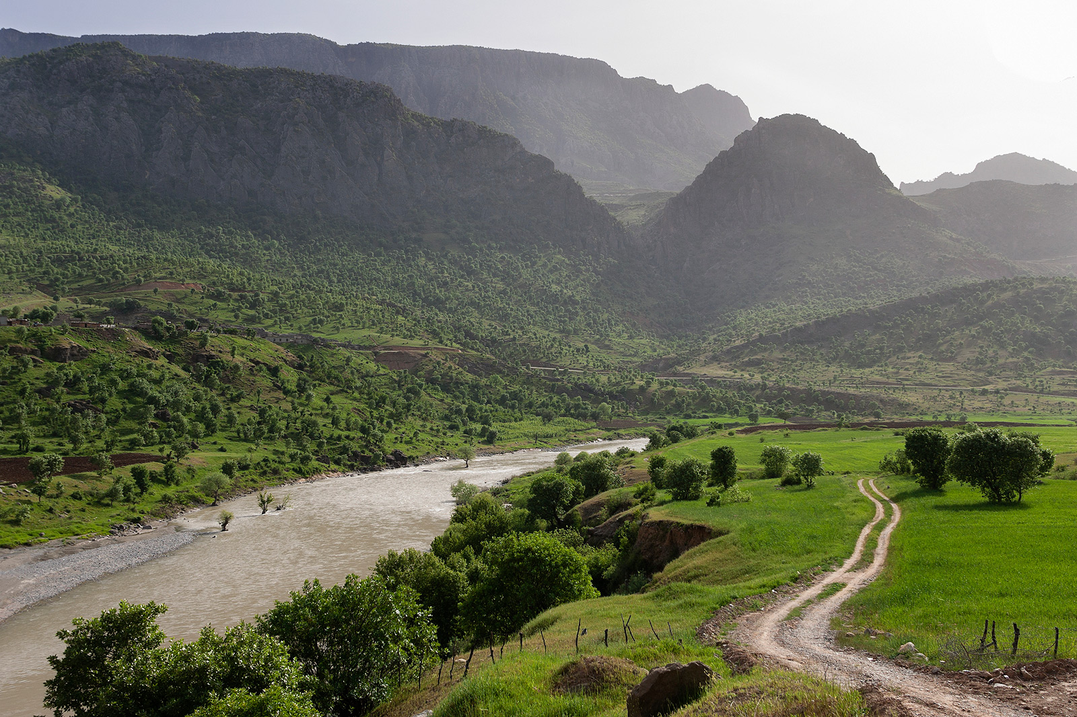
Notes:
Instructional Approach(s): The teacher should use the slide to show an illustration of the previous identified physical feature.

Slide 10
Middle East Physical Features
2
Euphrates
River
Notes:
Instructional Approach(s): The teacher should present the animated slide. The teacher can ask for student volunteers to name the identified physical feature. When ready, the teacher can click the mouse to reveal the answer. The students should record the correct name of the physical feature on their physical features map.

Slide 11
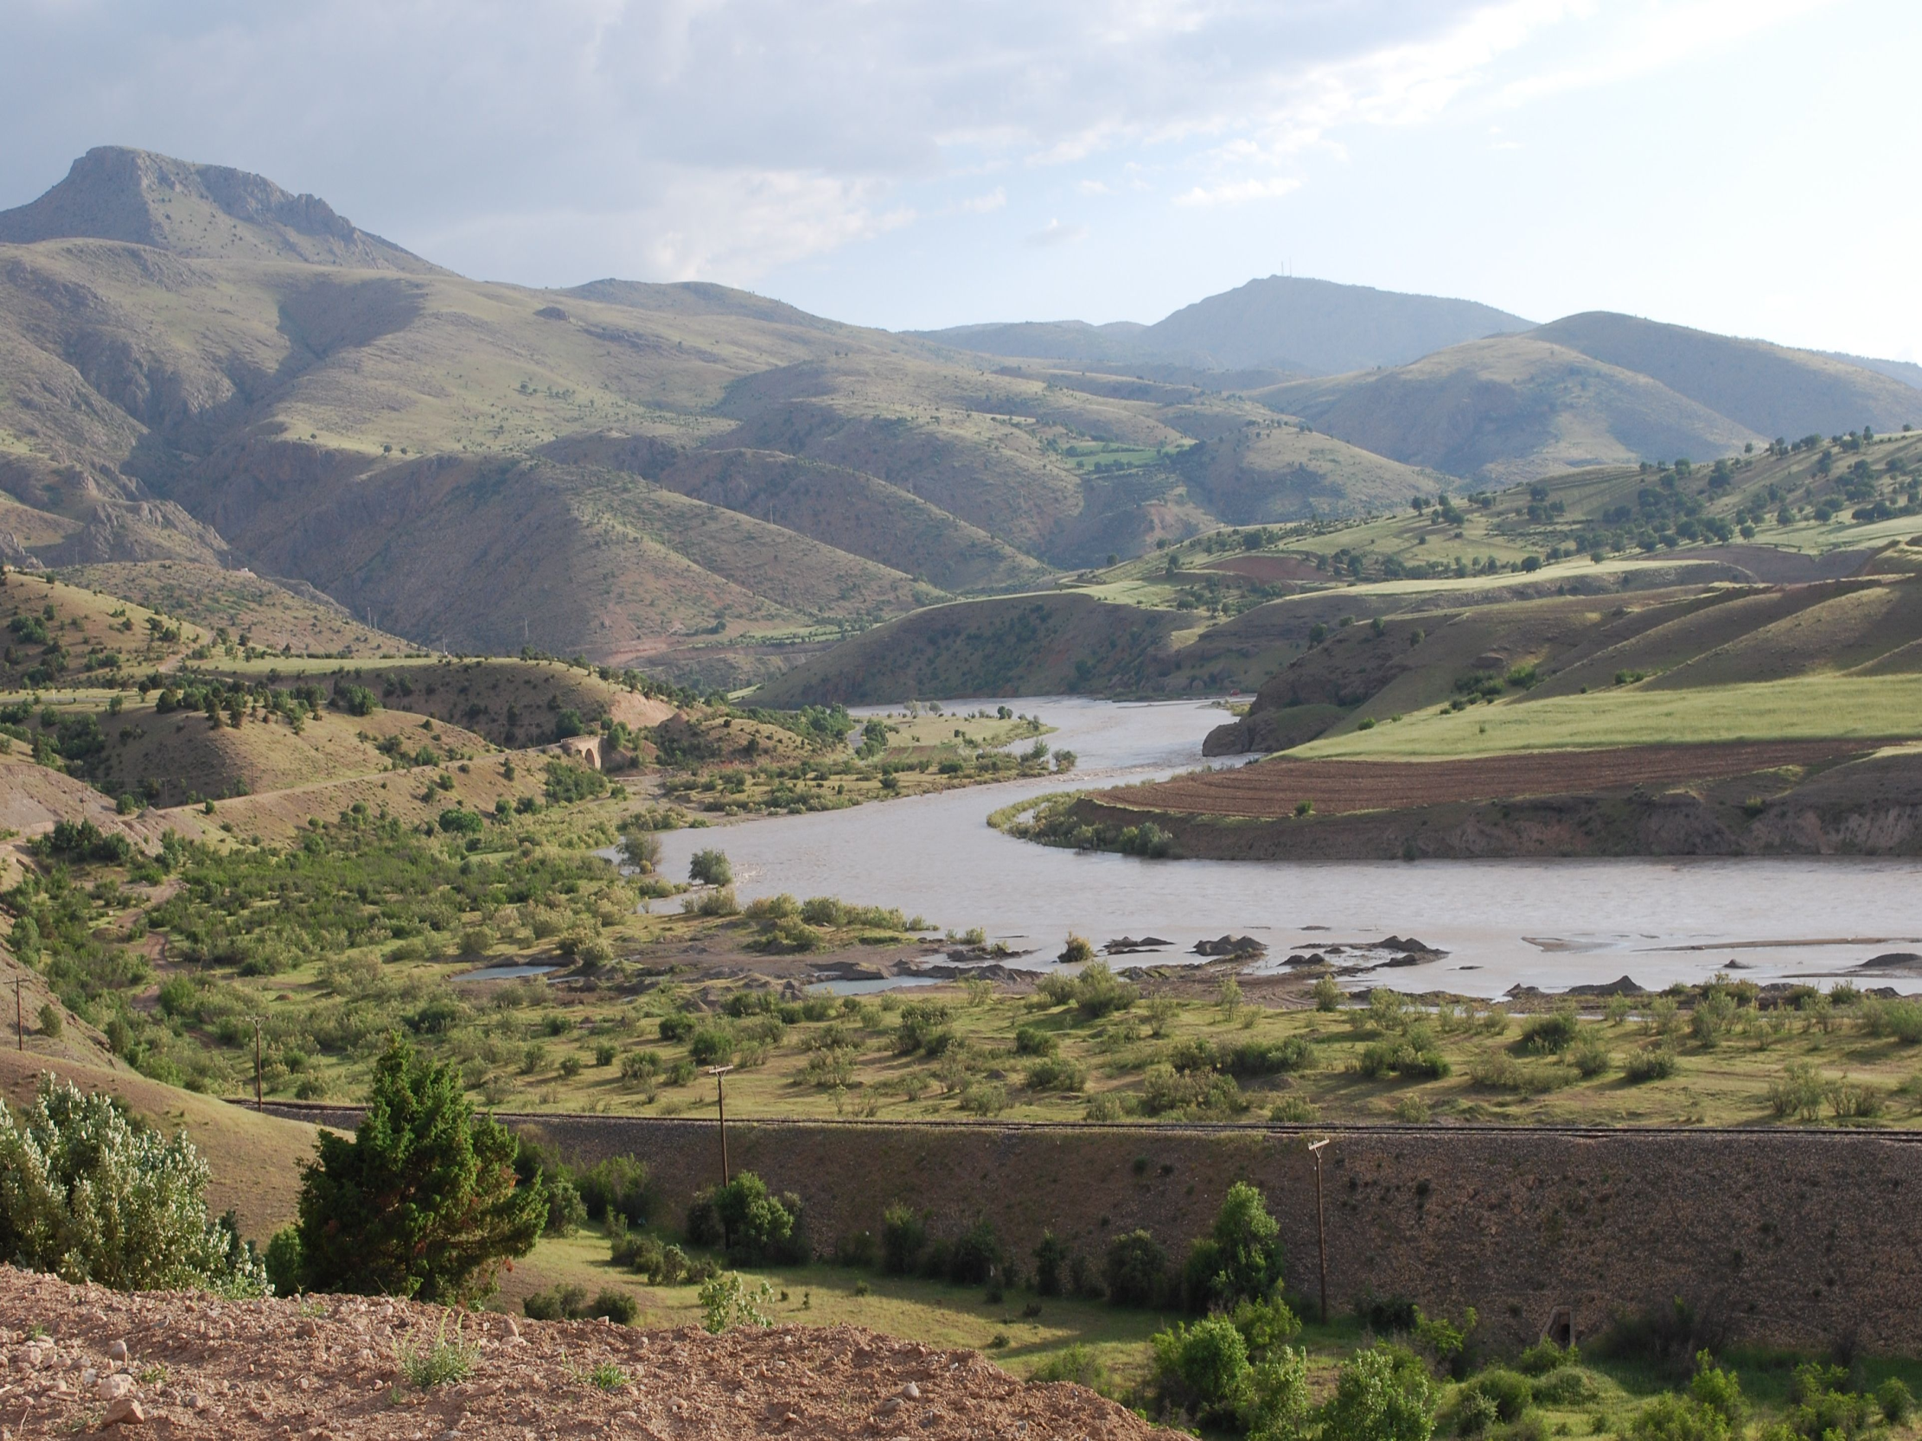

Slide 12
Middle East Physical Features
3
Persian
Gulf
Notes:
Instructional Approach(s): The teacher should present the animated slide. The teacher can ask for student volunteers to name the identified physical feature. When ready, the teacher can click the mouse to reveal the answer. The students should record the correct name of the physical feature on their physical features map.

Slide 13
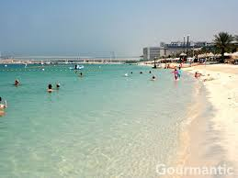
One view of the Persian Gulf

Slide 14
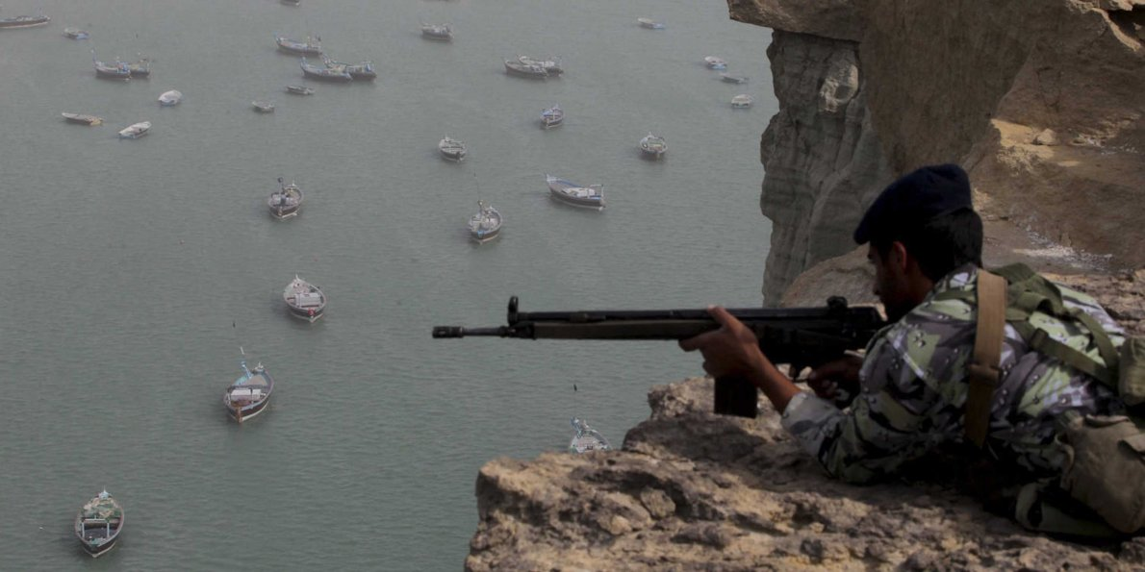
Another View

Slide 15
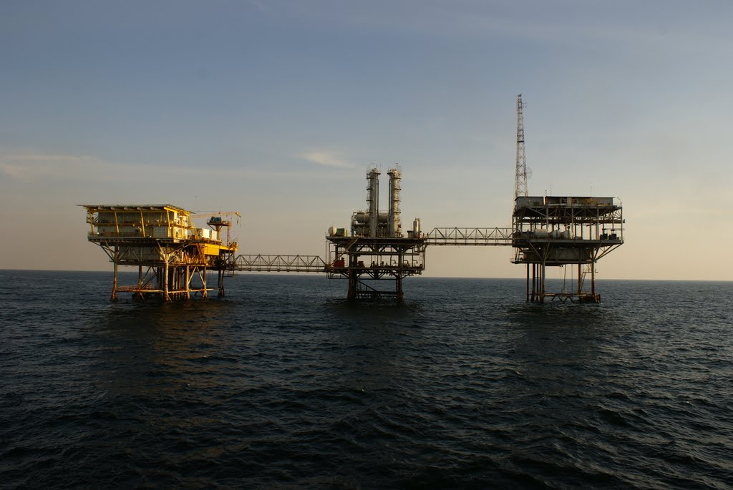
Oil Rig

Slide 16
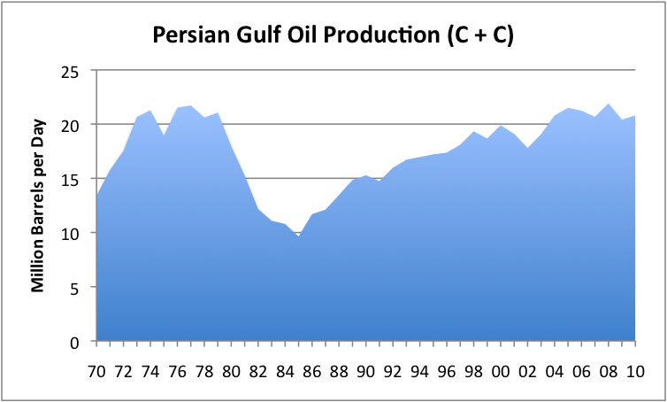

Slide 17
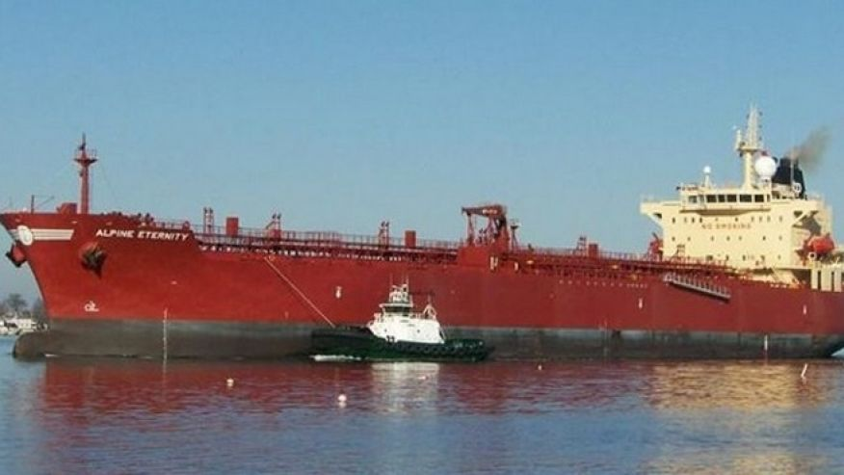
Oil Tanker

Slide 18

Middle East Physical Features
4
Strait of
Hormuz
Notes:
Instructional Approach(s): The teacher should present the animated slide. The teacher can ask for student volunteers to name the identified physical feature. When ready, the teacher can click the mouse to reveal the answer. The students should record the correct name of the physical feature on their physical features map.

Slide 19
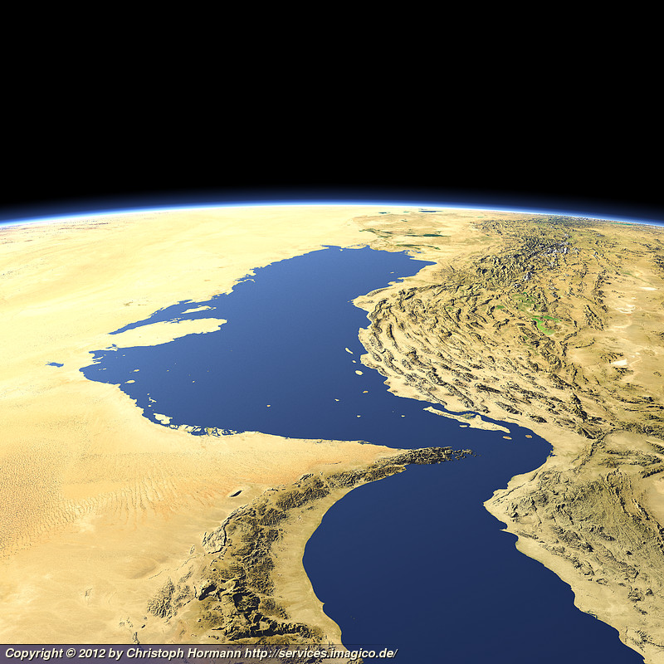
Notes:
Instructional Approach(s): The teacher should use the slide to show an illustration of the previous identified physical feature.

Slide 20
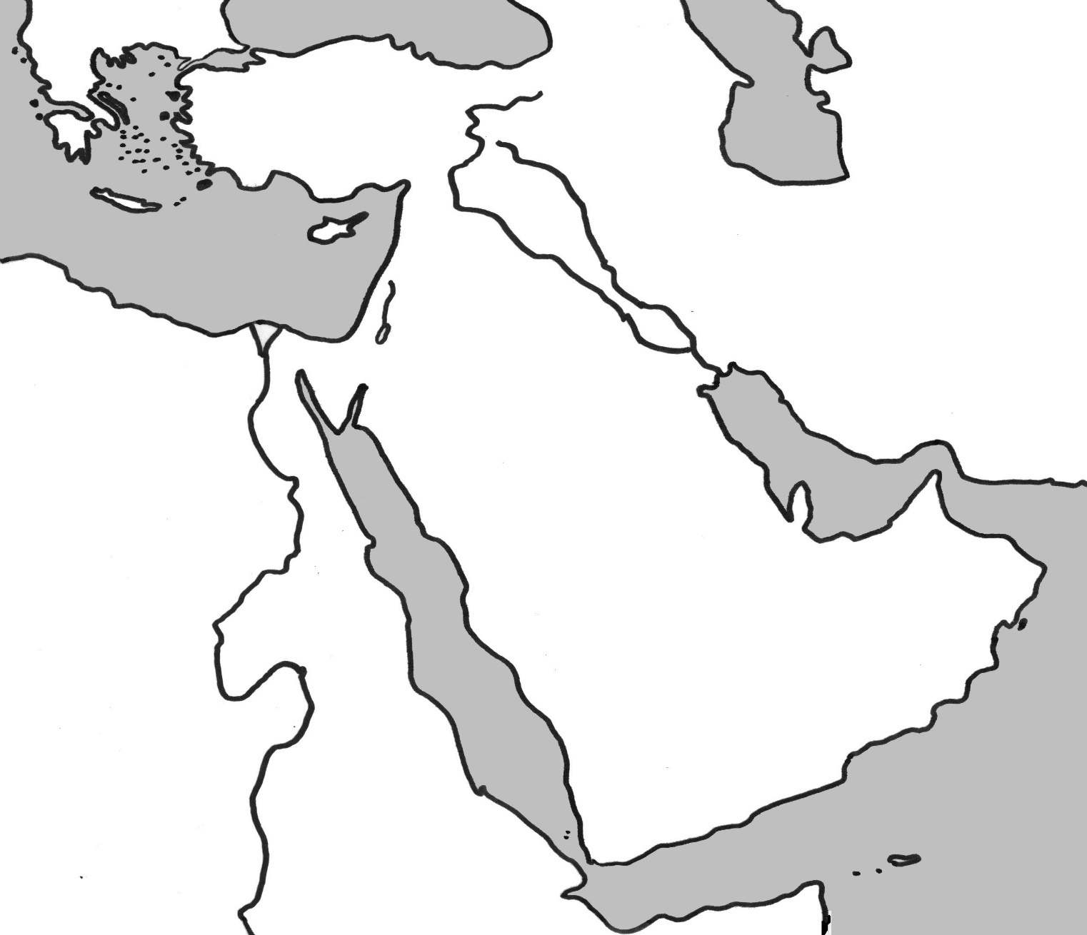
Middle East Physical Features
Arabian
Sea
5
Notes:
Instructional Approach(s): The teacher should present the animated slide. The teacher can ask for student volunteers to name the identified physical feature. When ready, the teacher can click the mouse to reveal the answer. The students should record the correct name of the physical feature on their physical features map.

Slide 21
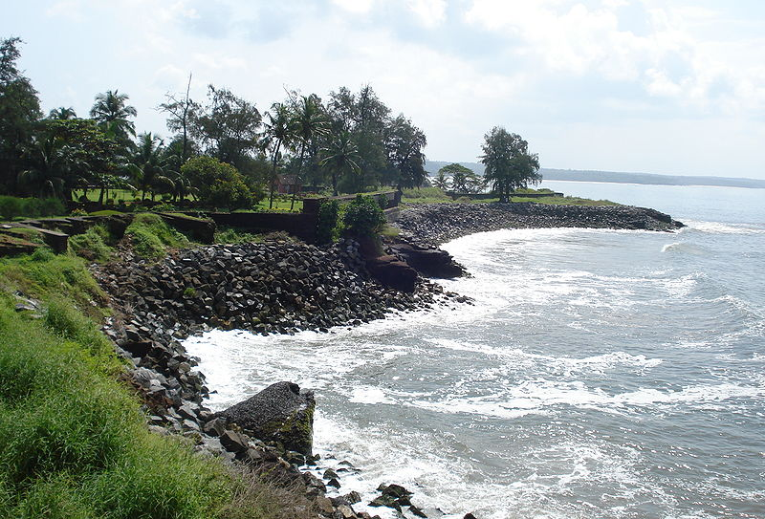
Notes:
Instructional Approach(s): The teacher should use the slide to show an illustration of the previous identified physical feature.

Slide 22
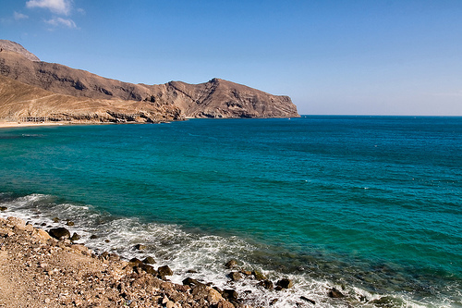
Notes:
Instructional Approach(s): The teacher should use the slide to show an illustration of the previous identified physical feature.

Slide 23
Middle East Physical Features
6
Red Sea
Notes:
Instructional Approach(s): The teacher should present the animated slide. The teacher can ask for student volunteers to name the identified physical feature. When ready, the teacher can click the mouse to reveal the answer. The students should record the correct name of the physical feature on their physical features map.

Slide 24
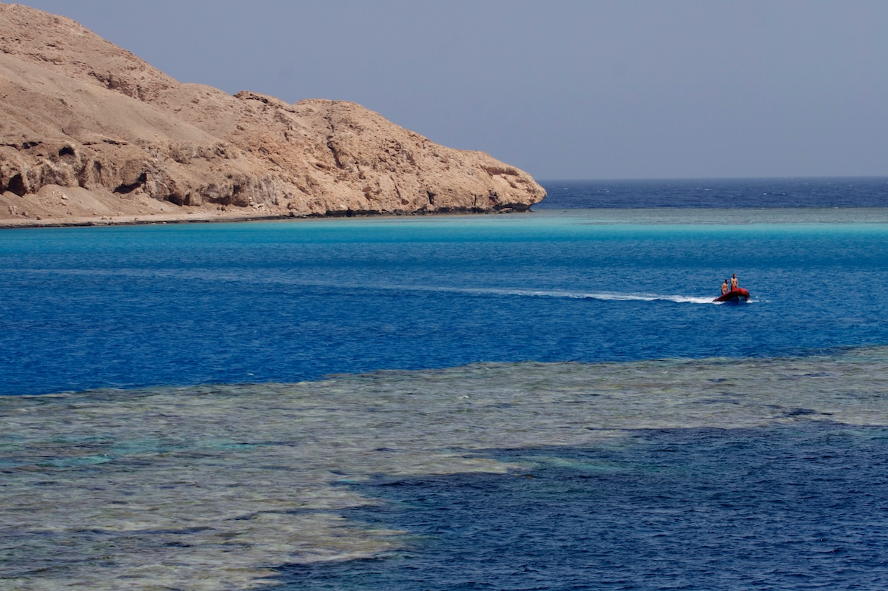

Slide 25
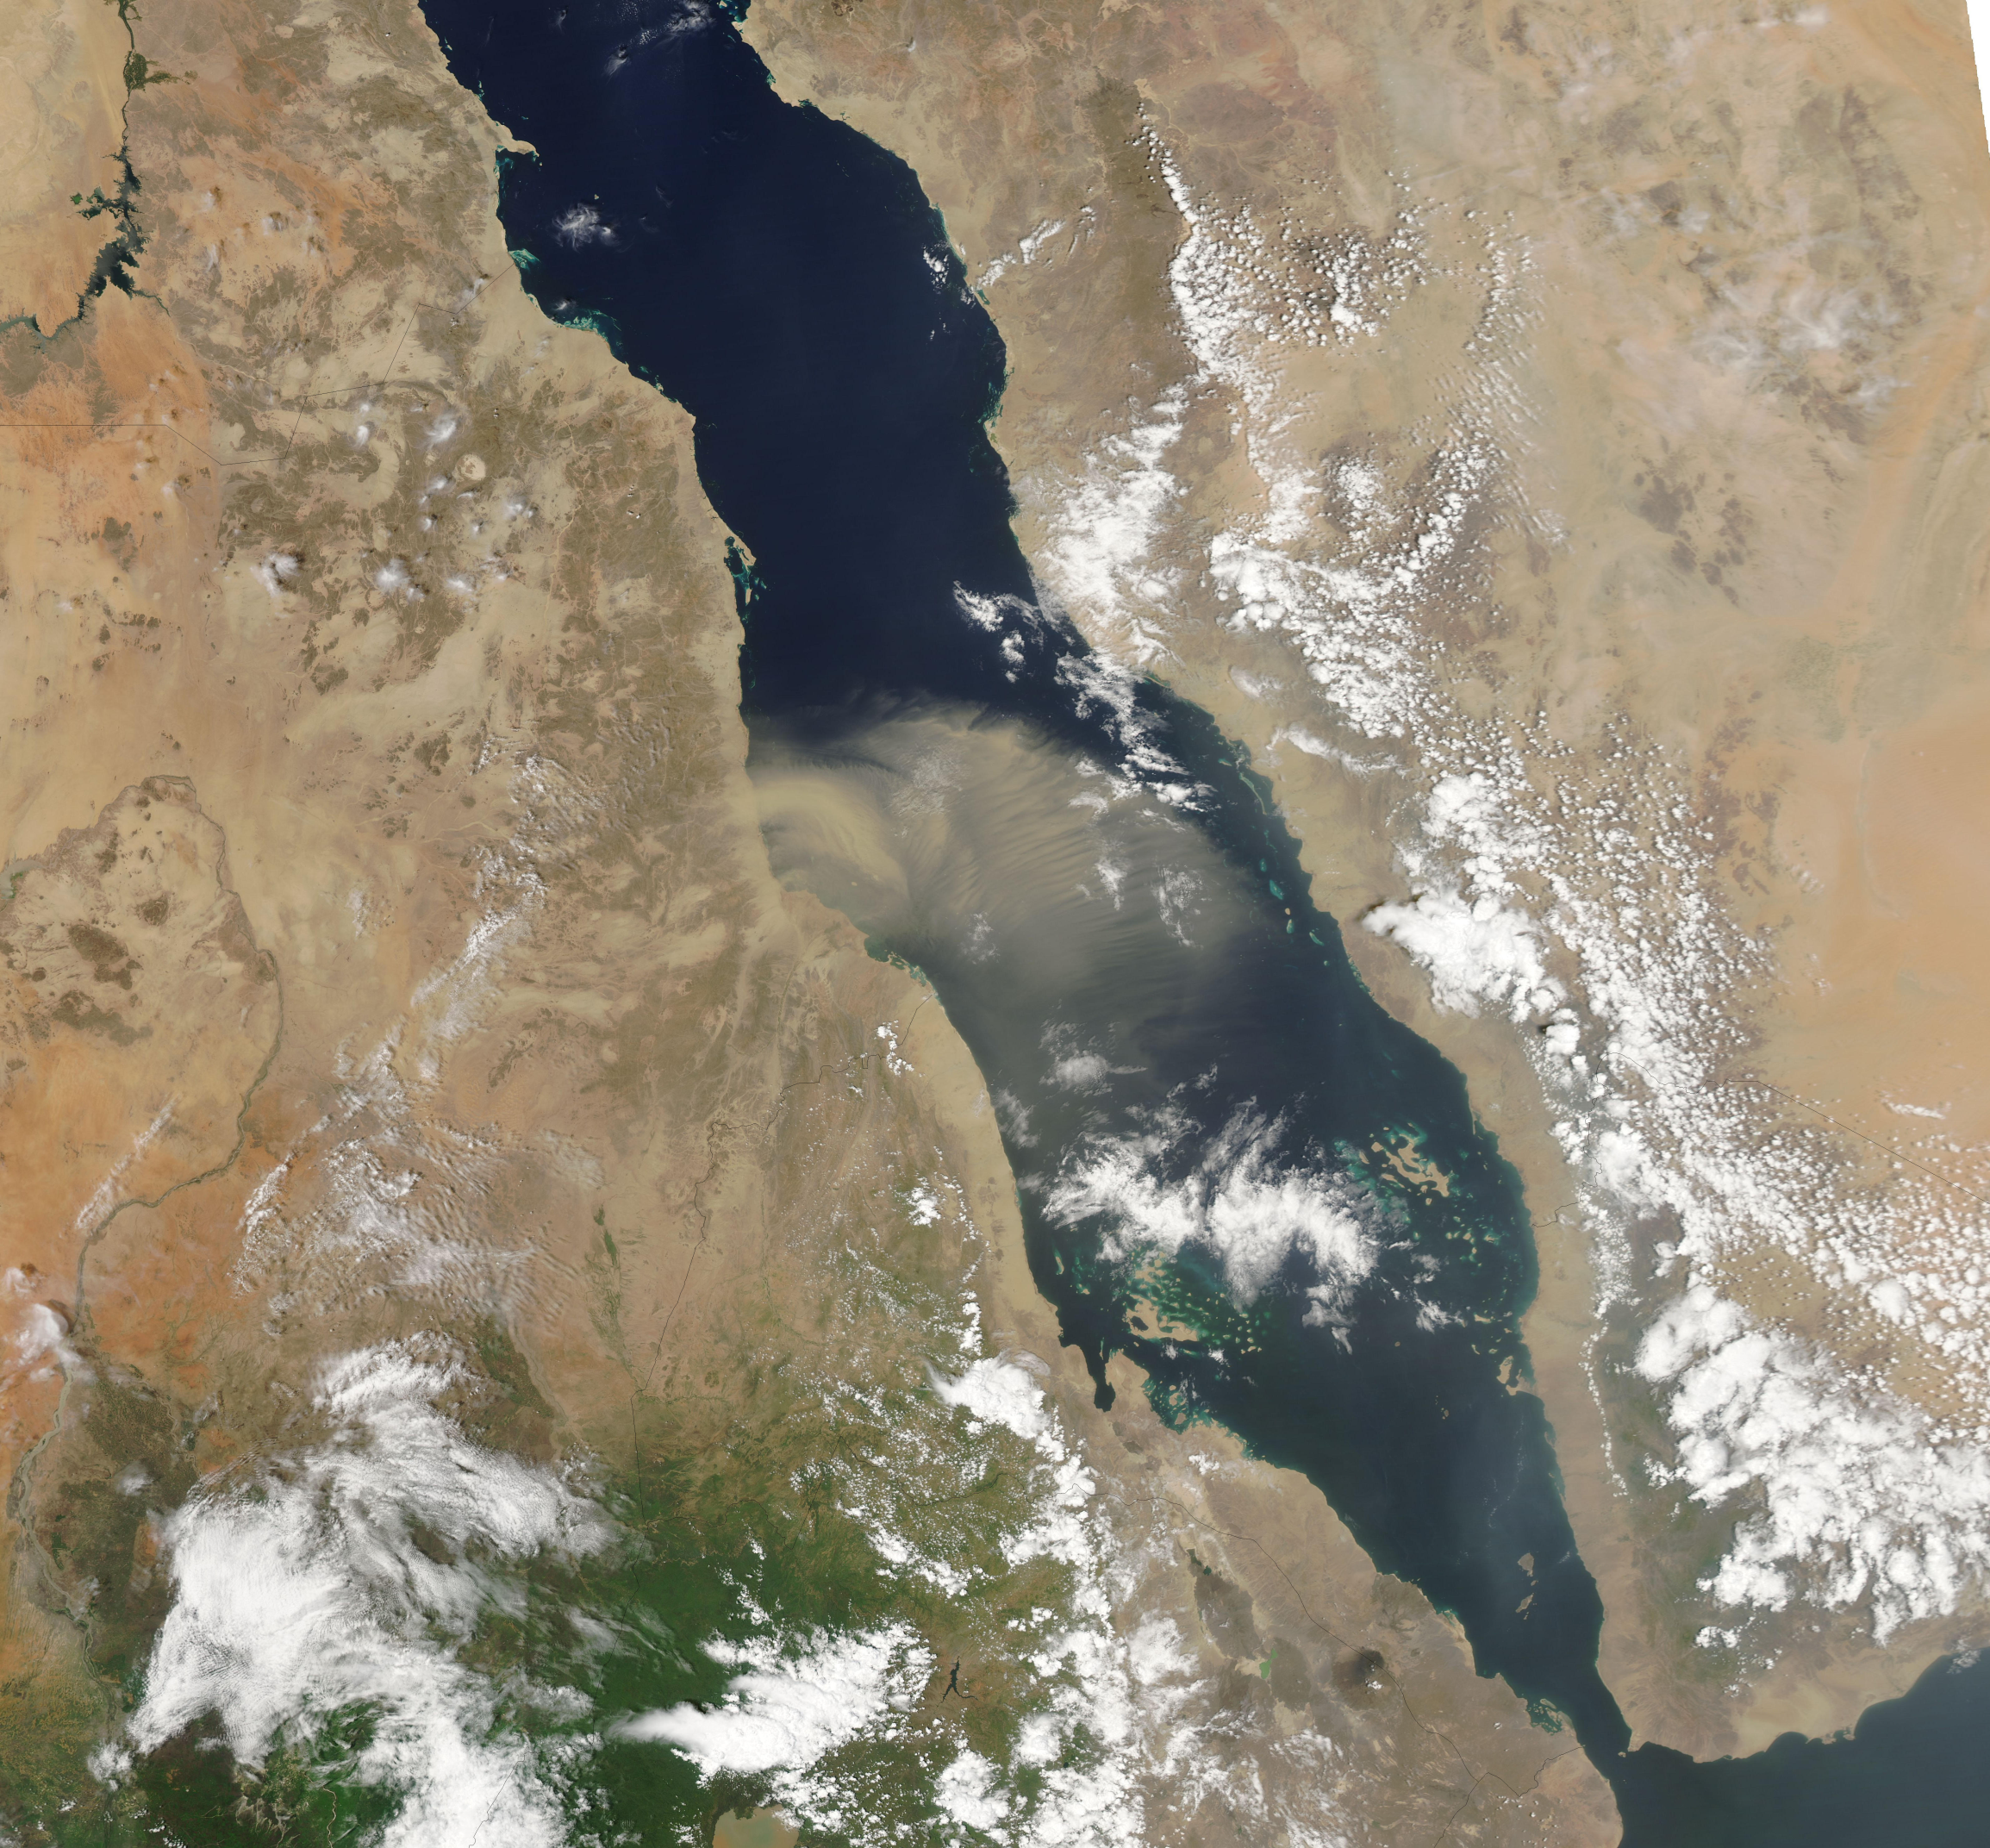
Notes:
Instructional Approach(s): The teacher should use the slide to show an illustration of the previous identified physical feature.

Slide 26
Middle East Physical Features
7
Suez
Canal
Notes:
Instructional Approach(s): The teacher should present the animated slide. The teacher can ask for student volunteers to name the identified physical feature. When ready, the teacher can click the mouse to reveal the answer. The students should record the correct name of the physical feature on their physical features map.

Slide 27
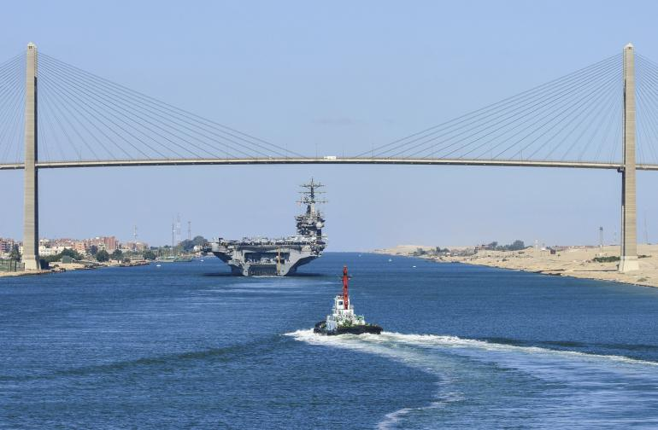
Notes:
Instructional Approach(s): The teacher should use the slide to show an illustration of the previous identified physical feature.

Slide 28
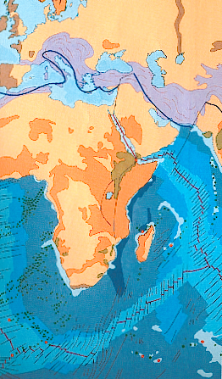
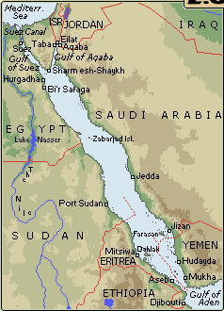
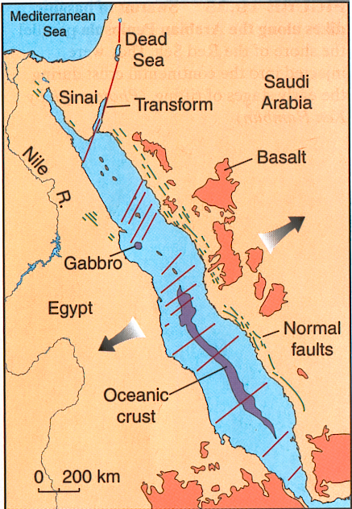
Geology

Slide 29
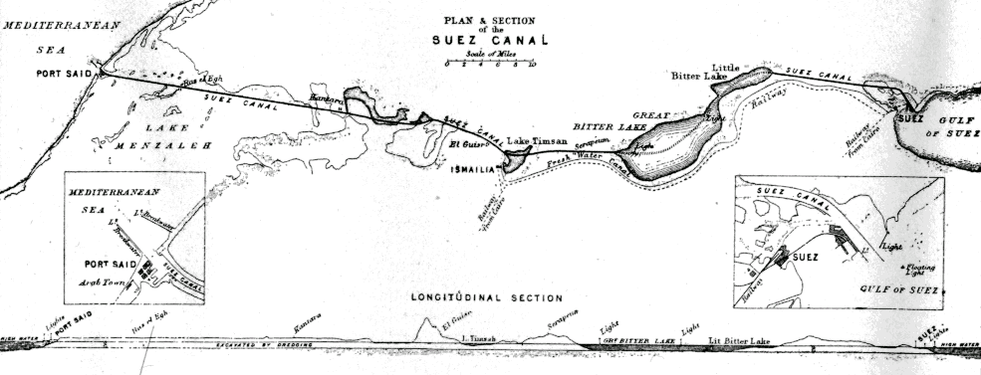
N

Slide 30
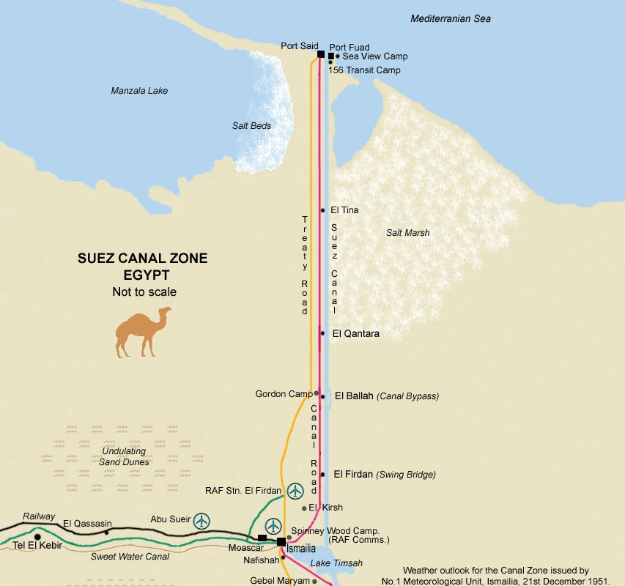

Slide 31
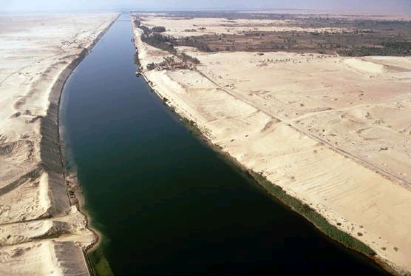

Slide 32
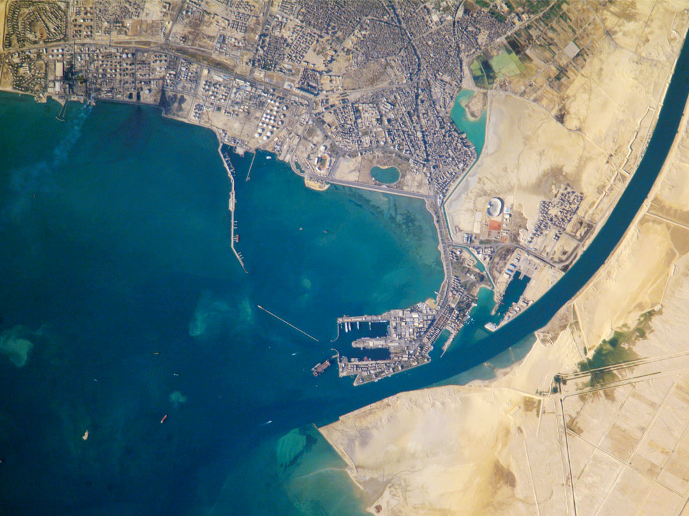
Notes:
Instructional Approach(s): The teacher should use the slide to show an illustration of the previous identified physical feature.

Slide 33
Middle East Physical Features
8
Jordan River
Notes:
Instructional Approach(s): The teacher should present the animated slide. The teacher can ask for student volunteers to name the identified physical feature. When ready, the teacher can click the mouse to reveal the answer. The students should record the correct name of the physical feature on their physical features map.

Slide 34
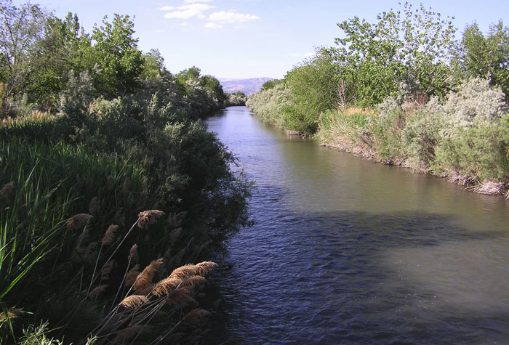
Notes:
Instructional Approach(s): The teacher should use the slide to show an illustration of the previous identified physical feature.

Slide 35
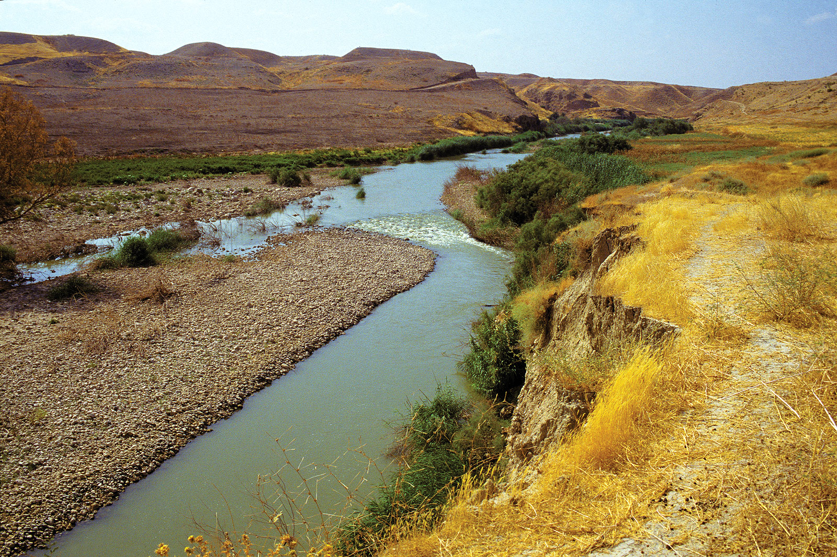

Slide 36


Distributed Summarizing:
Imagine that you took a vacation to the Middle East and followed the path shown on the map below. Write a letter to a friend describing the physical features that you visited or crossed during your trip.
Starting
Point
Ending Point
Notes:
Instructional Approach(s): Each student should complete the distributed summarizing task [linked on the resource page]. The teacher should use the task to determine student mastery and if differentiation is needed before moving on to the nations of the Middle East.

Slide 37
Use your labeled physical features map to:
*Mark each feature on a small map
*Write a description of where the feature is located in the Middle East
*Write a method for remembering the location of the physical feature
Middle East Physical Features Foldable
Notes:
Instructional Approach(s): The Middle East Foldable [linked on the resource page] can be used to reinforce the location of the physical features of the Middle East.

Slide 38
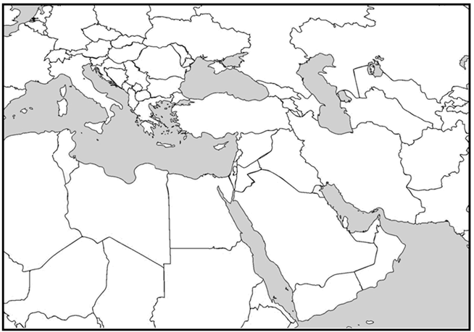
Nations of the Middle East
Notes:
Instructional Approach(s): The teacher should give each student a copy of the Nations of the Middle East Map [linked on the resource page] to label the nations of the Middle East during the lesson.

Slide 39
Saudi Arabia
1
Notes:
Instructional Approach(s): The teacher should present the animated slide. The teacher can ask for student volunteers to name the country. When ready, the teacher can click the mouse to reveal the answer. The students should record the correct name of the nation on their map.

Slide 40
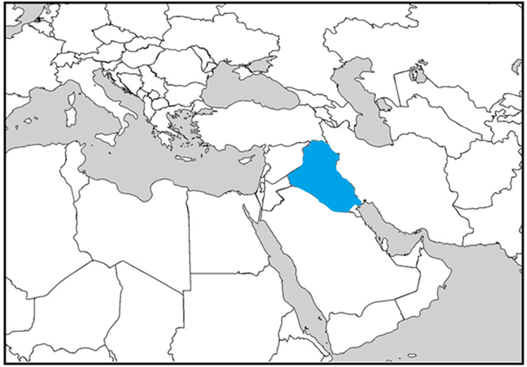
Iraq
2
Notes:
Instructional Approach(s): The teacher should present the animated slide. The teacher can ask for student volunteers to name the country. When ready, the teacher can click the mouse to reveal the answer. The students should record the correct name of the nation on their map.

Slide 41
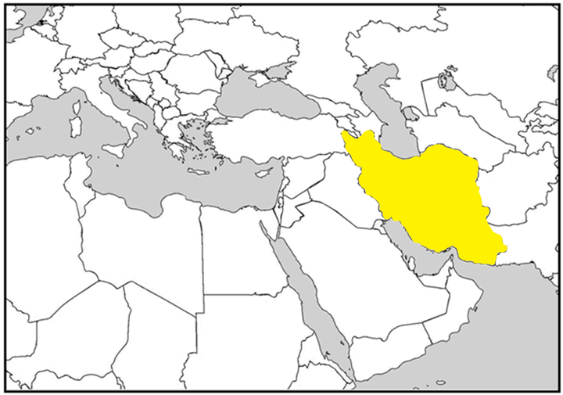
Iran
3
Notes:
Instructional Approach(s): The teacher should present the animated slide. The teacher can ask for student volunteers to name the country. When ready, the teacher can click the mouse to reveal the answer. The students should record the correct name of the nation on their map.

Slide 42
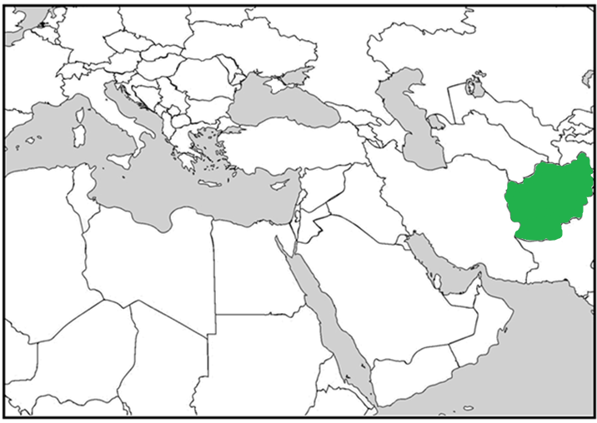
Afghanistan
4
Notes:
Instructional Approach(s): The teacher should present the animated slide. The teacher can ask for student volunteers to name the country. When ready, the teacher can click the mouse to reveal the answer. The students should record the correct name of the nation on their map.

Slide 43
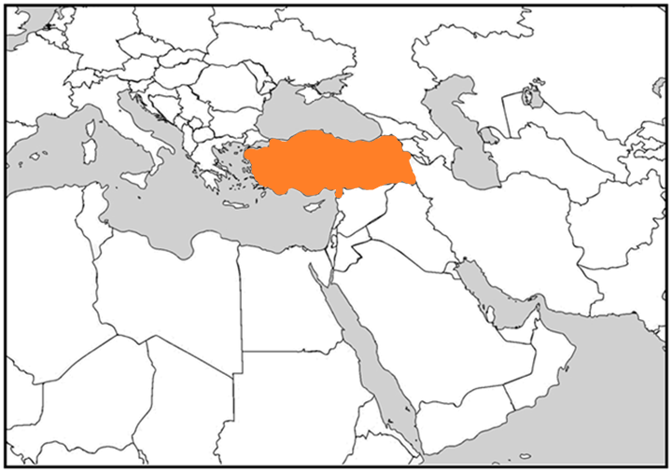
Turkey
5
Notes:
Instructional Approach(s): The teacher should present the animated slide. The teacher can ask for student volunteers to name the country. When ready, the teacher can click the mouse to reveal the answer. The students should record the correct name of the nation on their map.

Slide 44
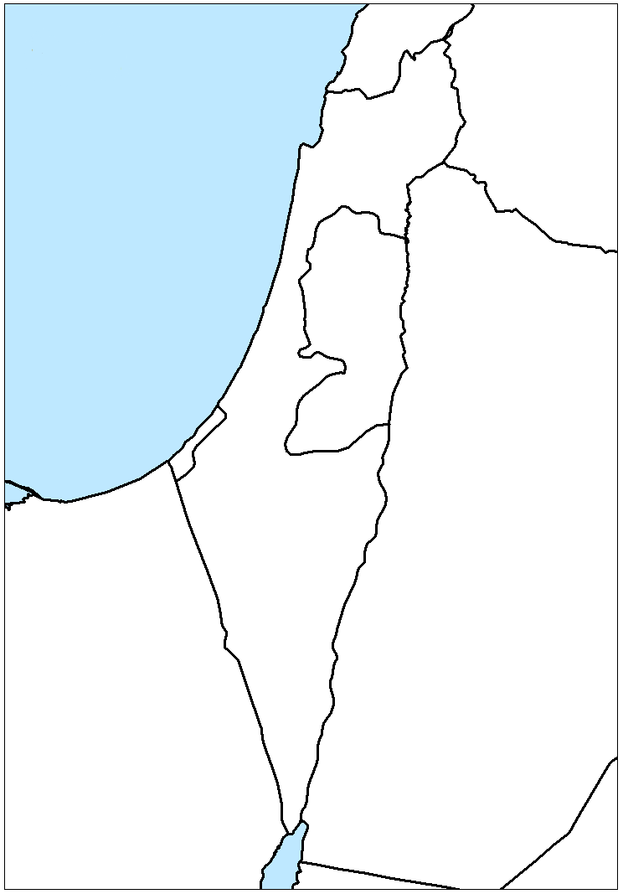
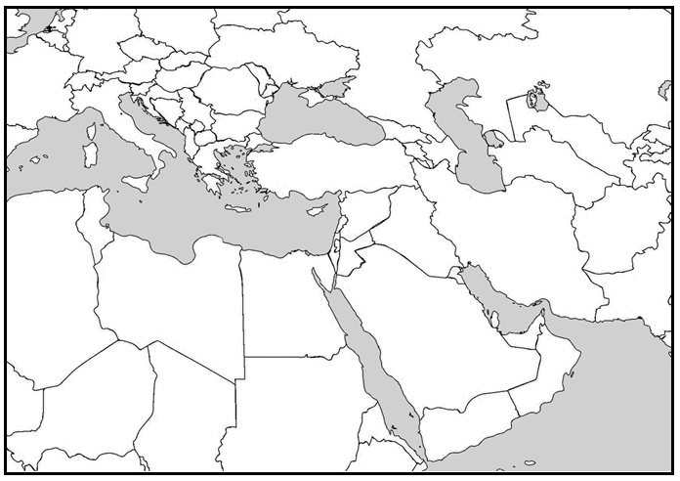
Nations of the Middle East
Notes:
Instructional Approach(s): The teacher should present the animated slide. The teacher can ask for student volunteers to name the country. When ready, the teacher can click the mouse to reveal the answer. The students should record the correct name of the nation on their map.

Slide 45
Gaza Strip
6
Notes:
Instructional Approach(s): The teacher should present the animated slide. The teacher can ask for student volunteers to name the country. When ready, the teacher can click the mouse to reveal the answer. The students should record the correct name of the nation on their map.

Slide 46
Israel
7
Notes:
Instructional Approach(s): The teacher should present the animated slide. The teacher can ask for student volunteers to name the country. When ready, the teacher can click the mouse to reveal the answer. The students should record the correct name of the nation on their map.

Slide 47
West Bank
8
Notes:
Instructional Approach(s): The teacher should present the animated slide. The teacher can ask for student volunteers to name the country. When ready, the teacher can click the mouse to reveal the answer. The students should record the correct name of the nation on their map. The standard does not include the West Bank; however, you may want students to understand the location of the West Bank in relation to the Gaza Strip and Israel and how it connects to the history standards.

Slide 48
Jordan River
Notes:
Instructional Approach(s): The teacher should present the animated slide. The teacher can ask for student volunteers to name the country. When ready, the teacher can click the mouse to reveal the answer. The students should record the correct name of the nation on their map.

Slide 49
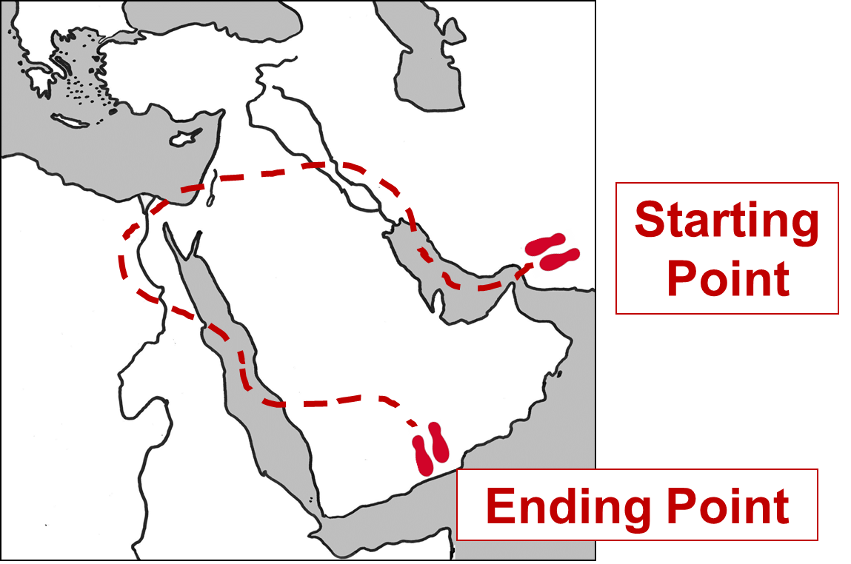
Distributed Summarizing: Use your Distributed Summarizing vacation in the Middle East handout. Identify the nations that you would have traveled through on your vacation. Write or draw arrows to identify the countries. Which countries did you not visit?
Notes:
Instructional Approach(s): Each student should complete the distributed summarizing task [linked on the resource page]. The teacher should use the task to determine student mastery and if differentiation is needed before moving on in the lesson.

Slide 50
Use the Middle East Physical Features and Nations PPT Review to quiz students on the location of the Middle East’s Physical Features and Nations.
Notes:
Instructional Approach(s): The teacher can use the Middle East Physical Features and Nations PPT Review [linked on the resource page] as a formative assessment and/or review for the lesson.

Slide 51
Summarizing Strategy
Notes:
Instructional Approach(s): Each student should complete the summarizer. The teacher should use the summarizer to determine the level of student mastery and if differentiation is needed.

