Slide 1
Inspiration: Help Our Friend, Mellon
By: Kaleb, Jordan, Nicholas and Joshua McNabb

Slide 2
Purpose
Mellon is a single mother of two, both attending school. She sells Irish potatoes, a business that sustains her family and that also keeps her children in school.
Her goal is a loan of $400 to help buy more Irish potatoes for selling in the Easter season to raise income so that she can provide for her children.
We need your help audience to support us in giving the effort to give our friend, Mellon $400.

Slide 3
Why are we choosing Mellon
There are main reason why we chose Mellon.
She cares about her children staying in school
Uganda is a poor place that is suffering, and people need help.
Irish potatoes are the only things that can support her family.

Slide 4
Care for the children
For her to get the money she needs, she needs to be able and use that money to take care for the children.
Her business is the only way to support her children going to school.
She is hopeful that with increased inventory, her sales will increase, thereby bringing in more income to fend for her children.
Mellon wants her children to stay and do well in school for them to do better in life.

Slide 5
Uganda
Another reason is that Uganda is a poor place that is suffering, and people need help.
Average annual income-$1,800, that is not a lot of money compared to the United States which is $46,000
Uganda covers most of lake Victoria and has fertile land nearby, however, only 15% of the population can afford the land.
19.7% of the population of Uganda lives in poverty.

Slide 6
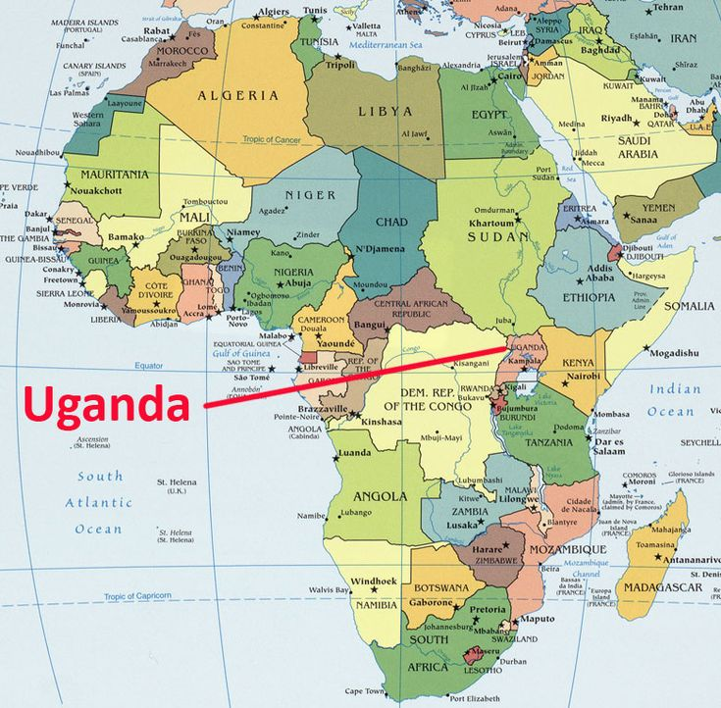
Uganda
This is where Uganda is. Uganda is in the near-center of Africa.

Slide 7
Irish Potatoes
Mellon sells Irish potatoes, which is a business that sustains her family. "These Irish potatoes are a big hit in Uganda", Mellon says
She applied for a loan of 1,500,000 Ugandan Shillings, which is only about $400 in U.S.
Mellon needs money to buy more Irish potatoes to sell and need to lower her costs in a bid to improve her sales.

Slide 8
Do the RIGHT THING!
Choose Mellon, and you will make a difference in this world by just giving a small donation of $100. This donation is critical, her kids rely on it because it determines if they can stay in school and get and education.

Slide 9
Thank you for your attention...
We would really appreciate you helping our friend Mellon and having your attention!

