Slide 3
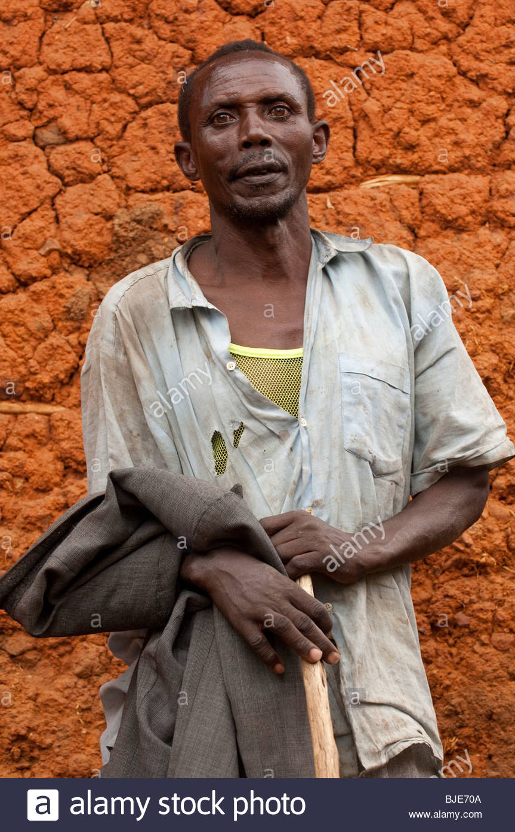
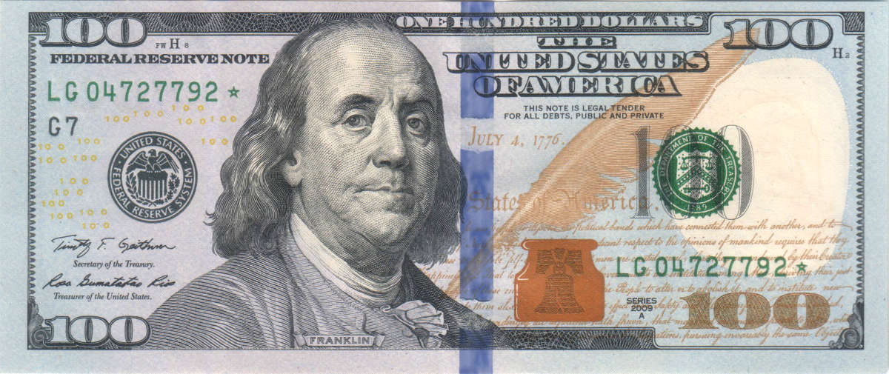
WE WOULD LIKE TO USE KIVA TO MAKE A $100 LOAN TO MAURICE FROM RWANDA

Slide 4
GIVING A HAND UP INSTEAD OF A HANDOUT
THIS IS MAURICE…HE IS A RANCHER
As Maurice pays back his $10,000 to Kiva, We get our $100 back into the Kiva lender account, $2.77 per month for 36 months!!
Maurice’s farm gains more revenue as a result of his larger herd, and he pays back the $10,000 over the coming 36 months.
If we lend $100 to Maurice, and 100 more individual lenders from around the world join us, that makes $10,000. This will allow Maurice to buy breeding stock (other bulls) for his herd.

Slide 5
THAT IS MONEY WELL SPENT

Slide 6
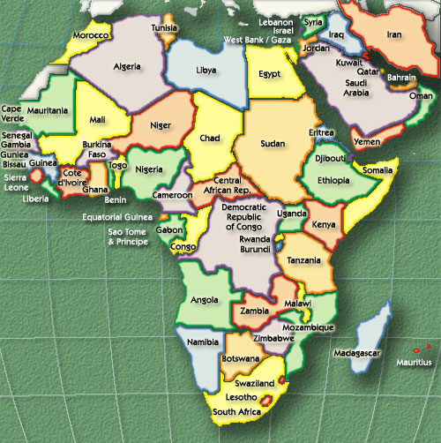
This is Rwanda

Slide 7
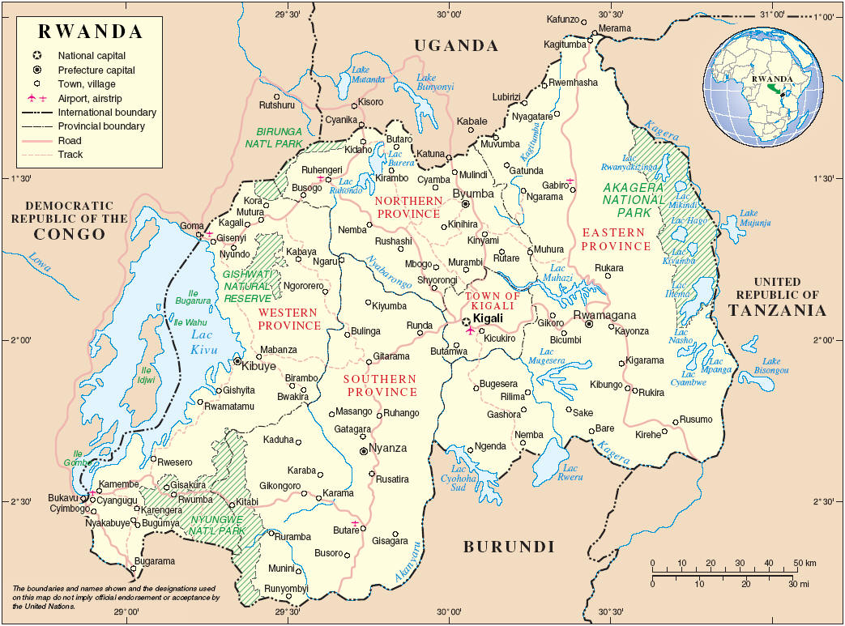
It is a small country in the middle of Africa.

Slide 8
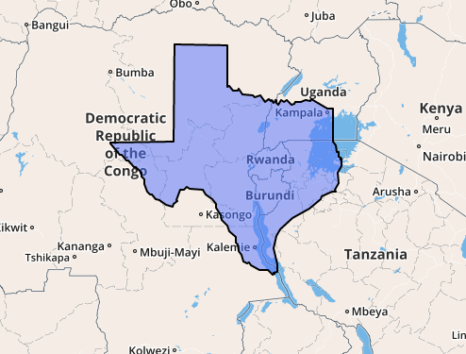
Rwanda is about 26 times smaller than Texas

Slide 9
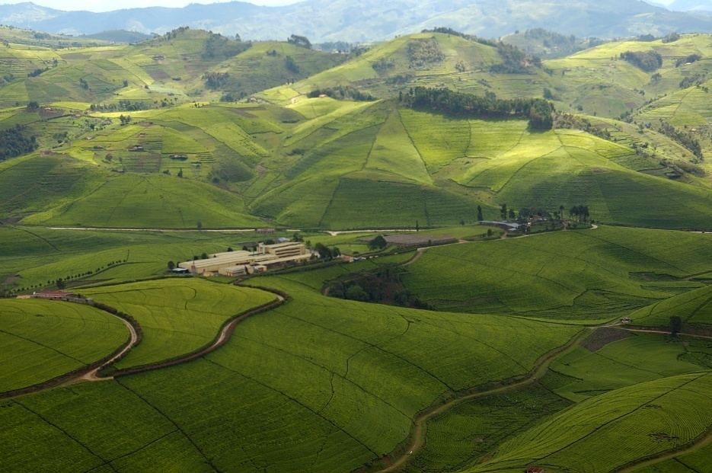
Rwanda’s economy is mostly agricultural

Slide 10
Background on Rwanda (remind you of Sudan?)
The Rwandan population is made up of two groups, the Hutu’s and the Tutsi’s.
Most of the Rwandan population belong to the Hutu ethnic group, traditionally crop-growers.
herdsmen - from northern Africa.
For 600 years the two groups shared the business of farming, essential for survival, their language, heir culture, and their nationality.
Now 600 years later, the Tutsis tended to be landowners and hold power and Hutus the people who worked the land.
Tutsi (left) and Hutu (right) men standing together.

Slide 11
Old Tensions Boil Over
Since the 1950s the Hutu felt resentful of the Tutsi.
Many conflicts occurred.
In 1994 Hutu’s began a massacre against Tutsi people.

Slide 12
The Genocide
The Hutu militia, at one point 30,000 people strong, slaughtered any Tutsi that came in their path.
They encouraged regular Hutu civilians to do the same.
In some cases, Hutus were forced to kill their Tutsi neighbors.

Slide 13
Machetes were the weapon of choice
The militia used machetes to hack their victims to death in the interest of saving ammo.

Slide 14
The Death Toll
In the span of 100 days, an estimated 800,000 Tutsis were slaughtered.
They were killed primarily with knives, machetes, and clubs.
100,000 of these were children.

Slide 15
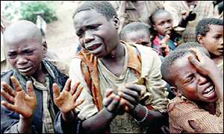

Slide 16
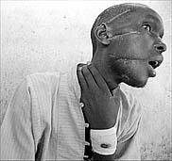

Slide 17
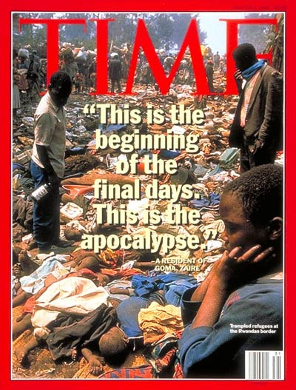

Slide 18
MAURICE IS A TUTSI.
HIS LIFE HAS BEEN HARD.
$100 could make it easier.
HE SURVIVED THE GENOCIDE and began farming cattle…he deserves a loan!!

Slide 19
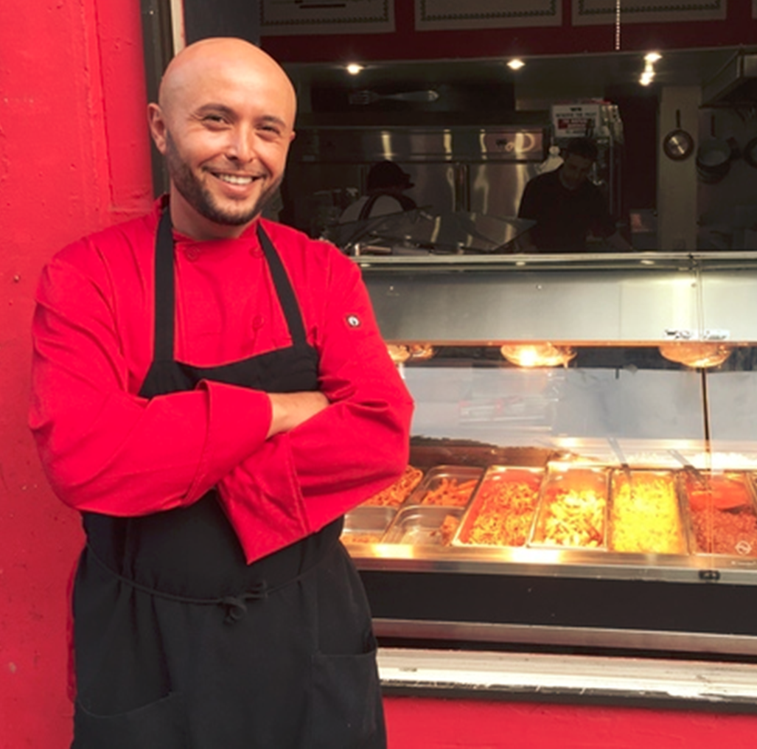
PAY IT FORWARD
Once our $100 is paid back, we can lend that same $100 to Amine, a restaurant owner here in Atlanta, so he can invest in new equipment.

Slide 20
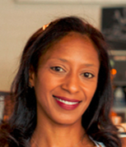
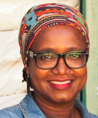
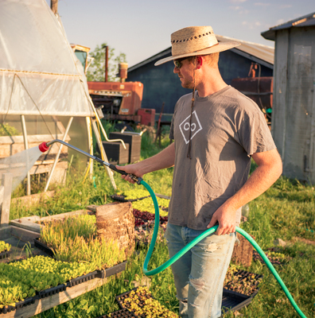
PAY IT FORWARD…AGAIN
We can continue recycling that same $100 over and over again, to impact dozens of entrepreneurs around the United States, and the wider world.

Slide 21
Do the right thing…choose Maurice!
Kiva is a great organization and our class will have to choose from many worthy candidates. The choice we make is important and can have a wonderful effect on people’s lives. Maurice is someone who we believe would be a great candidate for a $100.00 Kiva loan based on the goal he wants to achieve and the challenges that he and the country of Rwanda are facing. Please consider him and help make his life better.

