Slide 1
Umar has an issue
By Lindsey Mercer, Sophie Lopez, and John Telfer
And it can't be solved on his own.

Slide 2
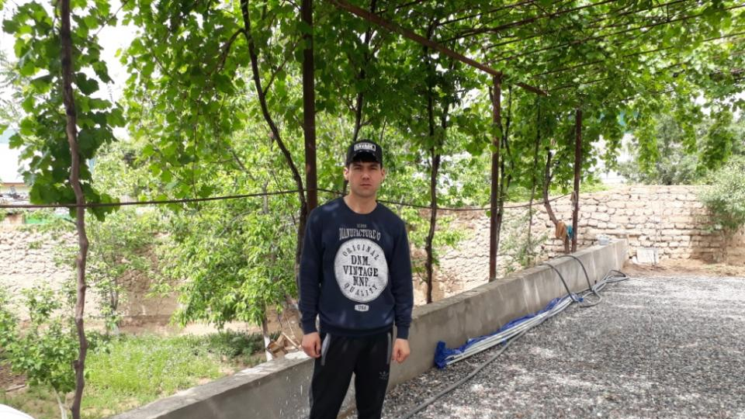
Meet Umar
This is Umar. He is 26 years old and has a beautiful wife and 2 adorable children.
He lived his life not necessarily in comfort, but with everything he needed to survive.
He now works out of his garage as a mechanic.

Slide 3
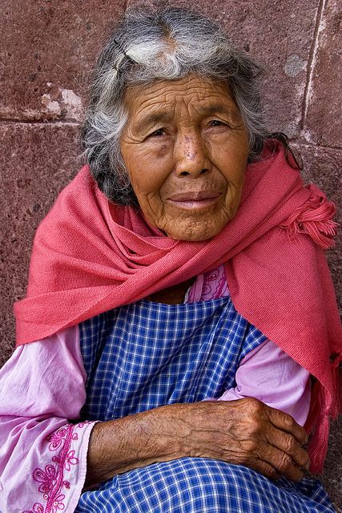
backstory
Umar lives in J. Rumy, Tajikistan. (which is in central Asia)
His mother began to get very very sick. Umar realized something serious was wrong. They took her to a local clinic and the doctor diagnosed her with a serious heart condition.
Unfortunately, being a mechanic in Tajikistan does not provide the adequate funds for hospital bills. Now Umar's mother is in dire need of a heart surgery.
She has trouble breathing and her heart doesn't function the way it should.
They need someone's help to get her back on her feet, so why not it be yours?

Slide 4
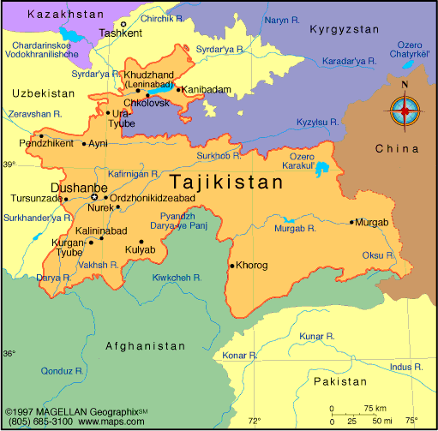
Tajikistan
Tajikistan is a very rural country in Central Asia with very low tourism rates.
The economy there is very poor and over 1/3 of its population is below the poverty line.
If you are wondering how low that population is, Georgia has a population of 10.43 million and the entire country of Tajikistan has a population of 8.1 million.
The annual income of Tajikistan is roughly $2,700 (for comparison, the U.S. income is about $51,017)

Slide 5
Medical attention there isn't what it should be
In rural areas such as Tajikistan, medical attention is constantly needed.
While clinics are fairly common, they are mostly found only in main towns.
The water quality there is also very poor. Giardia and many other water born illnesses plague the population. The tap water there is undrinkable.
According to numbeo.com, the satisfaction with cost of medical attention is 37.5% on average and the overall skill and competency of the staff is 25%.
If you loan the money for Umar's mother, you can fund the proper medical attention she needs for her condition

Slide 6
consequences
As of April 26, 2019; only 5 people have loaned their money to Umar for a total of $125.
If he wants to pay his mother's medical expenses, he will need a total of $1375 more.
There are only 26 days left on his MicroFund, and if he doesn't make the deadline then it could risk his mother's health and wellbeing.
What if Umar doesn't get the money? What if he can't pay the bills?
Then he will be in deep debt to the hospital and with 2 children, we don't want to make that an option.
If we are not able to provide Umar with this starter money, his entire family and future could go into poverty. Is that a chance you are willing to take?

Slide 7
In conclusion
Umar is in desperate need of this money and we believe him to be a reliable person.
Unlike many people on this site, Umar has a three-star risk rating when it comes to returning your money. Some people might see that and write him off as untrustworthy, but we see it the other way.
Well what about interest? Am I getting paid interest?
Yes.
Umar has an issue, and it can only be solved with your help.

Slide 8
Citations and sources
HTTPS://WWW.NUMBEO.COM/HEALTH-CARE/COUNTRY_RESULT.JSP?COUNTRY=TAJIKISTAN
HTTPS://TJ.USEMBASSY.GOV/U-S-CITIZEN-SERVICES/LOCAL-RESOURCES-OF-U-S-CITIZENS/DOCTORS/
HTTPS://WWW.LONELYPLANET.COM/TAJIKISTAN/HEALTH
HTTPS://WWW.ADVANTOUR.COM/TAJIKISTAN/GENERAL.HTM
HTTPS://WWW.KIVA.ORG/LEND/1744693

