Slide 1
Second Chance By: Khadija Buke, Blake Fortner, Megan Garner, and Eric Williams
.

Slide 2
Imagine living in a world where you are uncertain of everything. In a world where the only certainty is uncertainty. But surprisingly, you’re a lucky one. You’re not like the sad boys and girls you see walking in the market barefoot, skin and bone, empty eyes, and forever neglected stomachs. You will never go to school and will never manage to have a happy life because your family doesn’t have enough money to send you to school or you’re a girl and your brothers are always put first before you. For some people, they don’t have to imagine. This is the world they’ve lived in their entire lives and this is where they will stay unless given an opportunity for education.
Imagine…

Slide 3
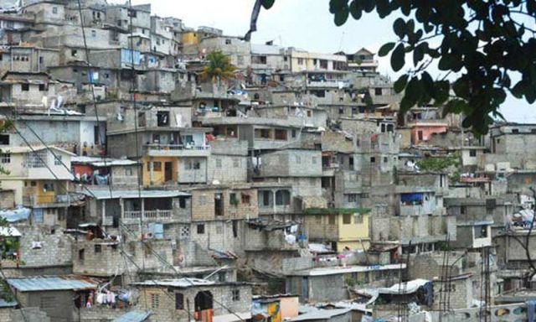
Pakistan
Pakistan is not known for their education. In fact, the literacy rate in Pakistan is only 50%. In Pakistan over half of the adolescents not enrolled in school are female. Getting an education is already difficult for those who are not able to meet the demands in money, however it doesn’t come any easier for females. Females are often threatened if they go to school. Extremist organizations like the Taliban have committed 642 attacks from 2009 to 2013 on educational institutions. In 2014, seven gunmen killed over 150 people in a public school in Peshawar. Through fear, the extremist organizations prevent many women and girls from going to school.

Slide 4
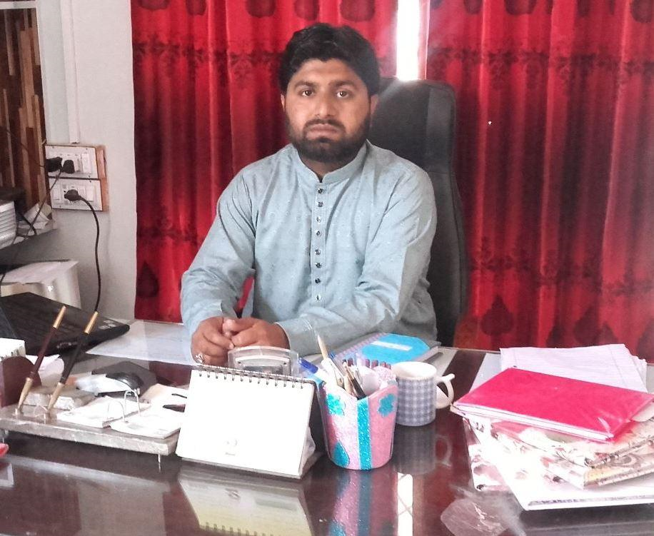
Ahsan
Ahsan is a 26-year-old man who opened his school with the belief that he could help the disadvantaged, low income students from urban slums gain a strong foothold in society by receiving a quality education. He has a total of 189 students enrolled in his school, out of which 51% are female. He is very devoted in guiding his students properly and then allowing them explore practical life themselves. He has requested a loan of 170,000 PKR for the construction of new classrooms and to also purchase furniture. Ahsan must have a lot of courage to do something so contradicting to his society. Not only will we be helping disadvantaged kids who may not be able to afford school, but we will also be helping girls who may not have even thought they could go to school.

Slide 5
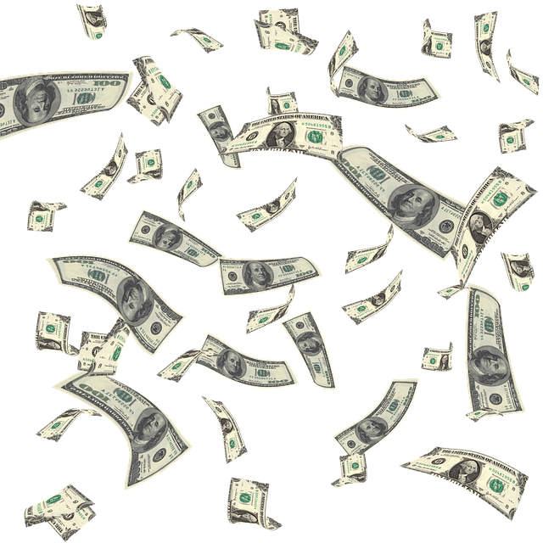
Let’s Talk Money
Ahsan originally wanted $1,225 USD to help build more classrooms and buy furniture, but after others have seen the amazing impact Ahsan wants to do, have contributed $825. Ahsan now only needs $400. So let’s lend a helping hand to Ahsan and help him make his dream a reality. By loaning to Ahsan, we will help dozens of girls whose dream is to live a happy, healthy life. Let's help that dream become a reality.

Slide 6
Let's Talk Money
Ahsan pays interest, which means that he will pay us back more than what we loan him. Ahsan also pays monthly.
It’s a win-win!

Slide 7
Okay, but what about risk?
Ahsan also has 4.5 stars risk rating, so there is a great possibility that he will pay you back.
The stars represent the likelihood of getting payed back with 1-star meaning unlikely and 5 stars meaning certain.

Slide 8
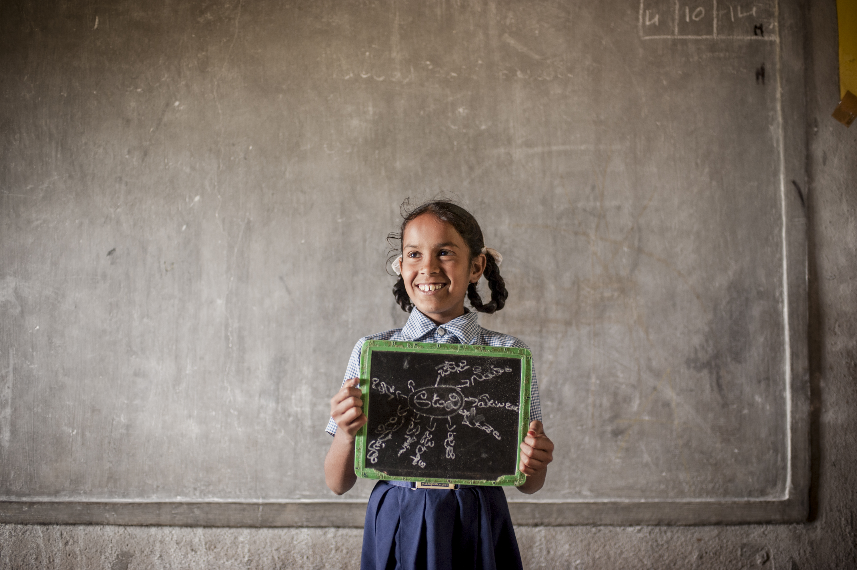
This is our chance to provide a better life to dozens of kids whose future ,not-too-long-ago, seemed bleak. This is our chance to give them a second chance. This is our chance to end the poverty cycle. Please consider us worthy of the $100 class loan. The children are depending on you!
Our Chance

