Slide 1
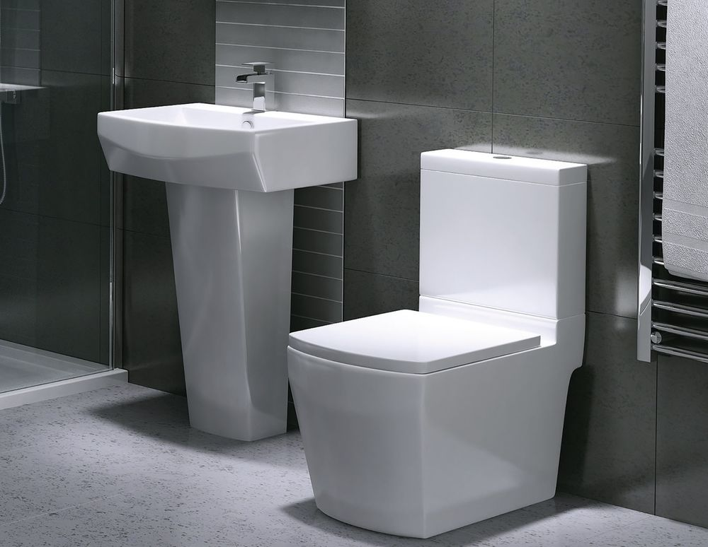
Make your choice
By: Taylor Alexander, Kaitlyn britt, brianna King, & Lucas Davis

Slide 2
As simple as a toilet As Americans, we are extremely spoiled. 97% of Americans have access to running water. In the Philippines 9 million people lack access water, while 19 million people lack sanitized water. That is around 38% of Filipinos, without access to safe, running water.

Slide 3
Our goal
Just $125
We are trying to persuade the seventh grade to loan Purificacion. She only needs $125 to change her life, and the $100 loan would help her get closer to her goal.

Slide 4
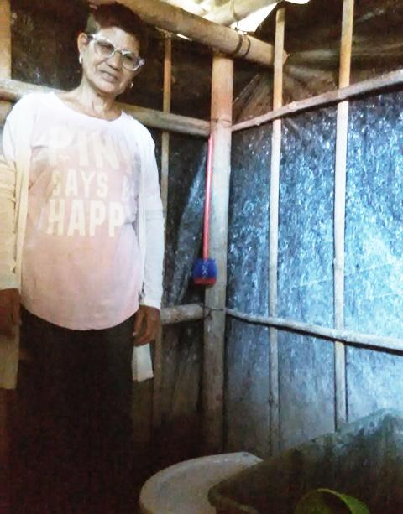
Get to know Purificacion
Purificacion supports six children. She is a widow and owns a general store in the Philippines. Purificacion requested an $8,000 loan through NWTF (Negro Women for tomorrow foundation) to build a sanitary toilet for her family. Purificacion is aware that by using the sanitary toilet, she is reducing health and hazard risks to her family and neighbors as well as promoting environment protection.

Slide 5
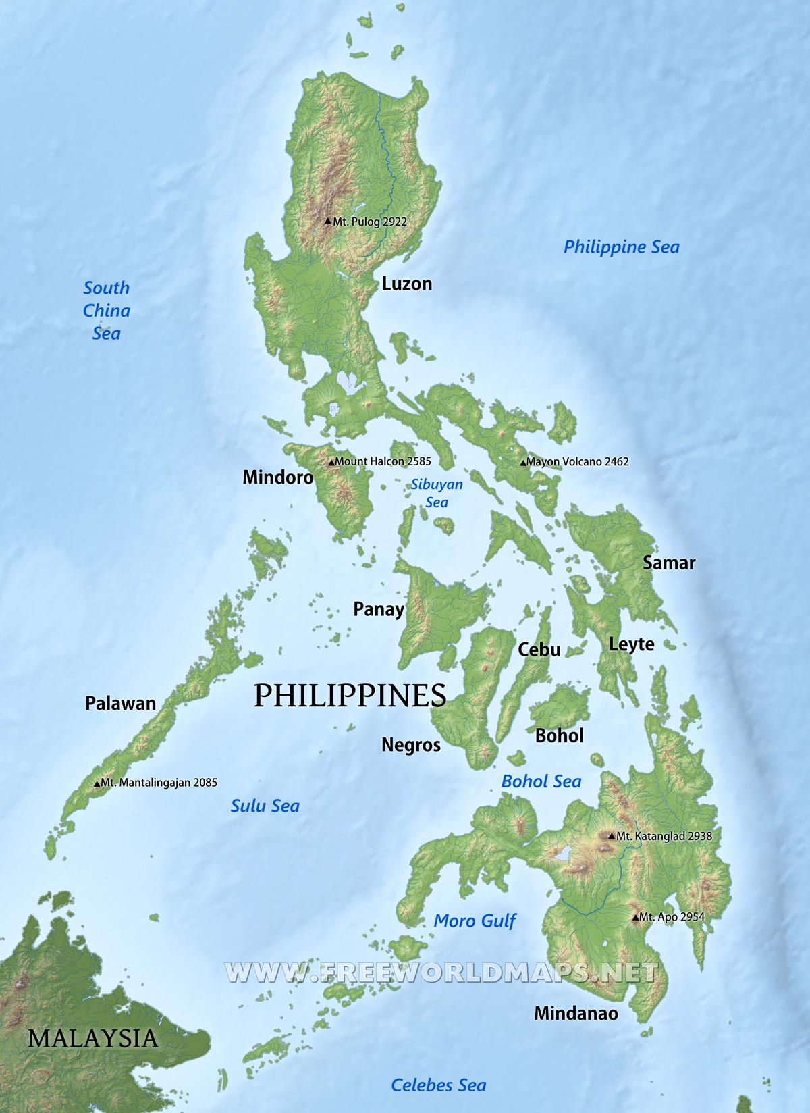
The Philippines
The Philippines are located south of Taiwan, east of the South China Sea, and east of the Pacific Ocean.
The islands are known for their tourism. They are also known for having a rich biodiversity. Its beaches, heritage towns and monuments, mountains, rainforests, islands and diving spots are part of the country's most popular tourist destinations.

Slide 6
More
The Philippines consist of over 7,000 islands.
Severe poverty leaves most of the Philippines desperate.
In 2015, 21.6% of Filipinos lived in poverty, placing the islands amongst the poorest Asian and Pacific countries.
Of the rough 100 million people population, most are living in rural areas.
Around 10% of the population lives on less than $2 a day.

Slide 7
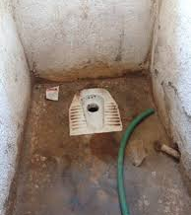
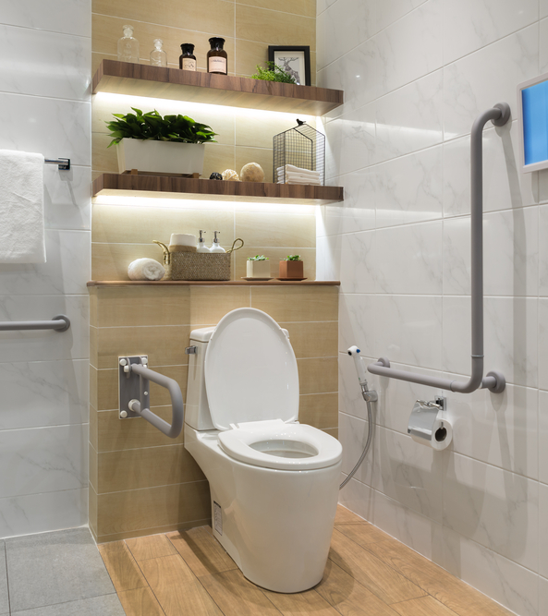
Your choice Can change her life.
Kiva is a very useful organization and the class may have a tough time choosing. The choice you make can change countless lives, such as Purificacion's. Plus, after your loan is paid back, you can keep giving, to change the world one person at a time. Purificacion is worthy of your choice. She has worked hard for years to support six kids, and a simple sanitary toilet could change her family's life. Try and put yourself in her shoes. Choose Purificacion.

Slide 8
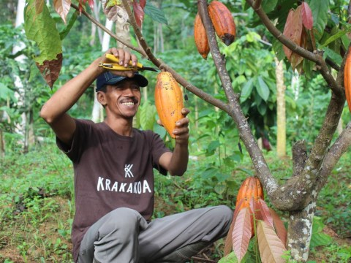
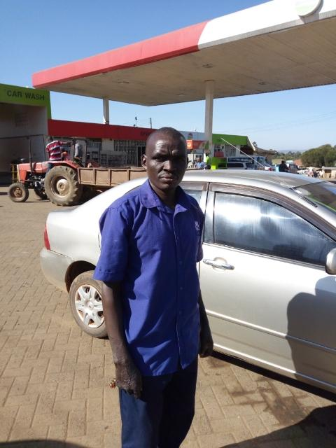
Purificacion Has a 4-star rating, and she is sure to pay you back. Once she does,
You could give to...
Then many other people.

Slide 9
Please pick PURIFICACION!
Thank you, Taylor Alexander, Kaitlyn Britt, Lucas Davis, and BRIANNA KING

Slide 10
Sources: https://www.kiva.org/ and https://www.vanndigit.com/the-top-10-poorest-countries/

