Slide 1
Our Kiva Loan Project
By: Joshua Meadows and Jason Rankin

Slide 2
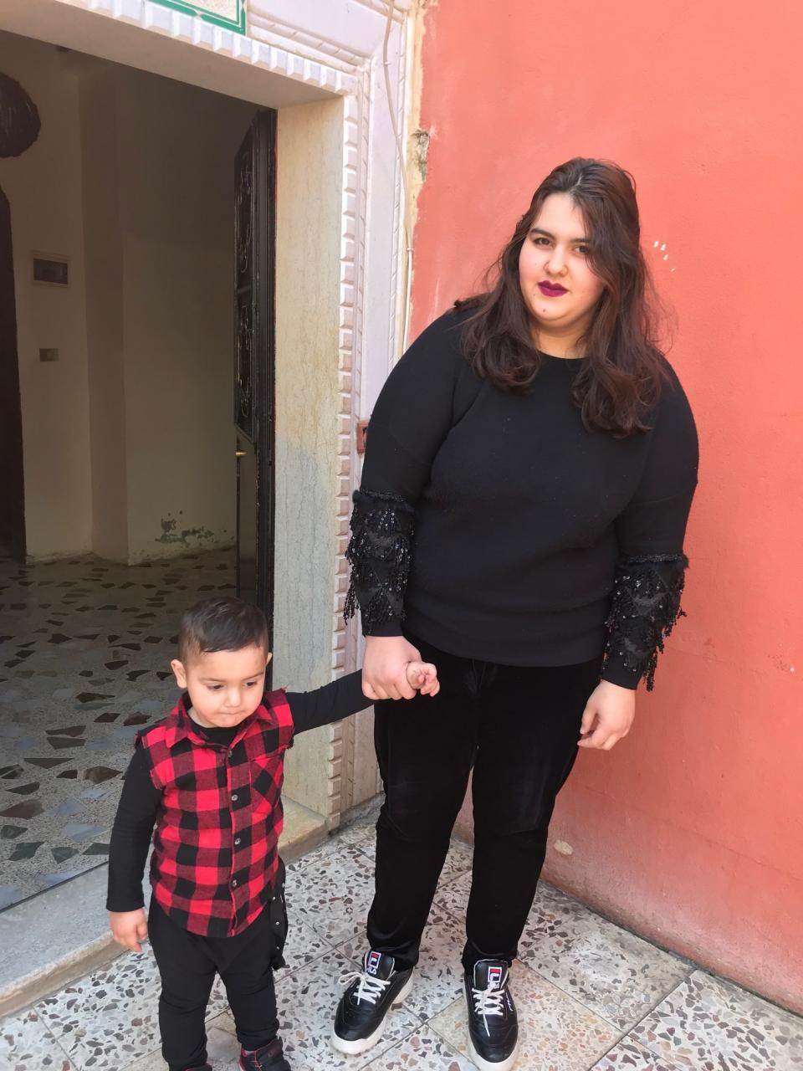
OUR GOAL IS TO LOAN $100 TO YASMINE FROM LEBANON

Slide 3
YASMINE IS A 21 YEARS OLD LEBANESE MARRIED WOMAN
She needs a total loan of $1,050 to help pay for her children's school fees.
If she is loaned 100 dollars, she can get the resources she need to pay for her children's school fees, purchase all the books, and ensure her children a suitable education.
This loan is special because it helps pay tuition and school expenses for her son.

Slide 4
THE SAD TRUTH
Lebanon has a literacy rate of 93.9%, yet children can't even afford school. Lebanon is even ranked globally as the 4th best country for math and science education, but children can’t take advantage of that. That is why Yasmine's child should be able to go to school along with his siblings.
Lebanon is a middle-income country; they have little access to aid. Those who are employed in Lebanon are not likely to have jobs that have fixed contracts, meaning that their employer can legally decide to pay their employee less at any time. That can cause Yasmine and her husband to earn less money to pay for her child's school fees.

Slide 5
Background Information About Lebanon
There are 407 loans currently fundraising in Lebanon
There are $37,802,650 funds lent in Lebanon
1,507.5 Lebanon Pounds = $1 in the U.S

Slide 6
THIS IS LEBANON

Slide 7
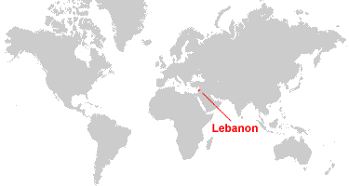
LEBANON IS LOCATED IN THE MIDDLE EAST IN WESTERN ASIA

Slide 8
LEBANON'S ECONOMY IS A FREE-MARKET ECONOMY
This background is a picture of Beirut, Lebanon.

Slide 9
CHOOSE YASMIN
Yasmine is someone who we believe would be a great candidate for a $100.00 Kiva loan based on the goal she wants to achieve.

