Slide 1
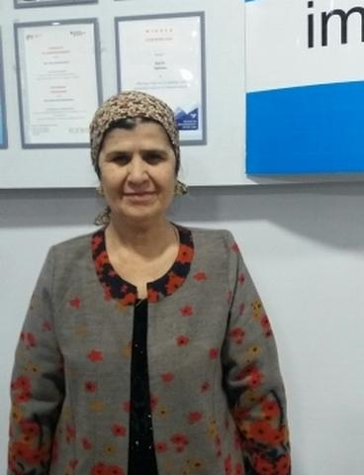
Idimo
BY;Teairra Lloyd, Kirah Wilder, and Olivia Frempong

Slide 2
WHY THE LOAN IS NEEDED:
The Loan of $100 is needed to help pay for the tuition of Idimo son's post graduate studies to help develop his knowledge.

Slide 3
Information about the country:
Tajikistan is one of the newest countries in South Central Asia.
The land that is now Tajikistan has been lived in since 4,000 BC.
Tajikistan is divided into 4 provinces.
The ruler of Tajikistan is Rahmon Nabiyev.

Slide 4
Intro:
Our person, Idimo, is a hard and a caring mother of three childern. She is 58 years old, and she is a nurse. She has been working in this sphere for a long time, and she is a good nurse. She is divorced and provides for her family alone. Idimo has always cared about her children's education.Her eldest son is a post graduate at Russian University. Idiomo needs' to pay for her son's tuition but doesn't have enough money. It's hard for her to save money and pay for her son's tuition. The income of Idiomo is to hard to do so. So she asked Kiva's partner IMON to help pay for her son's tuition.

Slide 5
Why we should give the money to her:
Persuasive facts:
We think that you should choose our person Idimo because she is a nice and caring person. She has four star rating on the kiva app. She really cares about her kids' future and wants them to be successful in life. We think that she is really caring and a nice mother. We think that you should choose us. We think that she is a really caring person. If our class votes for us,Idimo will be happy. If you decide not to vote for us it will make Idimo really sad.

Slide 6
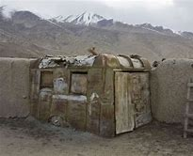
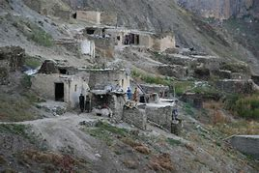
Pictures:
These are some of the houses that they have in Tajikistan.

Slide 7
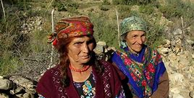
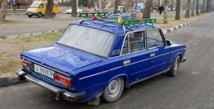
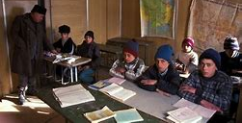
THESE ARE THE SCHOOLS THAT THE KIDS GO TO THESE ARE THE CARS THAT THEY DRIVE IN. THIS IS THE CLOTHING THE WOMEN WEAR.

Slide 8
Conclusion:
In conclusion We think that you should really vote for our person Idimo. We hope that Idimo gets the money she needs for her son's tuition.We hope that you liked our presentation.

