Slide 1
The vergen del cisne group
By: Heath Henley and Braedan Lue

Slide 2

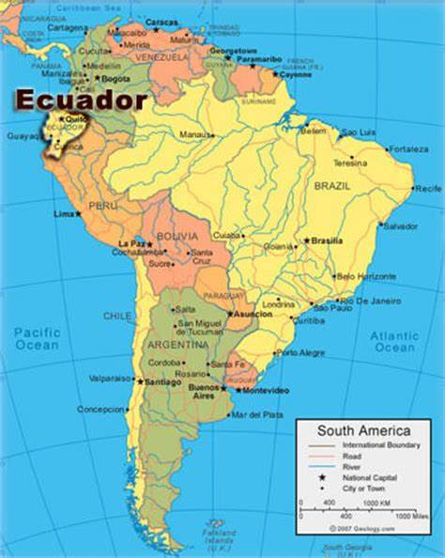
This is where they live
THE GROUP WE CHOSE WAS THE VERGEN DEL CISNE.
THEY LIVE IN ECUADOR.
ECUADOR BORDERS THE PACIFIC OCEAN, COLUMBIA AND PERU. ECUADOR IS A SMALL COUNTRY IN NORTHWESTERN SOUTH AMERICA.
THE ANNUAL INCOME IN ECUADOR IS $14,563.

Slide 3
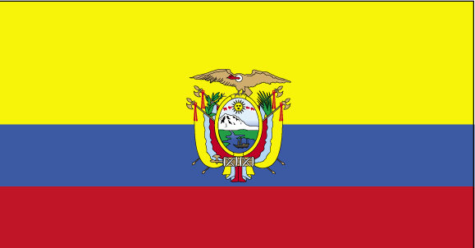
THIS IS THEIR FLAG

Slide 4
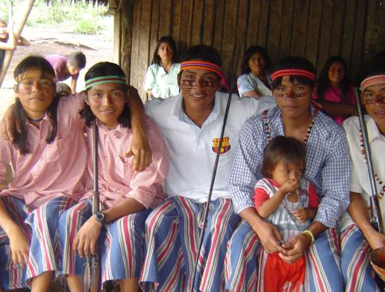
HERE'S WHAT THE GROUP LOOKS LIKE
THE LEADER OF THE GROUP IS ANA GABRIELA. SHE IS MARRIED WITH TWO CHILDREN AND NEEDS MONEY TO SUPPORT HER FAMILY.

Slide 5

WHY ARE WE LOANING THEM THE MONEY?
THEY NEED $7,650 TO BUY MEAT AND GROCERIES FOR THEIR FAMILIES SINCE PROTEINS CAN BE SCARCE IN ECUADOR. WE THOUGHT THAT WAS REASONABLE FOR A LOAN.
THEY ONLY HAVE $325 TO GO!

Slide 6
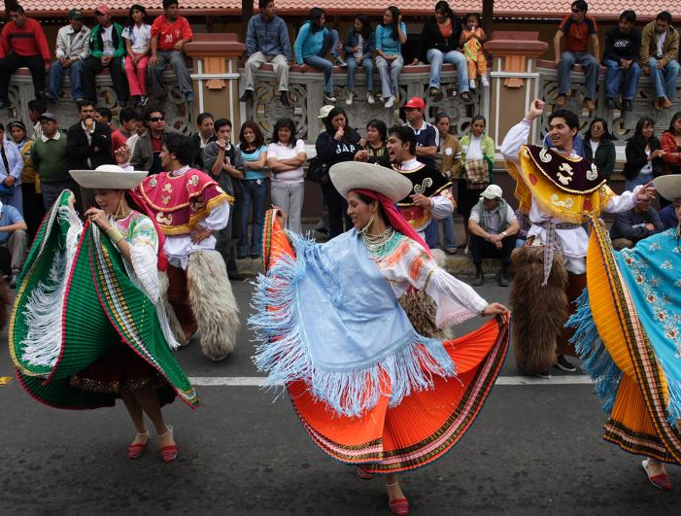
Background information
Ecuador's history has resulted in a fascinating culture. It is situated in Latin America, right next to the Equator. Though it is a relatively small country, Ecuador has an astonishingly high level of biodiversity. For example, there are around 1600 species of birds here, approximately half of all the bird species found in South America. There are over 17,000 types of plants in Ecuador - more than in the whole of Europe - and one in every four of these plant species is an orchid.

