Slide 1
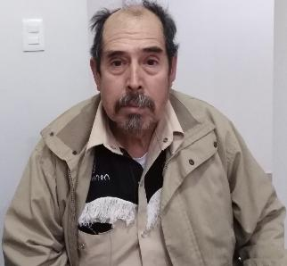
Guillermo
Ca'Riceya Miller

Slide 2
What do you Need to know
Guillermo lives in Ramos Arizpe Chohuila. He is 60 years old and married to Tomasa, with whom he has 2 children. His spouse works in the home and he has worked for 4 years at a dock company. Some time ago, they found a chronic degenerative illness in his sister which has begun to wreak havoc on her vision, so that little by little she is losing her eyesight. His sister needs several treatments so that she can recover her eyesight. It is for this that Guillermo wants to help her, so he asked for financial support to pay for the treatments so that she can recover her eyesight. And health.

Slide 3
What is chronic degenerative illness ?
A chronic condition is one that has been present for six months or longer. Not all chronic conditions will lead to disability. However, there are several chronic or degenerative conditions that can have a significant effect on a person’s ability to get around and take care of themselves. Common chronic and degenerative conditions that can lead to disability include:
multiple sclerosis arthritis Parkinson’s disease muscular dystrophy Huntington’s disease. If you or someone you are caring for has a chronic or degenerative condition, you may need to make some changes to make life easier. These might include making modifications around the home to make everyday tasks simpler moving closer to family purchasing speech and mobility aids planning for a future where you have limited mobility.

Slide 4
Facts about CHRONIC DEGENERATIVE ILLNESS
CHRONIC DEGENERATIVE ILLNESS is number 1 on the chart of what can kill humans and that’s even above cancer, 2.5 thousand people have cancer. 8.9 thousand people have chronic degenerative illness that is the highest population out of all the sickness & diseases.

Slide 5
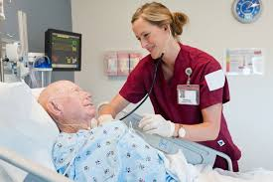
Why do we feel He should get the money?
The reason I think he should get the money Is because his sister is in danger her life is at risk. The only way she can make it out alive is if you give one donation towards her medical expenses so she can have a better life. This dieses doesn't only give her arthritis and paralyzed or takes away her eye sight but It stops her heart. We need to help her.

Slide 6
Money expenses
GUILLERMO needs 1175 dollars to help his little sister be able to see another day of sunshine.

Slide 7
Some of the sources used was :
https://www.kiva.org/lend/1752874
https://www.betterhealth.vic.gov.au/health/servicesandsupport/chronic-or-degenerative-conditions

Slide 8
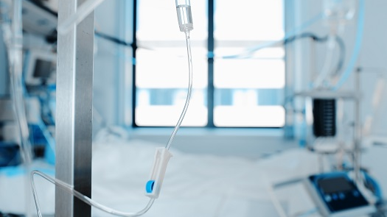
I hope that GUILLERMO's little sister will be able to see the sunlight again

