Slide 1
Kiva Project
By: Gavin Browning, Richard Freeman and Avery Walker

Slide 2
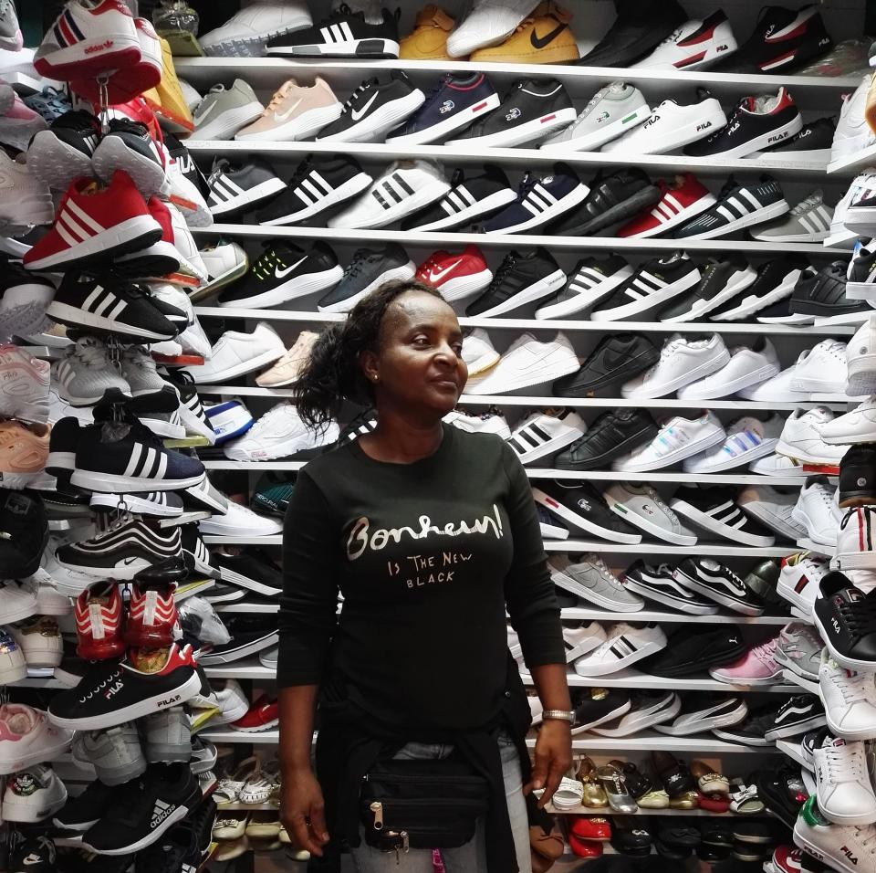
About Mirna
Mirna is an enterprising and hard-working person from the municipality of Medellín, Columbia. Mirna has worked at her business making and selling shoes for 23 years. She is very skilled at her shoe selling business.

Slide 3
About Colombia
Columbia has the second largest capital city in South America and at 2,640 m (661 ft) it is one of the highest capital cities in the world. Bogotá is the capital of Colombia. Colombia is the only country in South America that has a coastline on both the Pacific Ocean and the Caribbean Sea.
The capital of Colombia is Bogota. Majority of the people of Colombia are Roman Catholics. The official name of Colombia is the ‘Republic of Colombia. The official language of Colombia is Spanish. The currency of Colombia is Peso. Colombia follows the system of Presidential Republic.
Colombia covers a land area of 1,141,748 square kilometers – around the same size as Spain, Portugal and France put together. It has a population of nearly 47 million people. Colombia is a Democratic Constitutional Republic with a President.

Slide 4
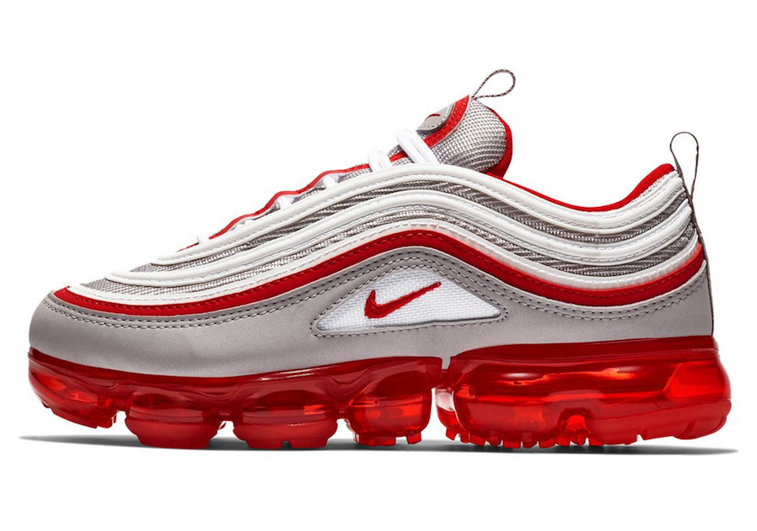
What is her business?
She asks for a loan from supplier, which she will invest in the purchase of tennis shoes. In this way, she will be able to improve her sales, expand her customer base and increase her profits.

Slide 5
Why should you fund her?
Currently, she is single and 51 years old. She has 2 children. She has not stopped for even one moment in her search for a better future for her family. There is a lot of crime in Colombia so money could help Marina, so that she can keep her children safe. If we fund her $100 dollars in Colombian pesos that is $328,400.00

Slide 6
PER CAPITA
According to the World Development Indicators, the Gross National Income of Colombia was $142 billion in 2006, or $3,120 per capita.

Slide 7
Citations
http://colombianproject.com/colombia-travel-guide/facts-about-colombia
https://www.worldnomads.com/travel-safety/south-america/colombia/is-it-safe-to-travel-to-colombia
lifestyle.iloveindia.com
www.kiva.com

