Slide 1
Kiva Project: Dung's Story
By: Alexandria Polk, Ronni Polane, and Truly Wood

Slide 2
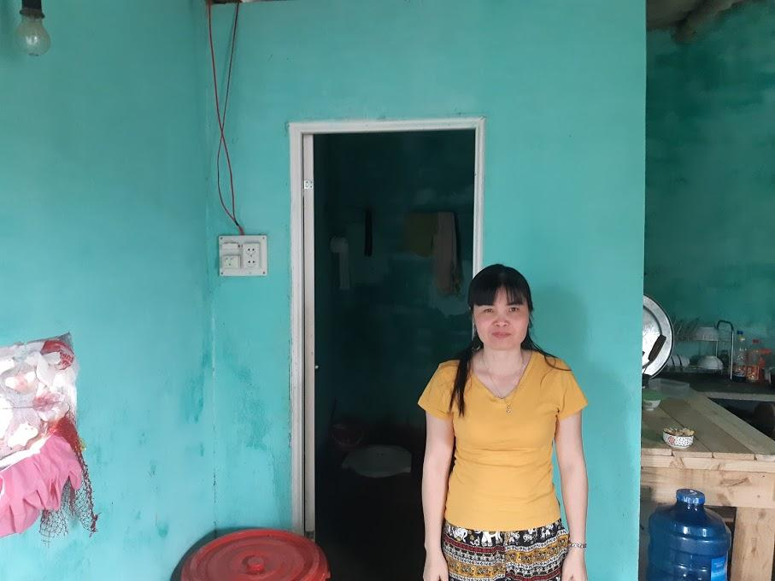
About Dung
Dung is a 36-year-old, married women, living in Vietnam. She has been farming for 10 years now, her family has a very low-income in her village. Dung and her family are hoping to live a healthy life with a clean toilet. Dung is seeking $235 loan for her toilet, and a loan of $100 from our class will go a long way.

Slide 3
Reasons why:
Reason 1
She has a good rating which means she is most likely good at returning funds.
Reason 2
She currently does not have a clean toilet and this loan would allow her to get the toilet
Reason 3
Getting Dung a sanitary toilet will prevent bad health hazards.

Slide 4
Reason 1:
Ratings do count and they give a lot of information concerning the likely-hood of the person you are loaning to pay you back. Since Dung has 3 ½ stars she is most-likely to pay back our loan of $100. So this means the risk rating we are going with is good.

Slide 5
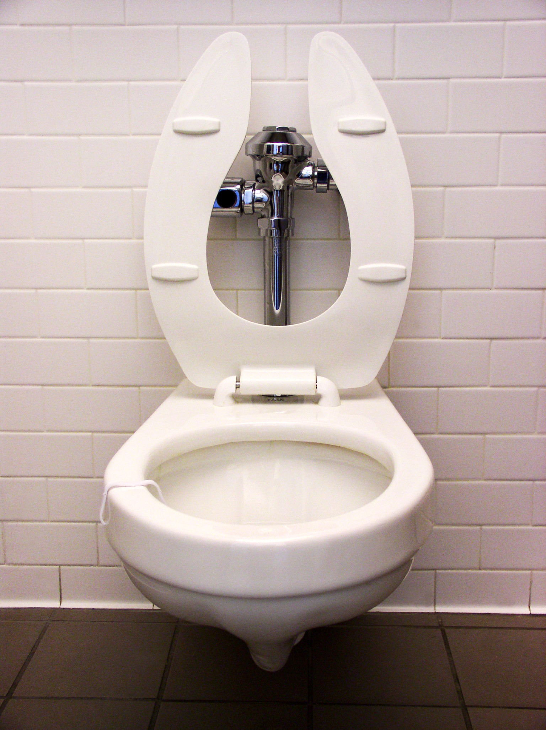
Reason 2:
It saves money! We are contributing to helping people like Dung who can't afford a sanitary toilet right now. Loaning this money will really help Dung for now, and she will later pay us back!

Slide 6
Reason 3:
This also prevents bad health hazards. With a sanitary toilet, Dung can stay away from dangerous situations concerning her health. Some health hazards include problems with managing waist, and the bad effects it has on the environment.

Slide 7
Why Choose Dung?
3 ½ stars
Only $235 to go
18 more days until Dung will no longer be on kiva
She is in need of something we take for granted!

Slide 8
Thanks for listening
PLEASE FUND FOR DUNG!

