Slide 1
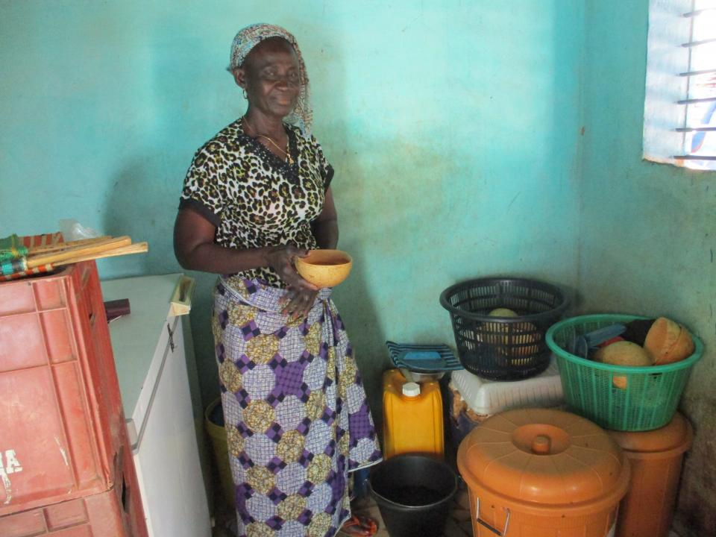
Jeanne d'arc

Slide 2
Where Does Jeanne D'arc live
Jeanne D'arc lives in the country of Burkina Faso.
About 80% of the population resides in rural areas, where agriculture is the main source of incomes and employment.
Although agriculture is the largest source of employment, it provides only 32% of gross domestic product (GDP) compared with 24% from industry and 44% from services. Agriculture sector

Slide 3
Why should you give her a loan
Jeanne D'Arc is a married woman with five children. Two of them go to school.
She prepares and sells DOLO (a famous drink) in Association with a Restaurant for 27 years.
She sells her drinks wholesale and her clients get their supply from her every time.

Slide 4
What will is she using the loan for?
With that much money in Burkina Faso, that's enough money to buy 20 bags of sprouted millet
truckload of wood, 3 bags, and condiments, in order to build a savings to also support her children.​

Slide 5
What are the loan details?
Loan length: 12 Months
Repayment schedule: Monthly
Currency exchange loss: Possible
Facilitated by field partner: YIKRI
Is borrower paying interest?: Yes

Slide 6
Why is kiva so important
Kiva leverages the Internet and a worldwide network of field partners to allow individuals to lend as little as $25 to help create opportunity around the world.
96.8% repayment rate It's a loan not a donation; so when you're repaid you can use the money again.
Some attractive aspects of a Kiva loan includes more flexible terms, low costs to borrowers and emphasis on supporting community-wide projects that can shape the future for a family or an entire community

Slide 7
More about this loan
This loan is part of an effort to provide financing to vulnerable and marginalized populations in Burkina Faso. This loan helps such communities purchase small equipment and working capital, agricultural inputs and livestock. This loan does not require collateral nor group guarantees in order to protect its most vulnerable clients. By supporting this loan, you are helping promote financial inclusion for Burkina Faso’s vulnerable and marginalized populations.​
About YIKRI:
Yikri is a microfinance institution based in Burkina Faso that serves vulnerable communities. Kiva financing will go towards Yikri work to bring about economic opportunities to underserved vulnerable populations in Burkina Faso, who would otherwise not have access to formal capital.

Slide 8
Why does kiva work with this partner: yikri
Kiva supports Yikri’s work to bring about economic opportunities to vulnerable populations in Burkina Faso who would otherwise not have access to formal capital. Kiva leverages the Internet and a worldwide network of field partners to allow individuals to lend as little as $25 to help create opportunity around the world.

Slide 9
About Burkina faso?
Burkina Faso is a landlocked country in West Africa. It covers an area of around 274,200 square kilometres and is surrounded by six countries: Mali to the north; Niger to the east; Benin to the southeast; Togo and Ghana to the south; and Ivory Coast to the southwest.

Slide 10
Thank you for your time I hope you loan Jeanne D'arc

