Slide 1
Donating to people in need by using Kiva.org
Written by Andrew Bogner
Edited by Miles Powers and Daniel Chaves

Slide 2
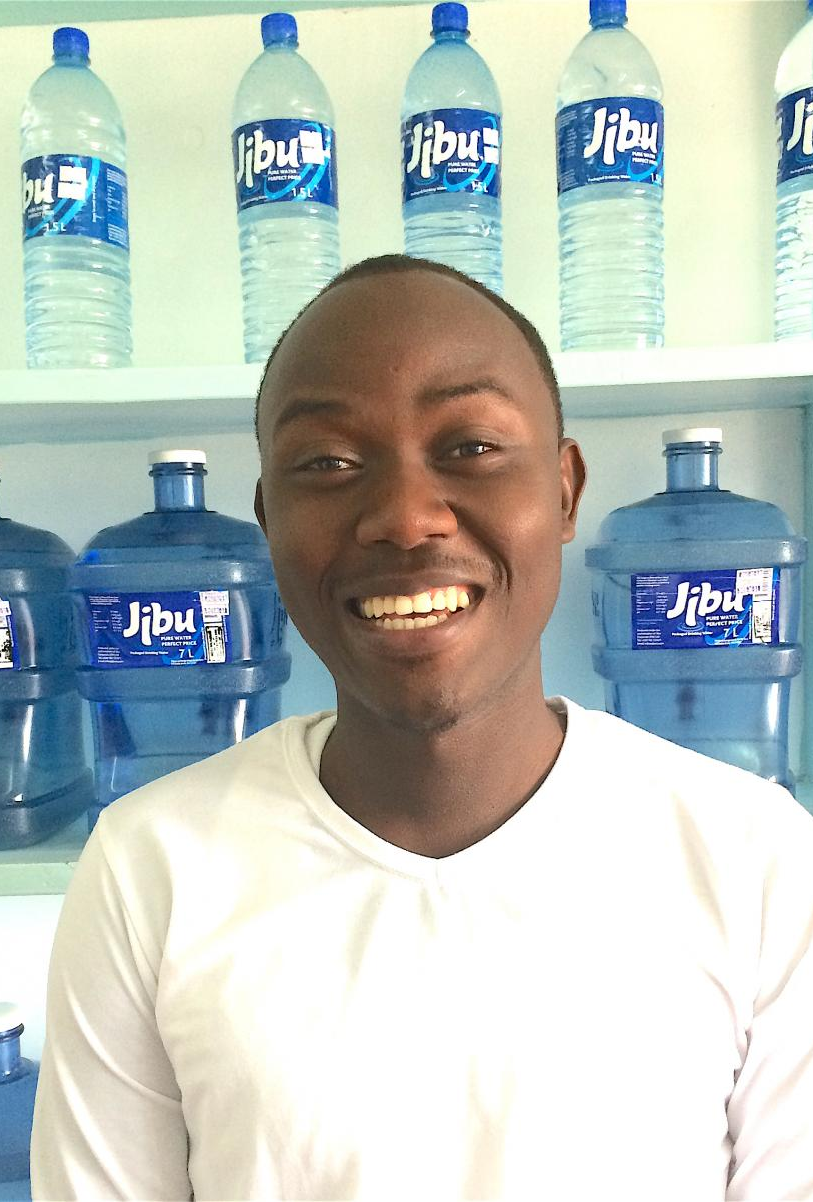
Jean D'amour
This is Jean
"Jean D'amour has expanded his Jibu business and recruited many re-sellers to make sure everyone in his territory has access to Jibu water on their doorsteps. His main challenge continues to be distribution cost to reach out to those who are a bit far from the franchise. This loan will help him purchase a water delivery van, which will deliver to many re-sellers in his territory that have no means of delivery, as well as to potential customers, and will help him penetrate deeper into his territory."
By donating to Jean he can help people in need.

Slide 4
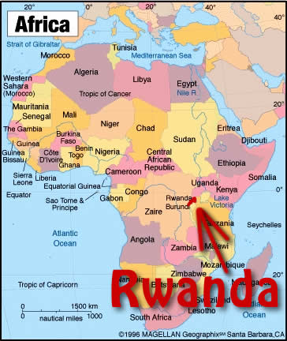
Rwanda
Jean is from Rwanda.
Rwanda is a rural farming country in Africa. The Tutsis one of the main tribes in Rwanda have been through a lot. In 1994 they were massacred by their rival tribe the Hutus. The Hutus militia that had 30,000 men used machetes to kill the Tutsis. The massacre lasted 100 days killing 800,000 Tutsis. Therefore I want to donate to a Tutsi. By donating to Jean he can get a van so he can donate water to people in need in Rwanda.

Slide 5
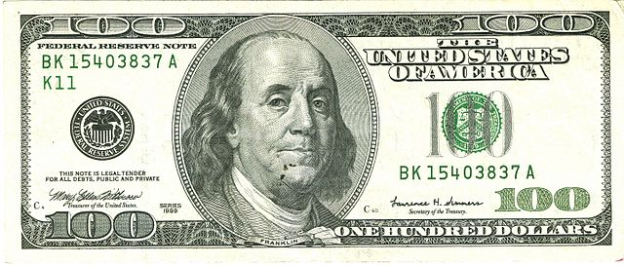
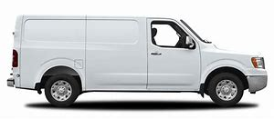
Why I think we should donate to Jean.
By Donating 100 dollars to Jean we can help him buy a delivery van so he can get water to people who need it. People all over Rwanda need water and other necessary essentials to survive. All Jean wants is a little money to help people in need. Will you do the right thing and donate to Jean, a person who has been through a lot and wants to help other people.

Slide 6
The right thing to do.
Jean and the other people in Rwanda have been through so much and they need help. A donation to Jean can make a big difference in so many people's lives in Rwanda.Do the right thing and donate to Jean.

Slide 7
Sources
https://www.kiva.org/

Slide 8
Thank you for your time.
Thank you for watching our presentation.

