Slide 1
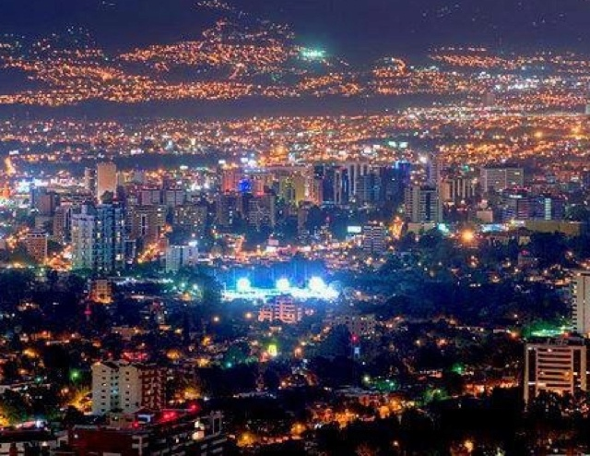
Amada
By. Bailey, Cheridan, Amaya, Yashiyah

Slide 2
About Amada
Amada in the agricultural business, raising pigs.
Amada lives in Guatemala; she is a married woman and has three kids.
Amada would like to save up money to send her children to college.

Slide 3
Goal
Are goal being to lend $100 to Amada so, she can buy animal feed, vitamins and other supplies to raise her livestock.

Slide 4
REASONS
Guatemala's economy, contributing 25 per cent of GDP, employing over half the labor force and providing two thirds of exports, mostly coffee, sugar, bananas and beef. Guatemala's three main staple foods are maize, beans and rice.
Public education is not free in Guatemala and many families cannot afford to send more than one child to school. As a result, in indigenous Guatemalan communities only 1 in 10 children ever reach high school.
In this low-income country with nearly 15 million people, roughly half of all families live below the poverty line. In this low-income country with nearly 15 million people, roughly half of all families live below the poverty line.

Slide 5
Facts about reason 1
In its wide variety of products grown in the country, it is well known for its coffee, banana and sugar crops, which are the main products.
42% of Guatemalan citizens do NOT have access to clean water

Slide 6
Facts about reason 2
59.3% of Guatemala's population is below the poverty line.
45% of the population over the age of 15 is illiterate

Slide 7
Facts about reason 3
A person working in Guatemala typically earns around 6,860 GTQ per month.

Slide 8
Thank you for listening
z

Slide 9
Thank you for listening
z

