Slide 1
ONE SMALL FIX CAN MAKE A BRIGHTER FUTURE
Aivale 48-year-old mother from Samoa with four children
By: Elijah, Henry, Thomas, Connor and Raymond

Slide 2
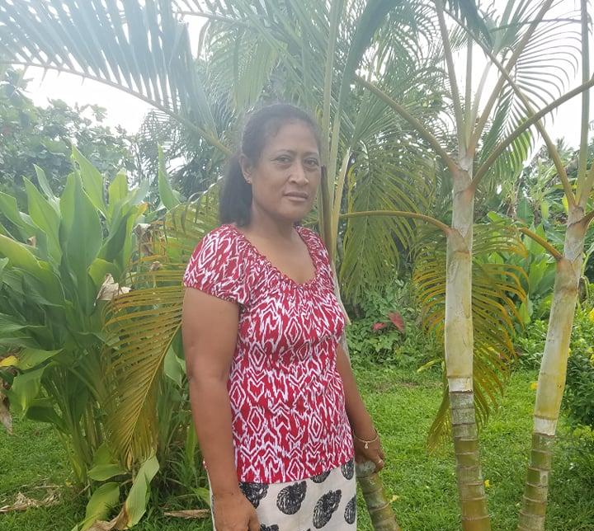
ONE SMALL FIX CAN MAKE A BRIGHTER FUTURE
Aivale 48-year-old mother from Samoa with four children
By: Elijah, Henry, Thomas, Connor and Raymond

Slide 3
Her Name Is Aivale
Aivale is a 48-year-old mother with four children. She runs a small business of selling taro and bananas in her village to earn a living. She has been doing this for more than three years to earn a living. She Lives in Ulutogia, Samoa.

Slide 4
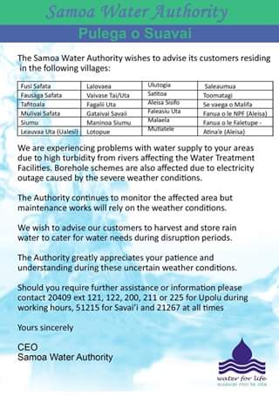
Samoa Water Authority
Aivale main goal in all of this is to get clean water because where she lives doesn’t have clean water.

Slide 5
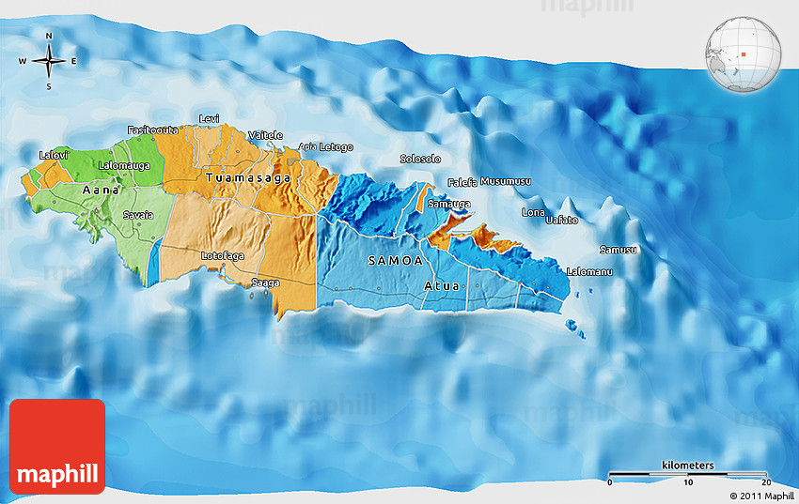

Slide 6
Goal
Ailvale needs a total loan of $500 dollars to get taro roots, banana tubers, a wheelbarrow, a rake, a shovel, a water tank, and hand gloves for her family farm business.

Slide 7
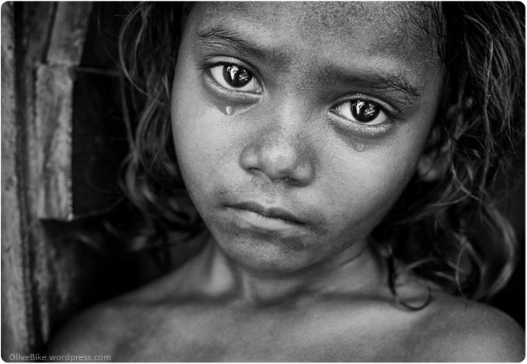
Reason
The reason why is because where she lives is under the poverty line but if she gets this money she will be able to make her business better so she buy more stuff and make more for her family and community.

Slide 8
References
([Digital image]. (n.d.). Retrieved from https://images.app.goo.gl/Q7UUid48rSCruHdo9
Kiva link:
https://www.kiva.org/lend/1753630

Slide 9
Help a business help the world
Aivale owns a farming business that sells organic crops. And if you care about her community you donate the money to her to business to help it grow.

